Slide 1
To The Nations
SRM – Part 2, Section 5

Slide 2
Saving Private Ryan

Slide 3
Abram
Moses
Isaiah
Jonah

Slide 4
The Heart of God

Slide 5
God’s Greatest Mission

Slide 6
The Mission of Jesus
¹ “Father, the hour has come. Glorify your Son, that your Son may glorify you. ² For you granted him authority over all people that he might give eternal life to all those you have given him. ³ Now this is eternal life: that they know you, the only true God, and Jesus Christ, whom you have sent. ⁴ I have brought you glory on earth by finishing the work you gave me to do.
(John 17)

Slide 7
¹⁵ My prayer is not that you take them out of the world but that you protect them from the evil one. ¹⁶ They are not of the world, even as I am not of it. ¹⁷ Sanctify them by the truth; your word is truth. ¹⁸ As you sent me into the world, I have sent them into the world. (John 17)
²¹ Again Jesus said, “Peace be with you! As the Father has sent me, I am sending you.” (John 20)

Slide 8
The Mission

Slide 9
In order to make disciples, you have to go. Otherwise, it’s not possible to make disciples. So, what does Jesus mean when he says to go? He is implying active engagement with our world and the people in it. Disciple-making does not happen any other way.
Our going and engaging eventually extends to all the nations. The word translated “nations” does not refer to national boundaries or political entities but ethnicities or peoples. The commission to make disciples is for every ethnic group everywhere. So, there is an assumption in this command that we will get up from our pews, get out of our comfort zones, and engage our world that we live in, and be extension also be involved in engaging peoples all over the world.
(Danny Hall, “Our Calling: Make Disciples”)

Slide 10
The Motivation

Slide 11
Make Disciples
An apprentice of Jesus … is to be one of those who have trusted Jesus with their whole life, so far as they understand it. Because they have done so they want to learn everything he has to teach them about life in the kingdom of God now and forever, and they are constantly with him to learn this.
(Dallas Willard, “Renovation of The Heart”)

Slide 12
Baptize Them
To be in the name of something means to be all of who that person is and all they stand for. So I believe that when we talk about baptizing people in the name of the Father, Son and Holy Spirit, we are actually encouraging them to be immersed in the total reality of who God is. This implies introducing people to the wonderful reality of a personal relationship with God.
(Danny Hall, “Our Calling: Make Disciples”)

Slide 13
Teach Them To Obey

Slide 14
Experiencing Eternal Life

Slide 15
Embrace The Mission
¹⁷ Therefore, if anyone is in Christ, the new creation has come: The old has gone, the new is here! ¹⁸ All this is from God, who reconciled us to himself through Christ and gave us the ministry of reconciliation: ¹⁹ that God was reconciling the world to himself in Christ, not counting people’s sins against them. And he has committed to us the message of reconciliation. ²⁰ We are therefore Christ’s ambassadors, as though God were making his appeal through us. (2 Corinthians 5)

Slide 16
Jesus did not, as incarnate, live a life of detachment. He lived a life of involvement.
He lived where he could see human sin, hear human swearing and blasphemy, see human diseases and observe human mortality, poverty and squalor.
His mission was fully incarnational because he taught men by coming alongside them, becoming one of them and sharing their environment and their problems.

Slide 17
For us, as individuals and churches in an affluent society, this is a great embarrassment. How can we effectively minister to a lost world if we are not in it? How can we reach the ignorant and the poor if we are not with them? How can our churches understand deprived areas if the church is not incarnate in the deprived areas? How can we be salt and light in the darkened ghettos of our cities if we ourselves don’t have any effective contacts and relationships with the Nazareths of our day?
We are profoundly unfaithful to this great principle of incarnational mission.
The great Prophet came right alongside the people and shared their experience at every level.
He became flesh and dwelt among us.
(Donald Macleod, “The Person of Christ” in “Sent Into The World: Jesus’ Mission & Ours”, David Matthis)

Slide 18
Three Promises
Authority
Power
Presence

Slide 19
Response

Slide 20
¹³ for, “Everyone who calls on the name of the Lord will be saved.”
¹⁴ How, then, can they call on the one they have not believed in? And how can they believe in the one of whom they have not heard? And how can they hear without someone preaching to them? ¹⁵ And how can anyone preach unless they are sent? As it is written: “How beautiful are the feet of those who bring good news!”
¹⁶ But not all the Israelites accepted the good news. For Isaiah says, “Lord, who has believed our message?”
¹⁷ Consequently, faith comes from hearing the message, and the message is heard through the word about Christ.
(Romans 10)

Slide 21
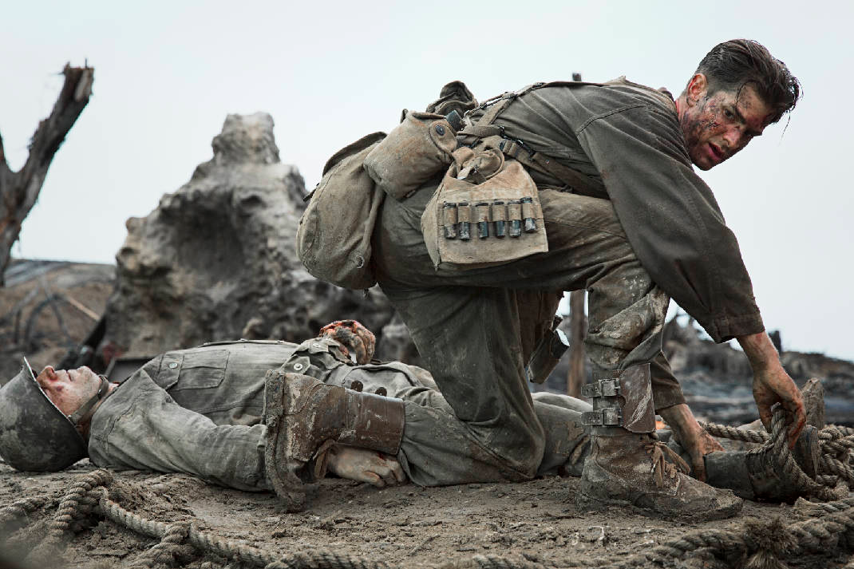
Please, Lord, Help Me Get One More

