Slide 1
Building the Future
Fettes Park Baptist Church 60th Anniversary 3rd June 2018

Slide 2
Theme
God has made all things grow 1 Cor 3:6b

Slide 3
1 Corinthians 3:1-4
Brothers and sisters, I could not address you as people who live by the Spirit but as people who are still worldly—mere infants in Christ. ² I gave you milk, not solid food, for you were not yet ready for it. Indeed, you are still not ready. ³ You are still worldly. For since there is jealousy and quarrelling among you, are you not worldly? Are you not acting like mere humans? ⁴ For when one says, “I follow Paul,” and another, “I follow Apollos,” are you not mere human beings?

Slide 4
1 Corinthians 3:5-9
⁵ What, after all, is Apollos? And what is Paul? Only servants, through whom you came to believe—as the Lord has assigned to each his task. ⁶ I planted the seed, Apollos watered it, but God has been making it grow. ⁷ So neither the one who plants nor the one who waters is anything, but only God, who makes things grow. ⁸ The one who plants and the one who waters have one purpose, and they will each be rewarded according to their own labor. ⁹ For we are co-workers in God’s service; you are God’s field, God’s building.

Slide 5
A rebuke

Slide 6
Neither Paul nor Apollos is anything, but only God who makes things grow.

Slide 7
How do we build our future?

Slide 8
Future ?

Slide 9
7 disruptive church trends
Carey Nieuwhof

Slide 10
A move beyond “church in a box”

Slide 11
The digital will become real

Slide 12
Location independence will rise

Slide 13
“Pop-up” churches will become more common

Slide 14
The rise of Preaching (more than teaching)

Slide 15
A desire for “non downloadable” experiences

Slide 16
Team leadership is eclipsing the solo leader

Slide 17
¹⁰ By the grace God has given me, I laid a foundation as a wise builder, and someone else is building on it. But each one should build with care. ¹¹ For no one can lay any foundation other than the one already laid, which is Jesus Christ.
1 Corinthians 3:10-11

Slide 18
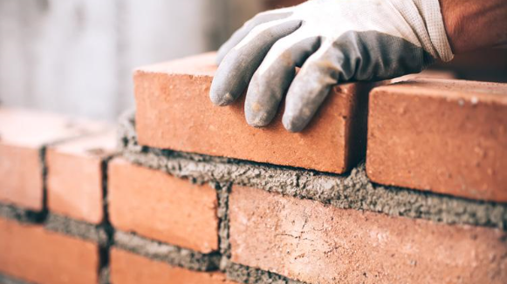
Each on should build with care

Slide 19
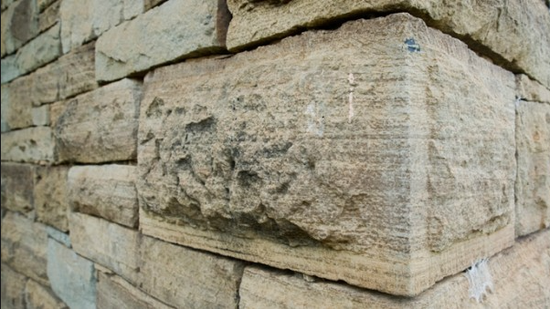
For no one can lay any foundation other than the one already laid, which is Jesus Christ.
1 Corinthians 3:11

Slide 20
Focus on the “Software”

Slide 21
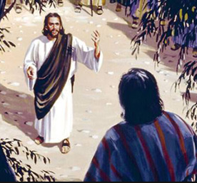
How does Jesus build?
The Story of Zacchaeus – Luke 19:1-10

Slide 22
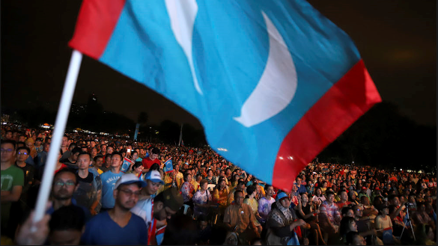
May 9th 2018 Malaysia Baru

Slide 23
The Call

Slide 24
Pay attention to the “Seventy times seven”
Forgive and unite

Slide 25
to the Zacchaeus, to the Simons the leper, to the Samaritan Women…
GO

Slide 26
We are a City on a Hill

