Slide 4
One Thing I Ask
Psalm 27:4

Slide 5
Passion

Slide 6
²² “I have found David son of Jesse a man after my own heart, he will do everything I want him to do.” (Acts 13)

Slide 7
One Thing You Lack
²¹ Jesus looked at him and loved him. ”One thing you lack,” he said. “Go, sell everything you have and give to the poor, and you will have treasure in heaven. Then come, follow me.”
(Mark 10)

Slide 8
Surrender

Slide 9
“Your attachment to your possessions needs to be replaced by an attachment to me. Stop treasuring money and start treasuring me. You want to inherit eternal life. You want to enter the kingdom of heaven. You want to be justified. Only by your attachment to me will you inherit eternal life, enter the kingdom, be justified.”
(John Piper, “Did Jesus Preach The Gospel of Evangelicalism?”)

Slide 10
Only One Thing Is Needed

Slide 11
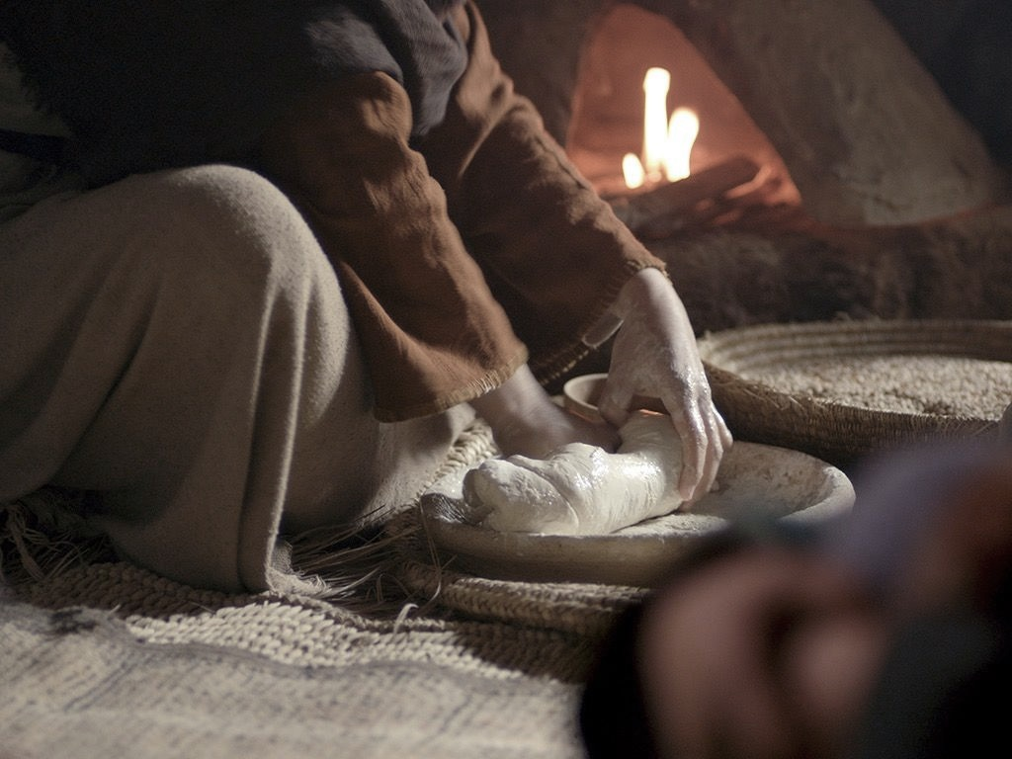
Service

Slide 12
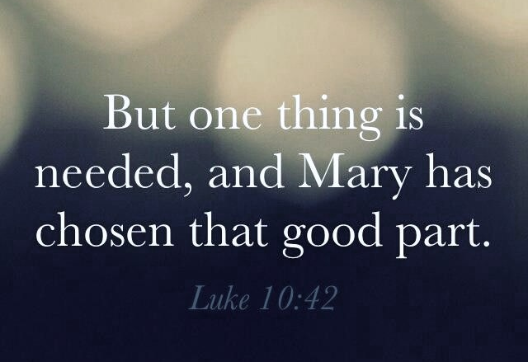
Very soon we shall leave all earthly possessions; in yet a little, service and toil will be past, but forever and ever Christ will be the Portion and Object of our souls. Mary chose the eternal portion in time; she made Him her one great Object, and chose above all else to sit in His company. Other things may be taken away but this will not be taken away. For as she chose to be with Him in time, so she will be with Him in eternity.
(Hamilton Smith, "One Thing”)

Slide 13
One Thing I Know

Slide 14
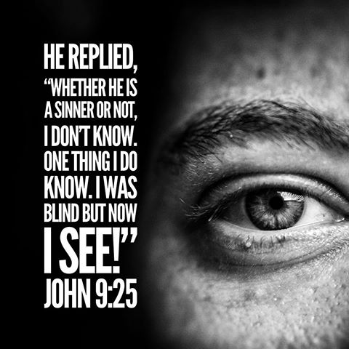
Witness

Slide 15
One Thing I Do

Slide 16
I Press On

Slide 18
Here, then, was a man who could say in all truth, the one thing that the ruler lacked, the "one thing" that Martha had to learn is needful, is the "ONE THING I DO." Henceforth his life was a life of single-hearted devotedness to Christ. For him Christ was the one supreme Object — not sinners, not saints, not service — but Christ.

Slide 19
No one was ever more zealous in preaching the gospel of the grace of God to sinners, no one ever cared for all the Churches like the Apostle, no one was more untiring in service; but above all, and before all, Christ was his one Object. He did not lack the "one thing" like the ruler: he was not distracted by "many things" like Martha. He had before him one thing — to follow Christ. Thus it was he forgot "those things which are behind" and reached forth to "those things which are before."
(Hamilton Smith, "One Thing”)

Slide 20
Response

Slide 21
One Lesson

Slide 23
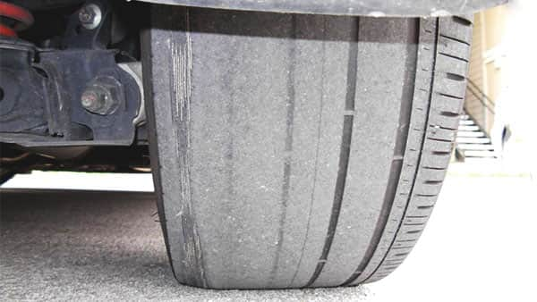
Alignment

