Slide 1
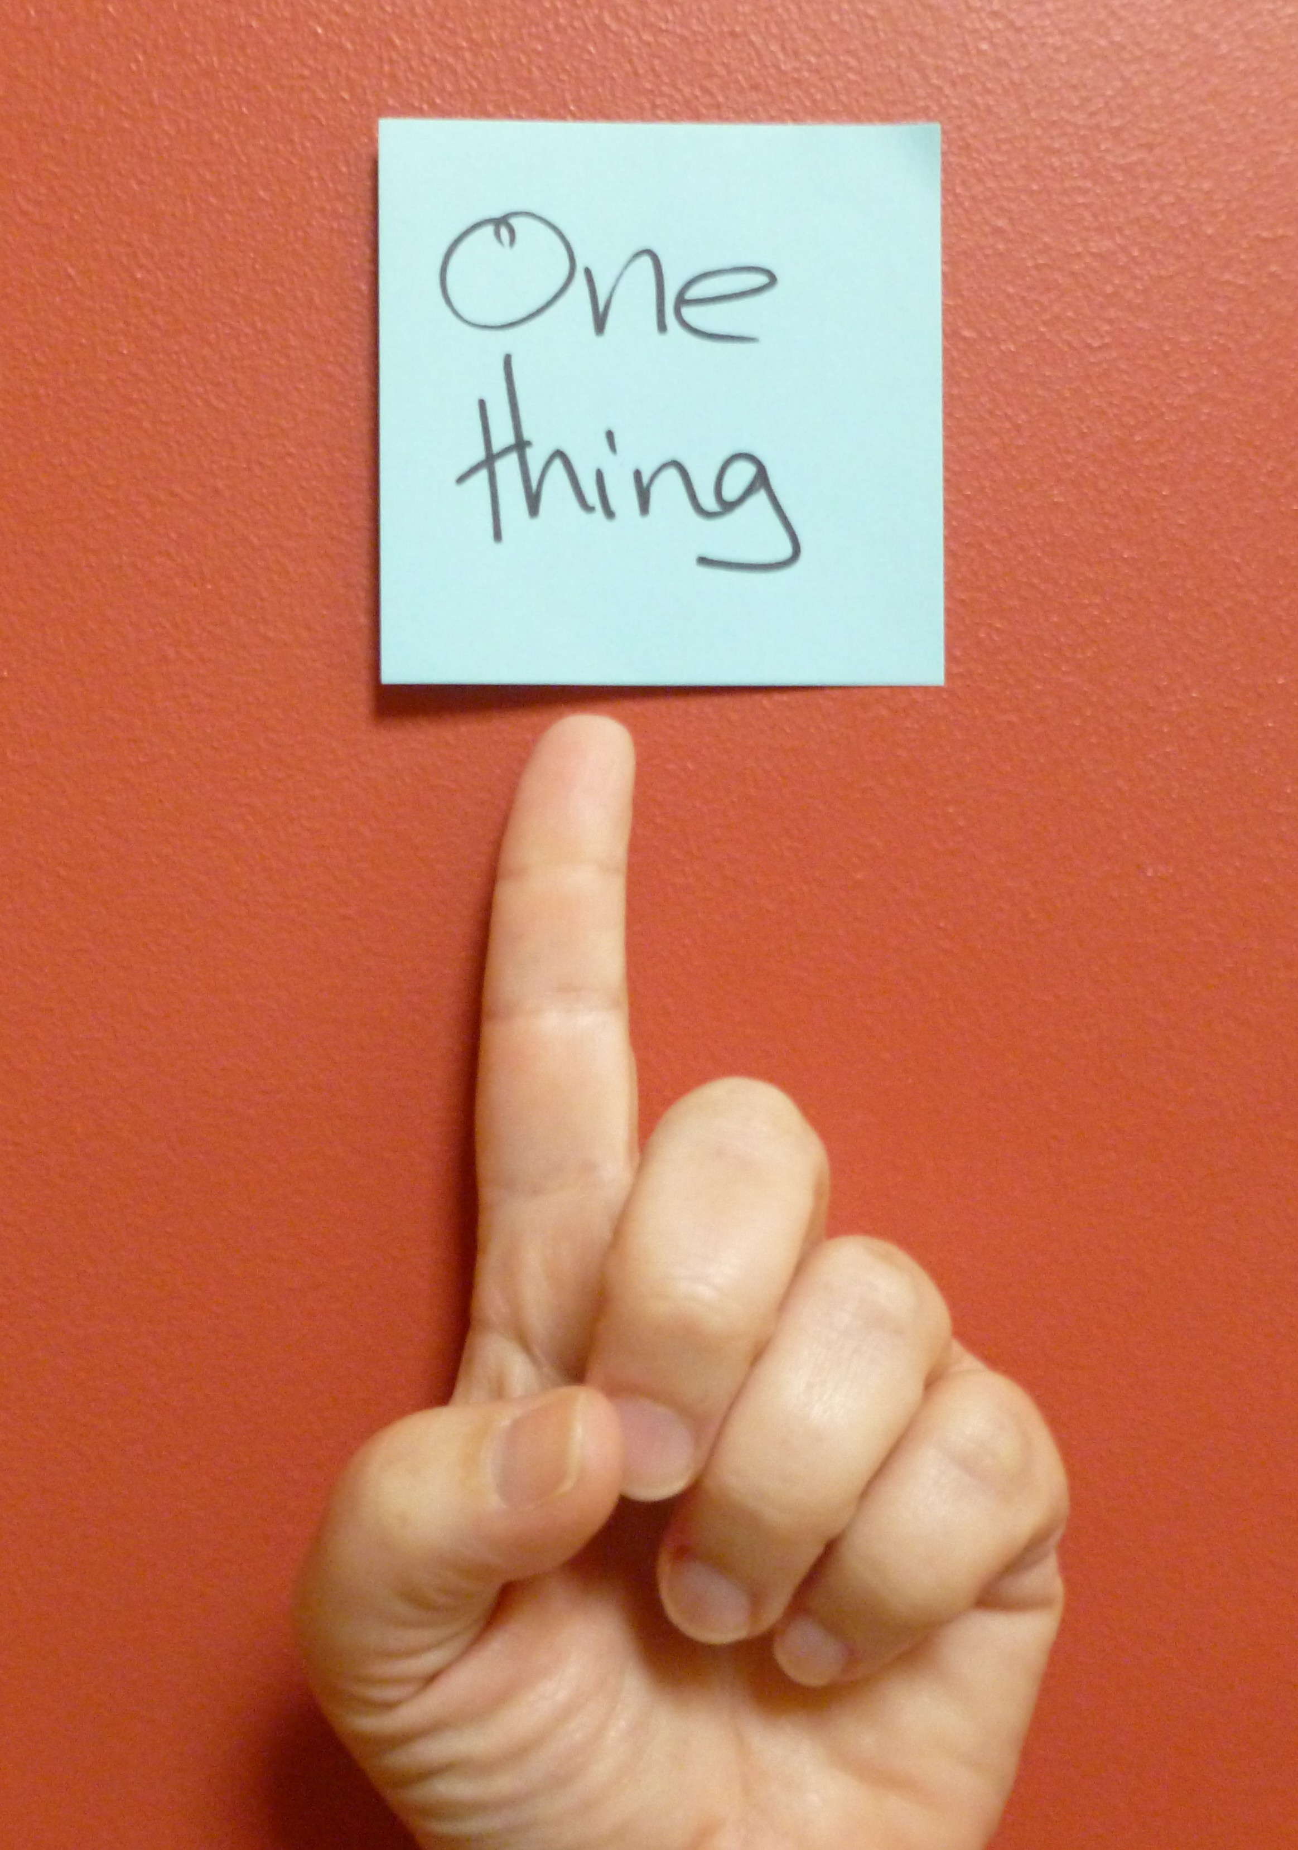
I Do

Slide 2
If anyone else thinks he has reasons to put confidence in the flesh, I have more: ⁵ circumcised on the eighth day, of the people of Israel, of the tribe of Benjamin, a Hebrew of Hebrews; in regard to the law, a Pharisee; ⁶ as for zeal, persecuting the church; as for legalistic righteousness, faultless.
⁷ But whatever was to my profit I now consider loss for the sake of Christ. ⁸ What is more, I consider everything a loss compared to the surpassing greatness of knowing Christ Jesus my Lord, for whose sake I have lost all things. I consider them rubbish, that I may gain Christ ⁹ and be found in him, not having a righteousness of my own that comes from the law, but that which is through faith in Christ – the righteousness that comes from God and is by faith. ¹⁰ I want to know Christ and the power of his resurrection and the fellowship of sharing in his sufferings, becoming like him in his death, ¹¹ and so, somehow, to attain to the resurrection from the dead.
¹² Not that I have already obtained all this, or have already been made perfect, but I press on to take hold of that for which Christ Jesus took hold of me. ¹³ Brothers, I do not consider myself yet to have taken hold of it. But one thing I do: Forgetting what is behind and straining towards what is ahead, ¹⁴ I press on towards the goal to win the prize for which God has called me heavenwards in Christ Jesus.
(Philippians 3)

Slide 3
One Thing
Ask
Lack
Needed
Know
Do

Slide 4
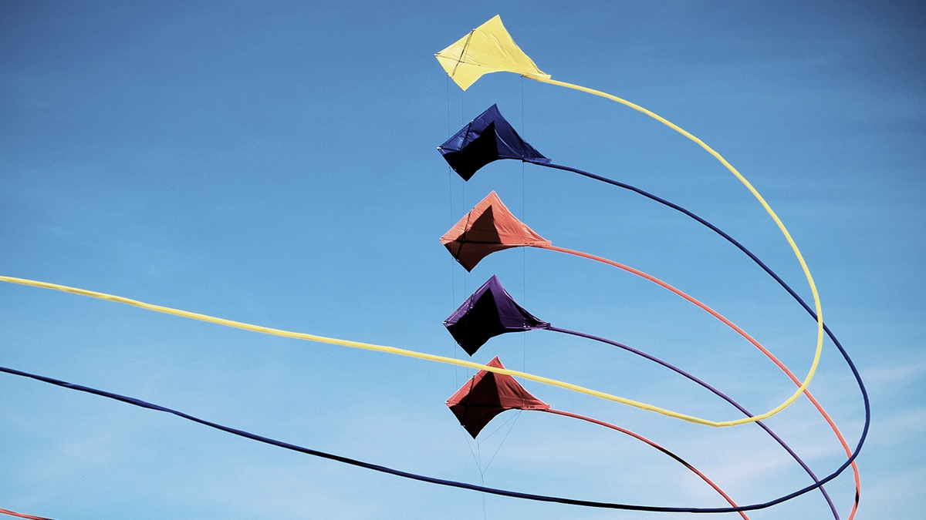
Alignment
A spiritual person is not just born again but born again and walking in spiritual alignment.
(Watchman Nee)

Slide 5
Alignment
Passion
Knowledge
Priority
Devotion
Pursuit

Slide 6
Pursuing After God

Slide 7
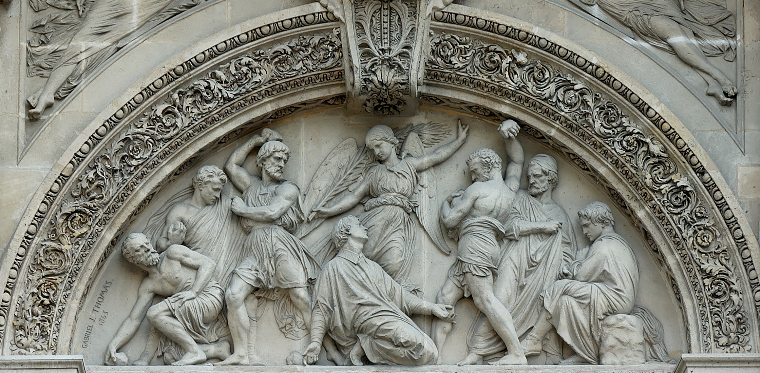
Persecutor
¹ And Saul was there, giving approval to his death … ³ But Saul began to destroy the church. Going from house to house, he dragged off both men and women and put them in prison. (Acts 8)

Slide 8
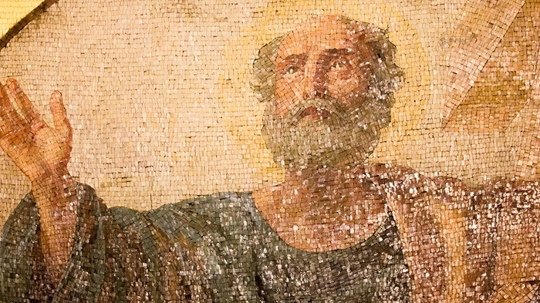
The Road To Damascus
Christ Jesus came into the world to save sinners – of whom I am the worst. ¹⁶ But for that very reason I was shown mercy so that in me, the worst of sinners, Christ Jesus might display his immense patience as an example for those who would believe in him and receive eternal life. (1 Timothy 1)

Slide 9
⁷ But whatever was to my profit I now consider loss for the sake of Christ. ⁸ What is more, I consider everything a loss compared to the surpassing greatness of knowing Christ Jesus my Lord, for whose sake I have lost all things. I consider them rubbish, that I may gain Christ ⁹ and be found in him, not having a righteousness of my own that comes from the law, but that which is through faith in Christ – the righteousness that comes from God and is by faith. ¹⁰ I want to know Christ and the power of his resurrection and the fellowship of sharing in his sufferings, becoming like him in his death, ¹¹ and so, somehow, to attain to the resurrection from the dead. (Philippians 3)

Slide 10
Philosophy of Life

Slide 11
Paul’s Life Pursuit
Philippians 3:13-14

Slide 12
I Have Not Yet Arrived
¹² Not that I have already obtained all this, or have already been made perfect, but I press on to take hold of that for which Christ Jesus took hold of me. ¹³ Brothers, I do not consider myself yet to have taken hold of it.
(Philippians 3)

Slide 14
I press on to take hold of that for which Christ Jesus took hold of me. ¹³ Brothers, I do not consider myself yet to have taken hold of it.
(Philippians 3)

Slide 15
How tragic that we in this dark day have had our seeking done for us by our teachers. Everything is made to center upon the initial act of 'accepting' Christ . . . and we are not expected thereafter to crave any further revelation of God to our souls. We have been snared in the coils of a spurious logic which insists that if we have found Him, we need no more seek Him.
(A.W. Tozer, “The Pursuit of God”)

Slide 16
… knowing Christ is a value that surpasses everything else. The evidence of conversion is whether you become a Christian Hedonist. Christian Hedonists always go hard after the highest value. They sell everything joyfully for the buried treasure and pearl of great price (Matthew 13:44-45). We must go hard after Christ, because not to means that we don't want to know him. And not to want to know Christ is an insult to his value and a sign of spiritual stupor or deadness in us. But when you go hard after Christ, to know him, the reward is your joy and his honor.
Paul prays for us in Ephesians 3:18-19 that we "may have power to comprehend with all the saints what is the breadth and length and height and depth, and to know the love of Christ which surpasses knowledge, that you may be filled with all the fullness of God." There is so much of Christ yet to be known! His wonders are inexhaustible to all eternity. You, who claim that he is your pearl of great price and your treasure chest of holy joy and yet who do not go hard after him to know him, are caught in a contradiction that cannot go on. You must go hard after Christ, or eventually surrender your claim to own him as the Lord of joy.
(John Piper, "Going Hard After The Holy God”)

Slide 17
Forward Focus
But one thing I do: Forgetting what is behind and straining towards what is ahead, ¹⁴ I press on towards the goal to win the prize for which God has called me heavenwards in Christ Jesus.
(Philippians 3)

Slide 18
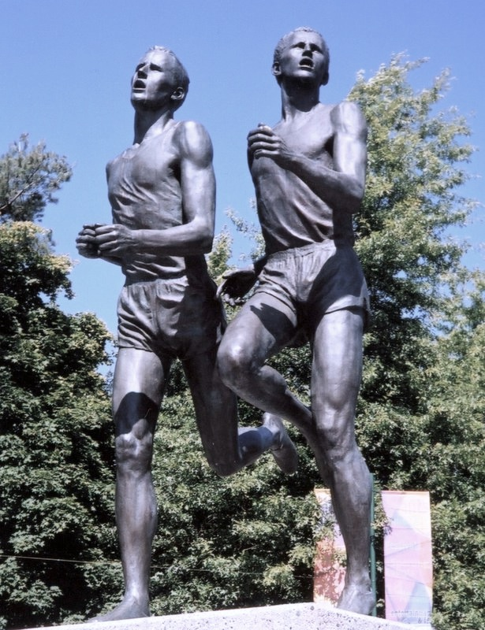
Forgetting What Is Behind
The Miracle Mile

Slide 19
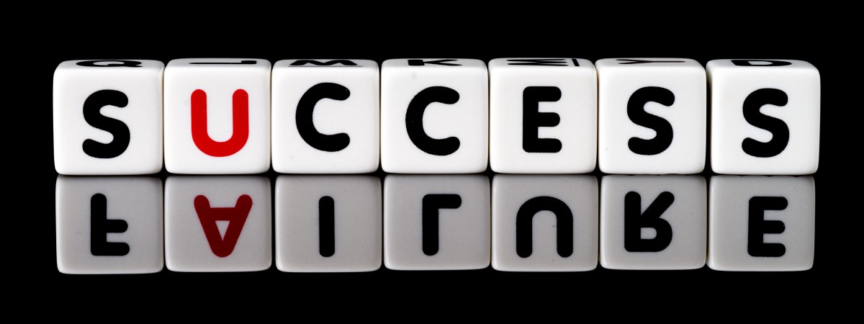
Forgetting What Is Behind
The point is not: never look back. The point is: only look back for the sake of pressing forward. Never substitute nostalgia for hope. Memories of successes can make you smug and self-satisfied. Memories of failure can make you hopeless and paralyzed in your pursuit of God. Never look back like that. Give humble thanks for successes; make humble confessions for failure; then turn to the future and go hard after God.
(John Piper, "Going Hard After The Holy God”)

Slide 20
Straining Towards What Is Ahead
²⁴ Do you not know that in a race all the runners run, but only one gets the prize? Run in such a way as to get the prize. ²⁵ Everyone who competes in the games goes into strict training. They do it to get a crown that will not last; but we do it to get a crown that will last for ever. ²⁶ Therefore I do not run like someone running aimlessly; I do not fight like a boxer beating the air. ²⁷ No, I strike a blow to my body and make it my slave so that after I have preached to others, I myself will not be disqualified for the prize. (1 Corinthians 9)

Slide 21
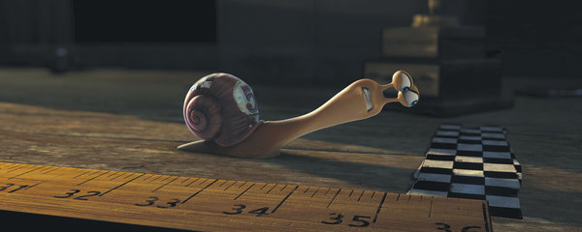
Press On
What good is it if you drop out before the finish line? You need to persevere. And how do you do that? You need to have a purpose. You need to keep your eyes on the goal. God has called you heavenward in Christ Jesus. Don’t live your life for earthly things. You have a higher calling. Don’t give in to complacency or contentment. You need to be satisfied in Jesus, and yet have a holy discontent about your progress in Christ. Keep your eyes on the goal; focus on the finish line; remember what the race is all about. Keep your eyes on the prize.
(Ray Fowler, "Eyes On The Prize”)

Slide 22
Response
For each one of us, there is only one thing necessary: to fulfill our own destiny, according to God’s will, to be what God wants us to be. (Thomas Merton)

Slide 24
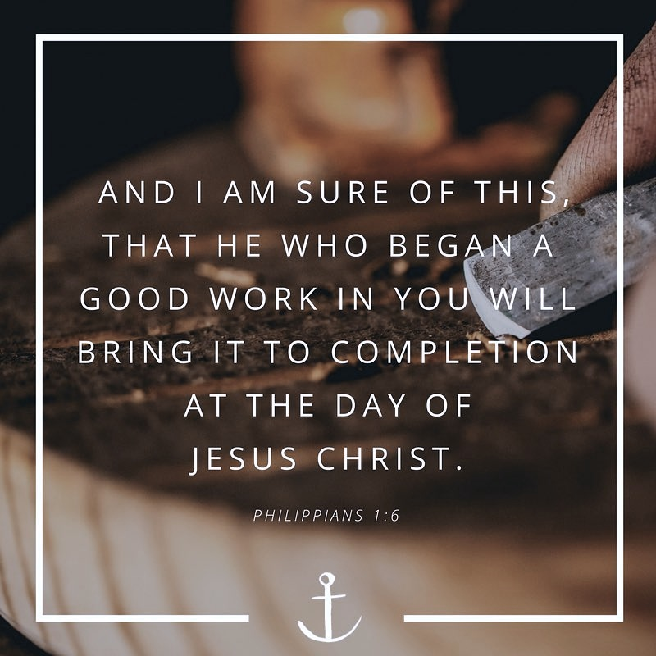
For imperfect as we are, it is God who is at work in us to will and to do his good pleasure. We do not run in our own strength and, all the more therefore, we can be assured that going hard after the holy God will bring us to know him deeply and enjoy the sweet confirmation of our justification.
(John Piper, "Going Hard After The Holy God”)

