Slide 1
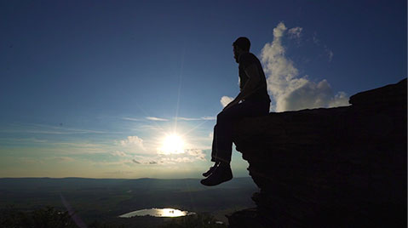
in view of our eternal glory
1 Peter 5:6-11

Slide 2
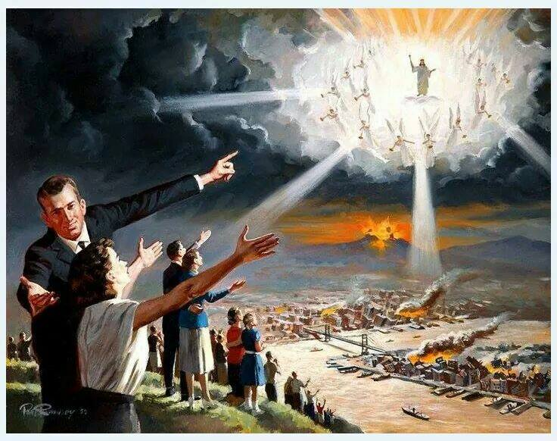
When the Chief Shepherd appears, you will receive the crown of glory that will never fade away. V4

Slide 3
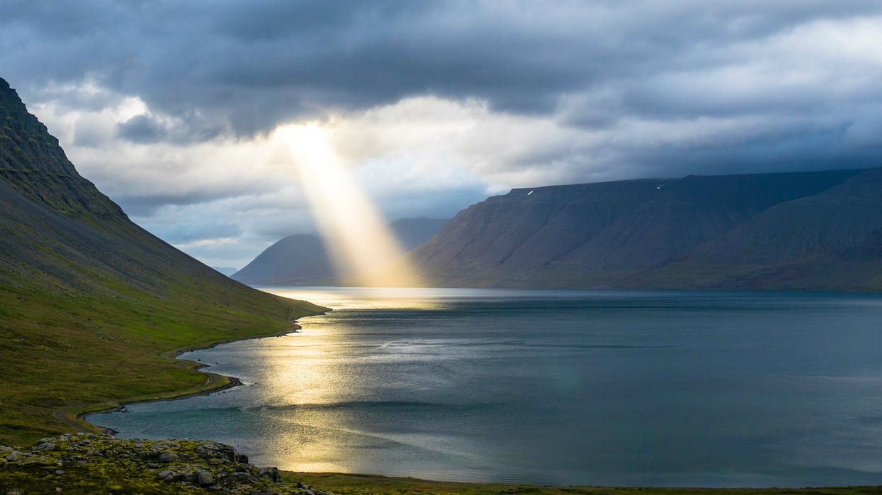
¹⁰ And the God of all grace, who called you to his eternal glory in Christ, after you have suffered a little while, will himself restore you and make you strong, firm and steadfast. ¹¹ To him be the power for ever and ever. Amen.

Slide 4
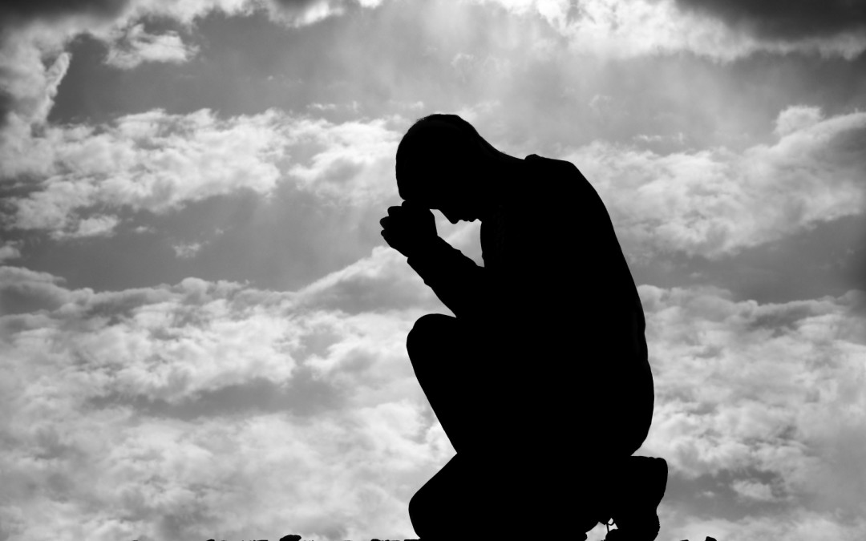
Humble Yourselves under God’s mighty hand
Humble yourselves, therefore, under God’s mighty hand, that he may lift you up in due time. V6

Slide 5
Humble Yourselves under God’s mighty hand
Likewise, you who are younger, be subject to the elders. Clothe yourselves, all of you, with humility toward one another, for "God opposes the proud but gives grace to the humble." V5

Slide 6
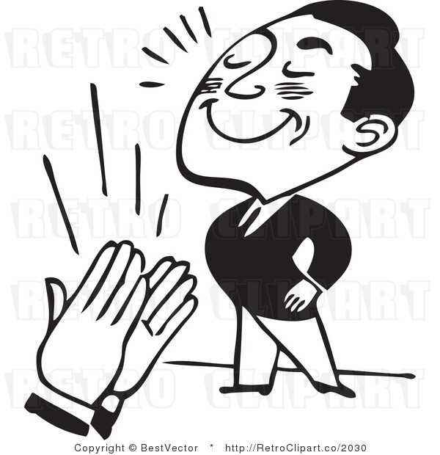
Humble Yourselves under God’s mighty hand
I say to everyone among you not to think of himself more highly than he ought to think … Rom 12:3

Slide 7
Humble Yourselves under God’s mighty hand
Love does not boast, is not proud. It is not rude, it is not self-seeking … 1 Cor 13:4-5

Slide 8
Humble Yourselves under God’s mighty hand
Humble yourselves before God and He will lift you up. James 4:10
For everyone who exalts himself will be humbled, and he who humbles himself will be exalted. Lu 18:14

Slide 9
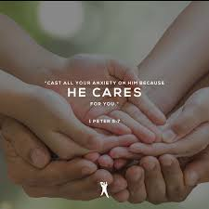
Cast All Our Anxiety On Him
Cast all your anxiety on him
because he cares for you. V7

Slide 10
Cast All Our Anxiety On Him
^{Mt 6:25} “Therefore I tell you, do not worry about your life … ²⁶ Look at the birds of the air … your heavenly Father feeds them. Are you not much more valuable than they?
²⁸ … See how the flowers of the field grow… ³⁰ … God clothes the grass of the field … ³¹ So do not worry …

Slide 11
Cast All Our Anxiety On Him
Peace I leave with you; my peace I give you. I do not give to you as the world gives. Do not let your hearts be troubled and do not be afraid. Jn 14:27

Slide 12
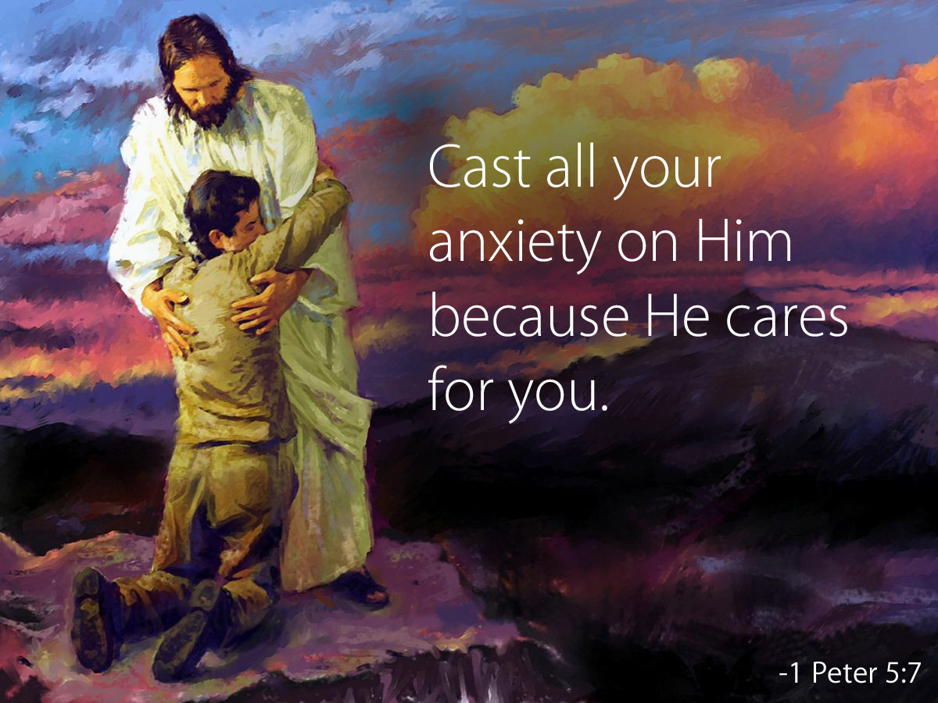
Be Sober and Watchful
Cast all your anxiety on him because he cares for you. Be alert and of sober mind … V7-8

Slide 13
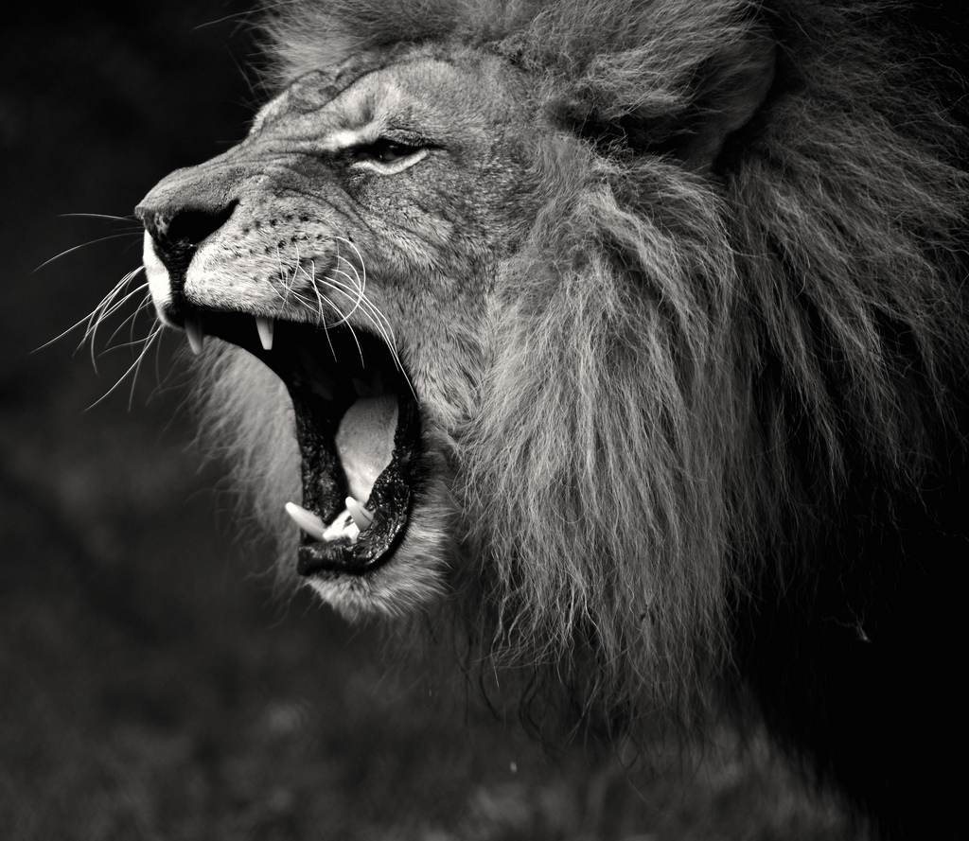
Be Sober and Watchful
Your enemy the devil prowls around like a roaring lion looking for someone to devour. V8

Slide 14
Be Sober and Watchful
Resist him, standing firm in the faith, because you know that the family of believers throughout the world is undergoing the same kind of sufferings. V9

Slide 15
In View of God’s Grace
¹⁰ And the God of all grace, who called you to his eternal glory in Christ, after you have suffered a little while, will himself restore you and make you strong, firm and steadfast. ¹¹ To him be the power for ever and ever. Amen.

