Slide 1
Genesis 16

Slide 2
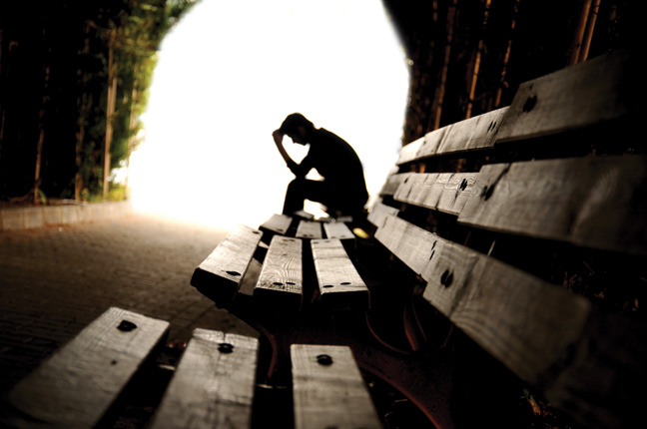
Abandoned & Forgotten

Slide 3
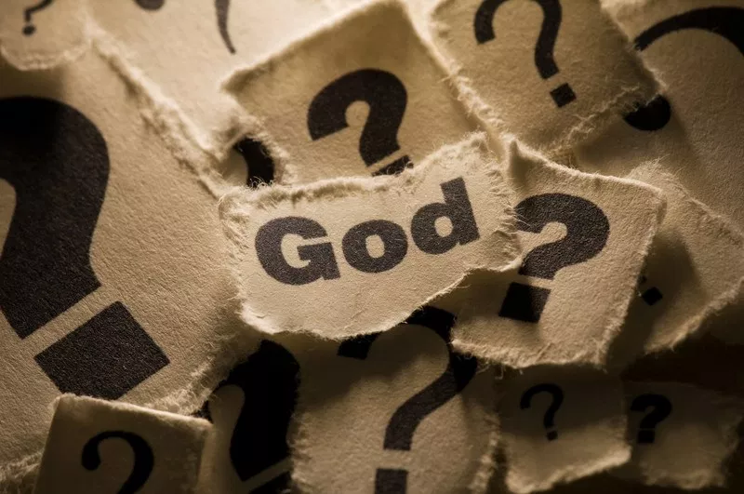
Where Is God In All Of This?

Slide 4
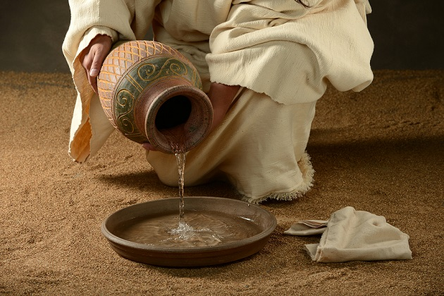
Hagar’s Story

Slide 5
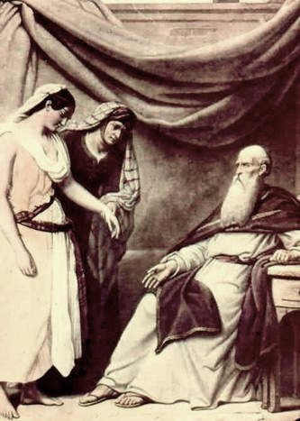
¹ Now Sarai, Abram’s wife, had borne him no children. But she had an Egyptian slave named Hagar; ² so she said to Abram, ‘The Lord has kept me from having children. Go, sleep with my slave; perhaps I can build a family through her.’
Abram agreed to what Sarai said. ³ So after Abram had been living in Canaan ten years, Sarai his wife took her Egyptian slave Hagar and gave her to her husband to be his wife. ⁴ He slept with Hagar, and she conceived. (Genesis 16)

Slide 6
The Lord’s Promise

Slide 7
At this point, Abram had the opportunity to make the choice to do what he knew God wanted done because he trusted God to know how best to proceed. He could choose either to make the promise happen himself or to continue to wait for God, seeking his approval, understanding, and direction. He had the opportunity to either replace God or to follow him. This is why his decision was such a great tragedy.
The promise had been made that Abram would have a son from his own body. The offer of Hagar did not necessarily contradict that promise. He and Sarai had waited ten years in Canaan and years before that. The weariness of waiting produced skepticism and spiritual dryness. Maybe this was the time for them to do something about the promise. The idea had a sensible ring to it, but essentially Abram was replacing God's with his own wisdom. He never asked the Lord in humility about the plan advanced by Sarai. He became god for himself.
(Steve Zeisler, “It Seemed Like A Good Idea At The Time”)
⁴ When she knew she was pregnant, she began to despise her mistress.
(Genesis 16)

Slide 8
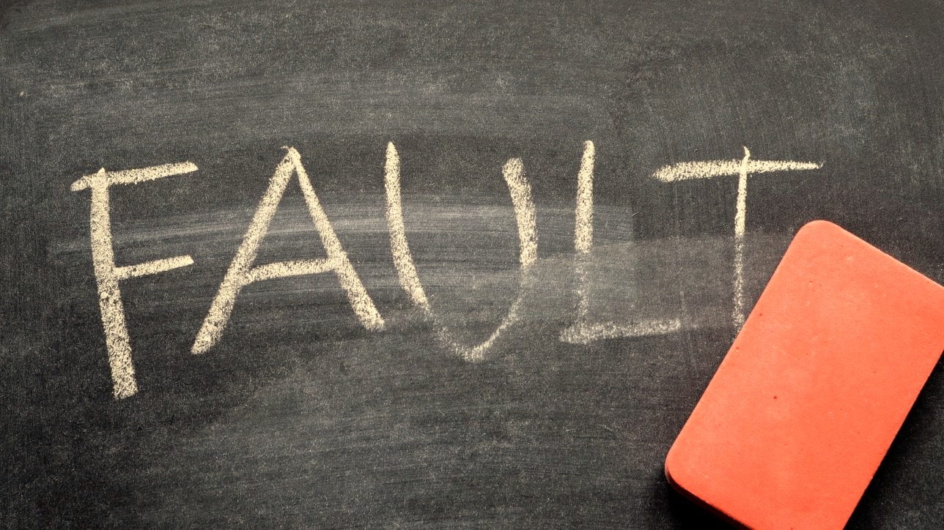
Omission & Commission
⁵ Then Sarai said to Abram, ‘You are responsible for the wrong I am suffering. I put my slave in your arms, and now that she knows she is pregnant, she despises me. May the Lord judge between you and me.’
⁶ ‘Your slave is in your hands,’ Abram said. ‘Do with her whatever you think best.’ (Genesis 16)

Slide 9
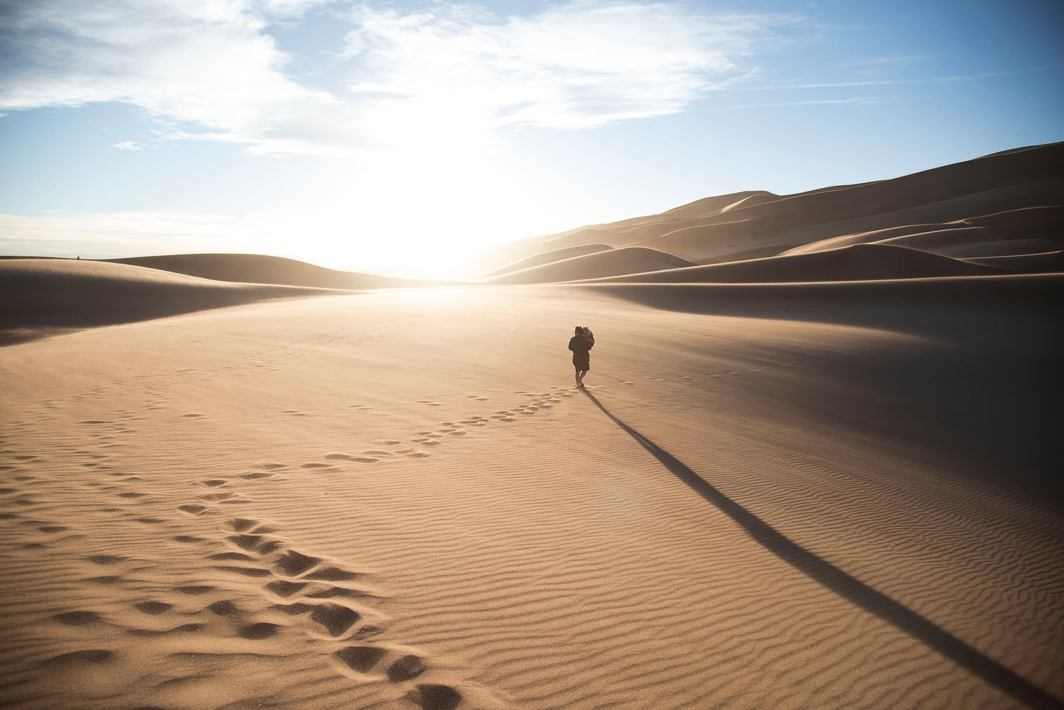
Then Sarai ill-treated Hagar; so she fled from her. (Genesis 16)

Slide 10
Found
⁷ The angel of the Lord found Hagar near a spring in the desert; it was the spring that is beside the road to Shur.
(Genesis 16)

Slide 11
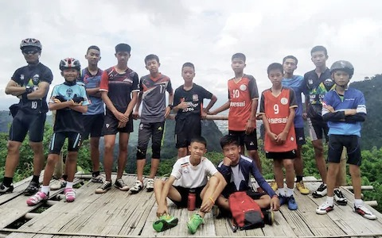

Slide 12
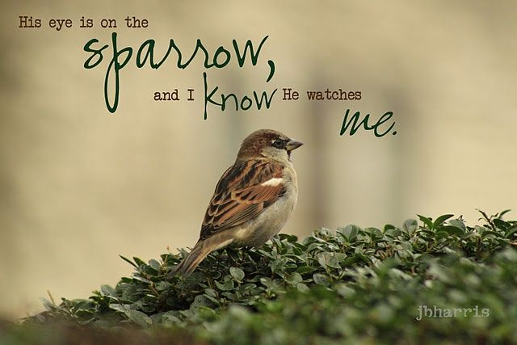
⁶ Are not five sparrows sold for two pennies? Yet not one of them is forgotten by God. ⁷ Indeed, the very hairs of your head are all numbered. Don’t be afraid; you are worth more than many sparrows. (Luke 12)

Slide 14
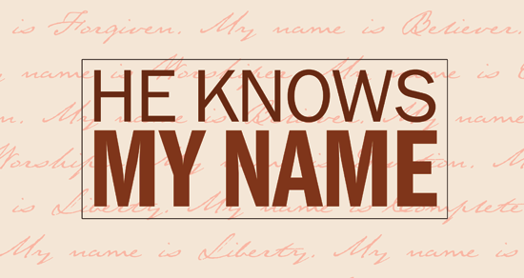
⁸ And he said, ‘Hagar, slave of Sarai, (Genesis 16)

Slide 15
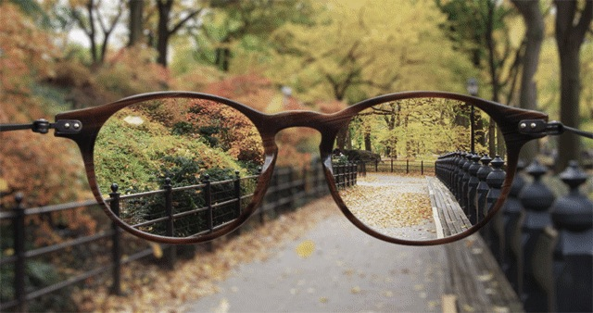
Seeing

Slide 16
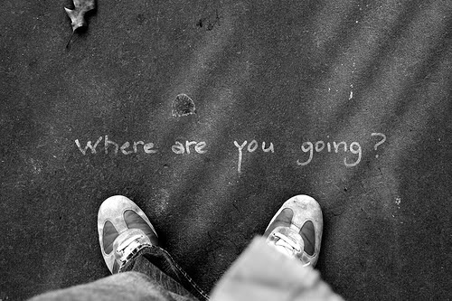
God’s Questions
And he said, ‘Hagar, slave of Sarai, where have you come from, and where are you going?’
‘I’m running away from my mistress Sarai,’ she answered. (Genesis 16)

Slide 17
⁹ Then the angel of the Lord told her, ‘Go back to your mistress and submit to her.’ (Genesis 16)

Slide 18
“Return and submit.” This is the only way to experience the grace and blessing of God. Had she gone on wandering into the wilderness, it would have been disastrous. Both she and the child in her womb would have died. When God finds us wandering, this is always what he says, “Return and submit!” “Submit to the circumstances you dislike, and I will work it out. To do anything else is folly.”
(Ray Stedman, “It All Depends on Me”)

Slide 19
While that’s a difficult word, it’s also a merciful word. Hagar may have suffered greatly or even perished if she had continued her flight into the wilderness. God often mercifully checks us in our disobedience to prevent us from even greater damage. The way of obedience is hard, but the way of disobedience is even more difficult. It was better for Hagar to be associated with Abram and Sarai, even with Sarai’s harshness, than with her native Egyptians, who worshiped false gods.
Some of you may be in trying situations right now, but you haven’t submitted to God. Maybe your pattern has been to run from one difficult situation to the next, always blaming others or complaining about bad luck, but never humbling yourself under God’s mighty hand. You won’t know His blessing until submit to Him in whatever circumstances He has placed you. It’s hard news, but it’s not really bad.
(Steven J. Cole,”The God Who Sees Me”)

Slide 20
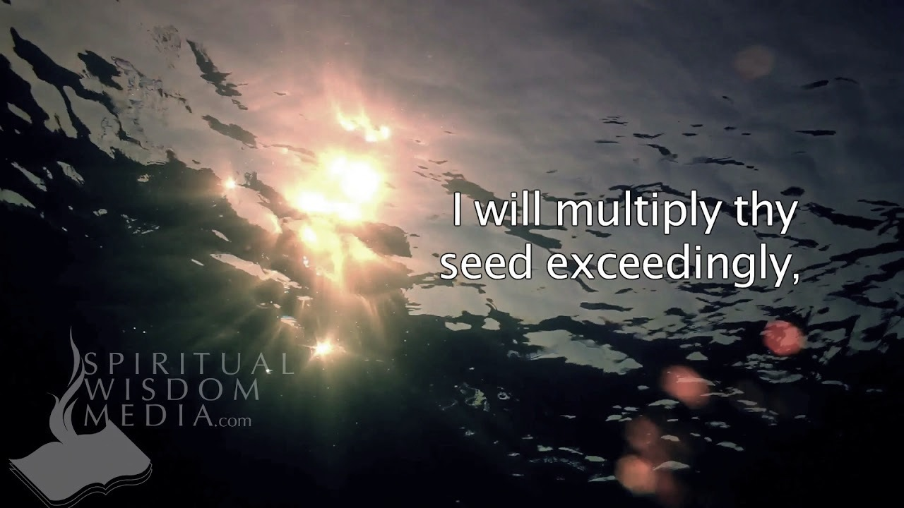
¹⁰ The angel added, ‘I will increase your descendants so much that they will be too numerous to count.’
¹¹ The angel of the Lord also said to her:
‘You are now pregnant and you will give birth to a son. You shall name him Ishmael, for the Lord has heard of your misery.
¹² He will be a wild donkey of a man; his hand will be against everyone and everyone’s hand against him, and he will live in hostility towards all his brothers.’ (Genesis 16)

Slide 21
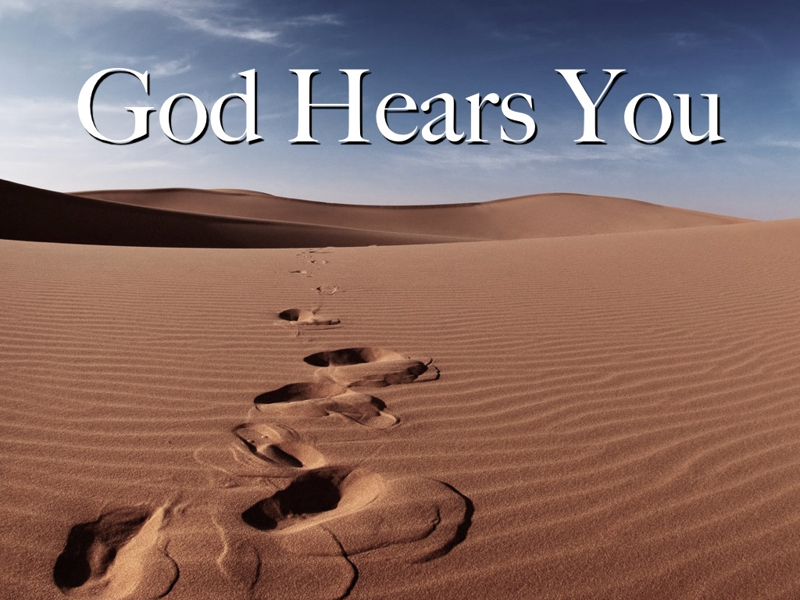
You Shall Name Him Ishmael

Slide 22
¹³ She gave this name to the Lord who spoke to her: ‘You are the God who sees me,’ for she said, ‘I have now seen the One who sees me.’ ¹⁴ That is why the well was called Beer Lahai Roi; it is still there, between Kadesh and Bered. (Genesis 16)

Slide 23
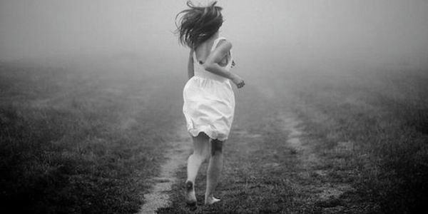
Response

Slide 24
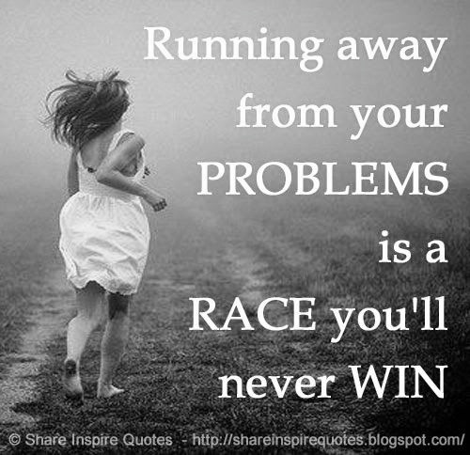

Slide 26
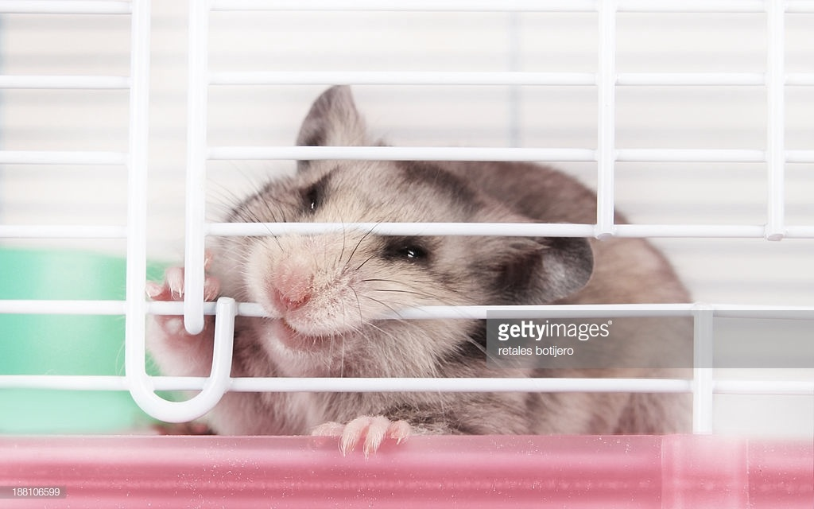
Christ did not come to do away with suffering; He did not come to explain it; He came to fill it with His presence.
(Paul Claudel)

