Slide 1
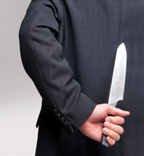
Frenemies from within
Jude 17-25 Part 2

Slide 2
Recap
Believers must contend for their faith
Frenemies have slipped into the church
These people are “shepherds” with ambitions
You can identify them by observing their behaviours

Slide 3
¹⁷ But, dear friends, remember what the apostles of our Lord Jesus Christ foretold.
¹⁸ They said to you, “In the last times there will be scoffers who will follow their own ungodly desires.”
¹⁹ These are the people who divide you, who follow mere natural instincts and do not have the Spirit.

Slide 4
²⁰ But you, dear friends, by building yourselves up in your most holy faith and praying in the Holy Spirit, ²¹ keep yourselves in God’s love as you wait for the mercy of our Lord Jesus Christ to bring you to eternal life.
²² Be merciful to those who doubt; ²³ save others by snatching them from the fire; to others show mercy, mixed with fear—hating even the clothing stained by corrupted flesh.

Slide 5
²⁴ To him who is able to keep you from stumbling and to present you before his glorious presence without fault and with great joy
²⁵ to the only God our Saviour be glory, majesty, power and authority, through Jesus Christ our Lord, before all ages, now and forevermore! Amen.

Slide 6
Forewarning from the Apostles
¹⁷ But, dear friends, remember what the apostles of our Lord Jesus Christ foretold. They said to you, “In the last times there will be scoffers who will follow their own ungodly desires.” These are the people who divide you, who follow mere natural instincts and do not have the Spirit.
Jude 17-19

Slide 7
How to shield ourselves?
²⁰ But you, dear friends, by building yourselves up in your most holy faith and praying in the Holy Spirit, ²¹ keep yourselves in God’s love as you wait for the mercy of our Lord Jesus Christ to bring you to eternal life.

Slide 8
Keep yourselves in God’s love

Slide 9
Keep yourselves in God’s love by..
Building up in your most holy faith
Praying in the Spirit
Jude 20

Slide 10
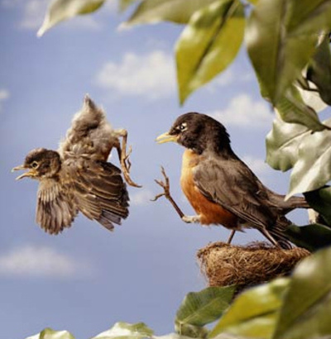
Building up your faith by leaving your comfort zone

Slide 11
Leaving your comfort zone

Slide 12
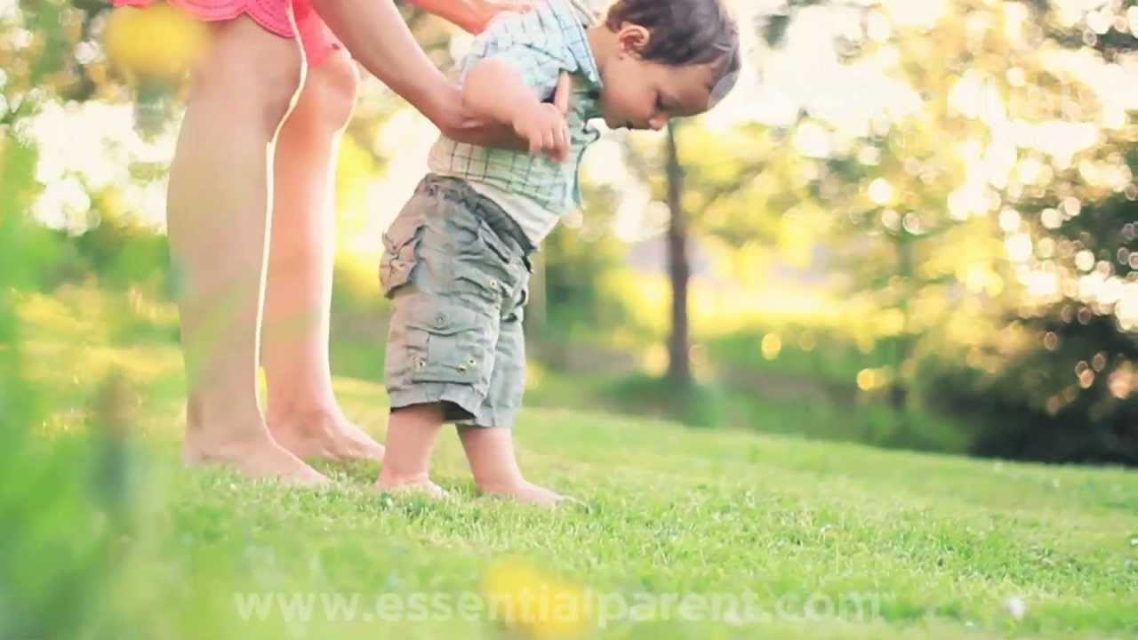
Building up our Faith
Our journey with God is an adventure but we have to start by taking the first step

Slide 13
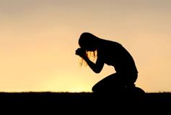
Praying in the Spirit

Slide 14
¹⁸ And pray in the Spirit on all occasions with all kinds of prayers and requests. With this in mind, be alert and always keep on praying for all the Lord’s people.
Praying in the Spirit is not necessarily speaking in tongue
Ephesians 6:18

Slide 15
Praying in the Spirit could mean praying with the help of the Holy Spirit
In the same way, the Spirit helps us in our weakness. We do not know what we ought to pray for, but the Spirit himself intercedes for us through wordless groans
Romans 8:26

Slide 16
Pray without ceasing 1 Thes 5:17

Slide 17
Have a Heart and use our Head
²² Be merciful to those who doubt; ²³ save others by snatching them from the fire; to others show mercy, mixed with fear—hating even the clothing stained by corrupted flesh.
Jude 22-23

Slide 18
Our God is able
²⁴ To him who is able to keep you from stumbling and to present you before his glorious presence without fault and with great joy— ²⁵ to the only God our Saviour be glory, majesty, power and authority, through Jesus Christ our Lord, before all ages, now and forevermore! Amen

