Slide 1
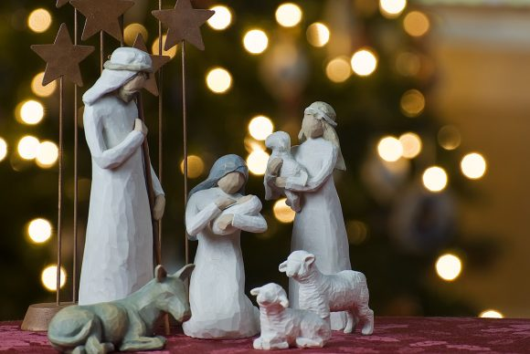
For God So Loved
John 3:16

Slide 2
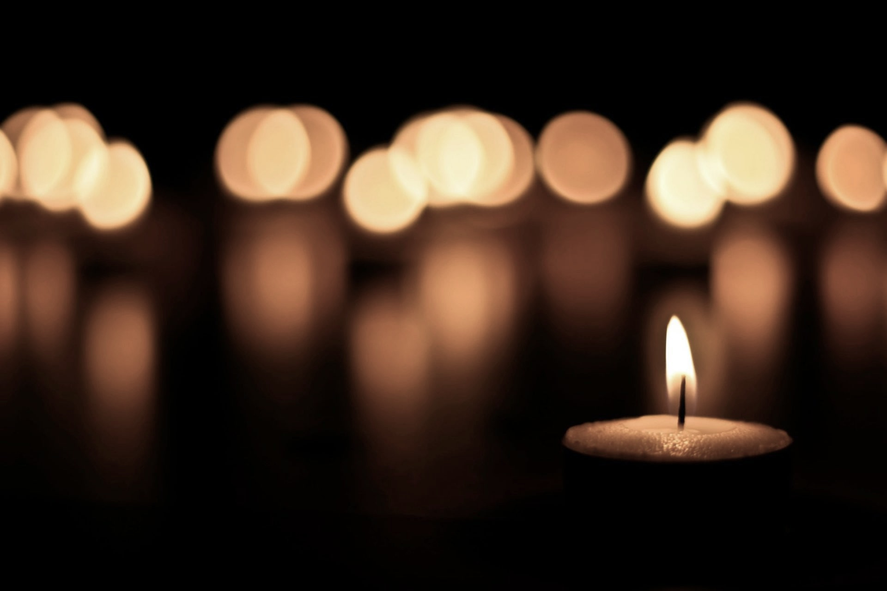
Advent

Slide 4
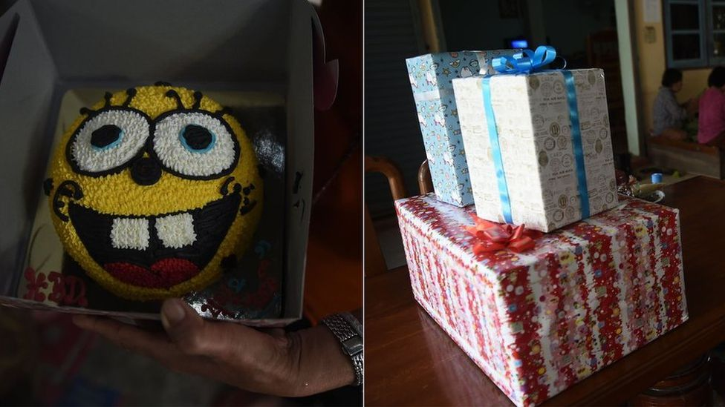
It All Began With A Birthday

Slide 5
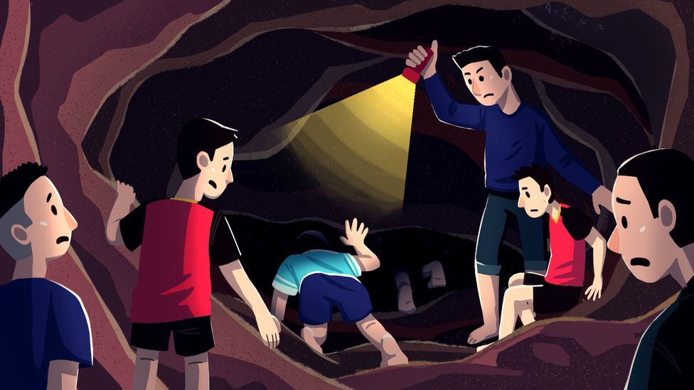
In Danger Of Perishing

Slide 6
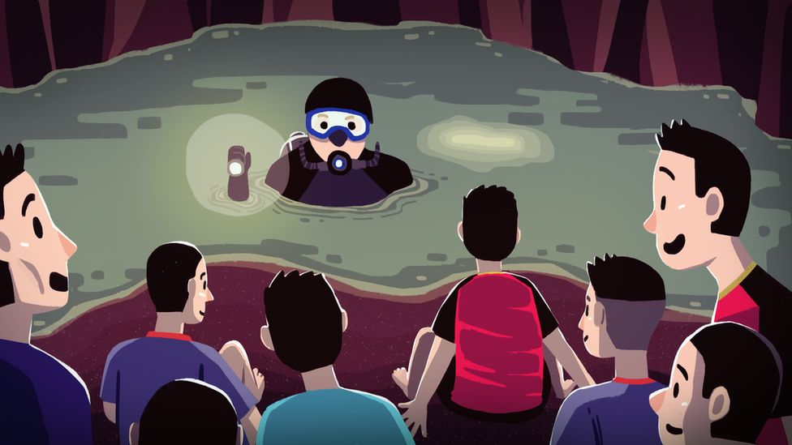
Rescued!

Slide 7
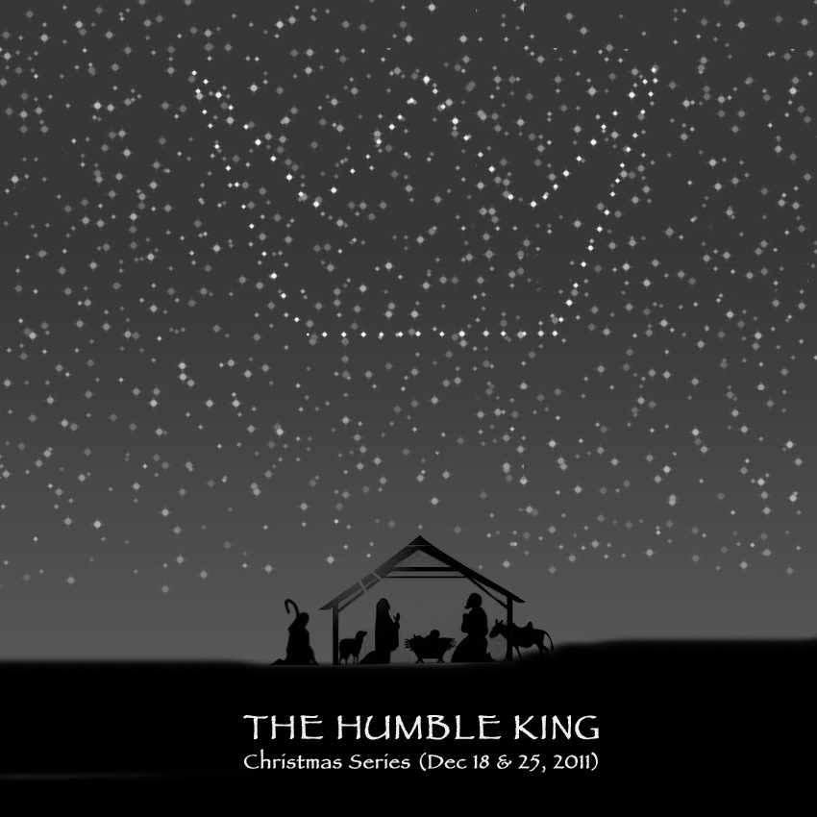
The Greatest Rescue

Slide 8
The Fall

Slide 9
The Danger

Slide 11
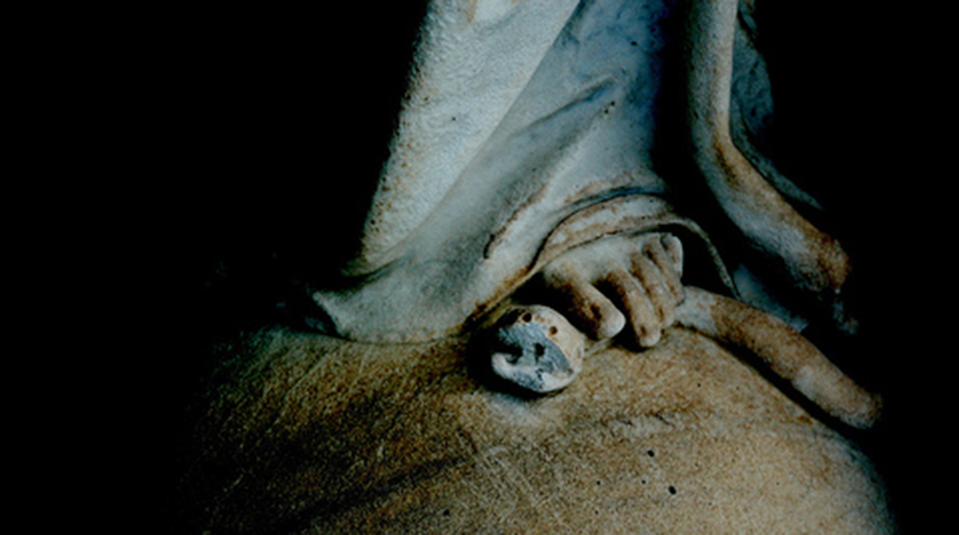
Protoevangelium
¹⁵ And I will put enmity between you and the woman, and between your offspring and hers; he will crush your head, and you will strike his heel.’ (Genesis 3)

Slide 12
Protoevangelium
This is the first promise given after Adam and Eve ate the forbidden fruit in the Garden of Eden. Theologians call it the protoevangelium – or first gospel because these words spoken by God contain the first promise of redemption in the Bible. Everything else in the Bible flows from these words in Genesis 3:15. As the acorn contains the mighty oak, so these words contain the entire plan of salvation. The great English preacher Charles Simeon called this verse “the sum and summary of the whole Bible.”
Although you may not see it at first glance, Christ is in this verse. He is the ultimate Seed of the Woman who would one day come to crush the serpent’s ugly head. In the process his “heel” would be bruised on the cross. In short, this verse predicts that Jesus would win the victory over Satan but would himself be wounded at the same time.
(Ray Pritchard, “What Is The Protoevangelium?”)

Slide 13
The Omitted Stanza
Come, Desire of Nations, come,
Fix in us Thy humble home. Rise the woman’s conquering Seed,
Bruise in us the serpent’s head. Adam’s likeness now efface,
Stamp Thine image in its place, Second Adam from above,
Reinstate us in Thy love, Hark, the herald angels sing,
Glory to the newborn King.

Slide 15
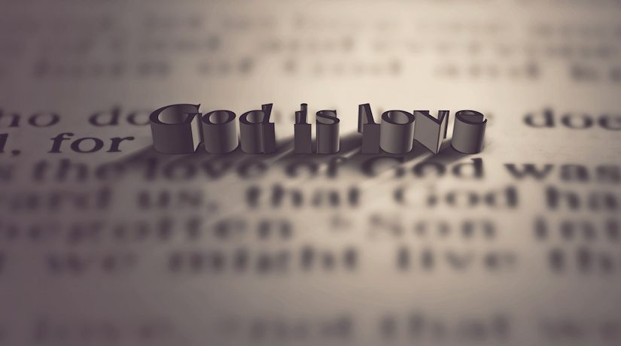

Slide 16
God SO Loved
I lay it down of my own accord. (John 10:18)

Slide 17
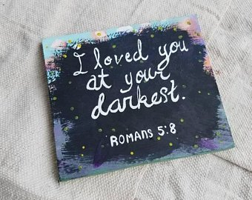
God so loved the WORLD
⁶ You see, at just the right time, when we were still powerless, Christ died for the ungodly. ⁷ Very rarely will anyone die for a righteous person, though for a good person someone might possibly dare to die. ⁸ But God demonstrates his own love for us in this: while we were still sinners, Christ died for us. (Romans 5)

Slide 18
Just before John 3:16 Jesus compares his own coming with the what happened in the day of Moses when the people rebelled against God and said they were sick of manna. The result of this sin was a plague of serpents all through the camp, people dying everywhere.
When Moses prayed for the people, Numbers 21:8 says:
Then the Lord said to Moses, “Make a fiery serpent, and set it on a standard; and it shall come about, that everyone who is bitten, when he looks at it, he shall live.”
So God’s design of love to rescue the rebellious people from perishing was to lift up a serpent on a pole so that all the people had to do was look at it in faith and be saved.
Then Jesus says in John 3:14-15
And as Moses lifted up the serpent in the wilderness, even so must the Son of Man be lifted up; that whoever believes may in Him have eternal life.
When John 3:16 says, “God so loved the world that he gave,” it means he gave his one and only begotten Son to a world of rebels, serpent bitten, sinful, perishing — and him their only hope. God loved this world.
(John Piper, "The Design Is Love”)

Slide 19
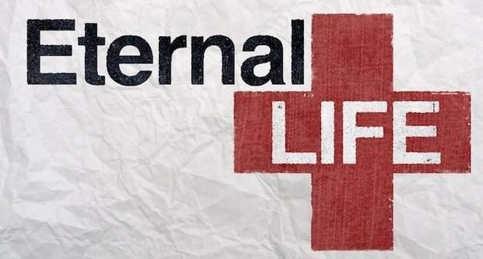
WHOEVER Believes

Slide 20
The Freedom To Refuse
⁵ Love does not insist on its own way (1 Corinthians 13)
God does not send us to heaven or hell depending on how often we obey or disobey. God is love and only love. In God there is not hatred, desire for revenge, or pleasure in seeing us punished God wants to forgive, heal, restore, show us endless mercy, and see us come home. But just as the father of the prodigal son let his son make his own decision, God gives us the freedom to move away from God’s love even at the risk of destroying ourselves. Hell is not God’s choice. It is ours.
(Henri Nouwen, “The Freedom To Refuse Love”)

Slide 21
Grateful Celebration

Slide 22
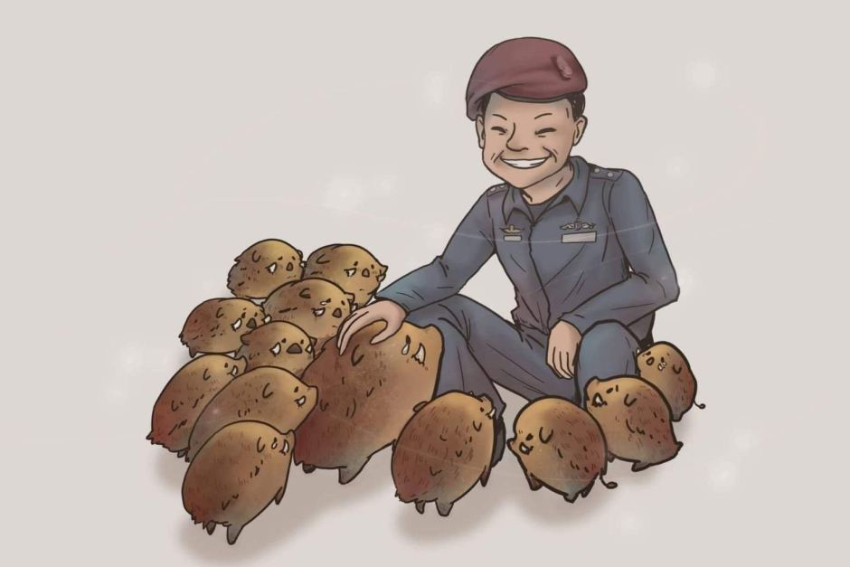
Ultimate Love & Sacrifice

Slide 23
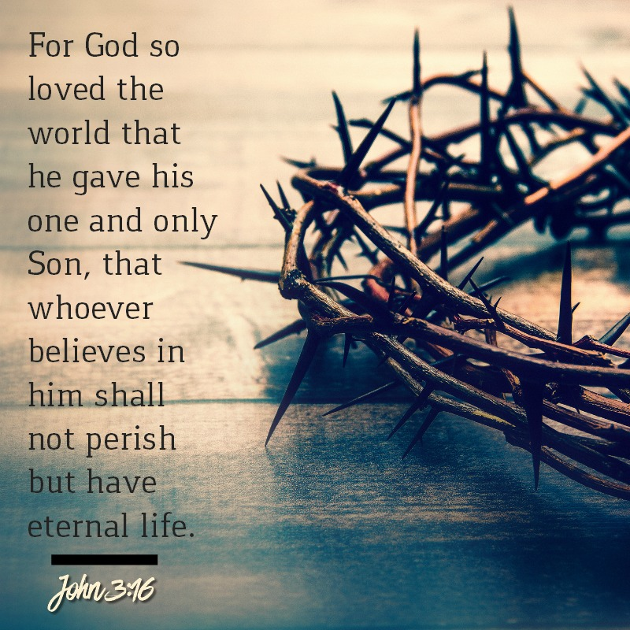
Ultimate Love & Sacrifice

Slide 25
