Slide 1
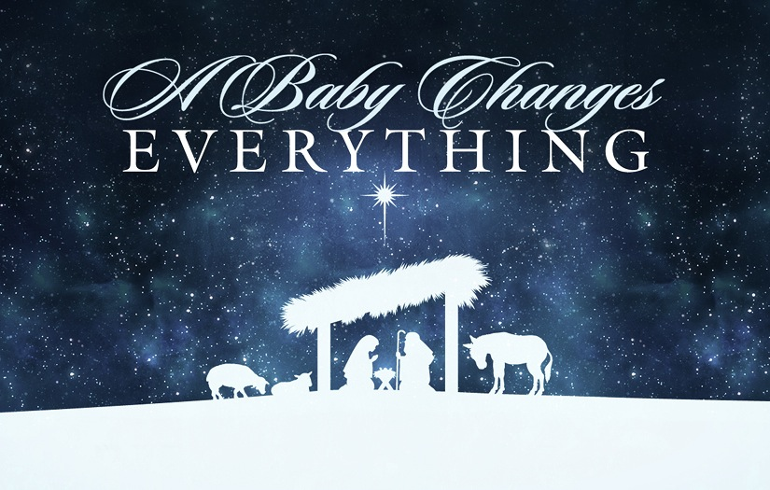
Isaiah 9:1-7

Slide 2
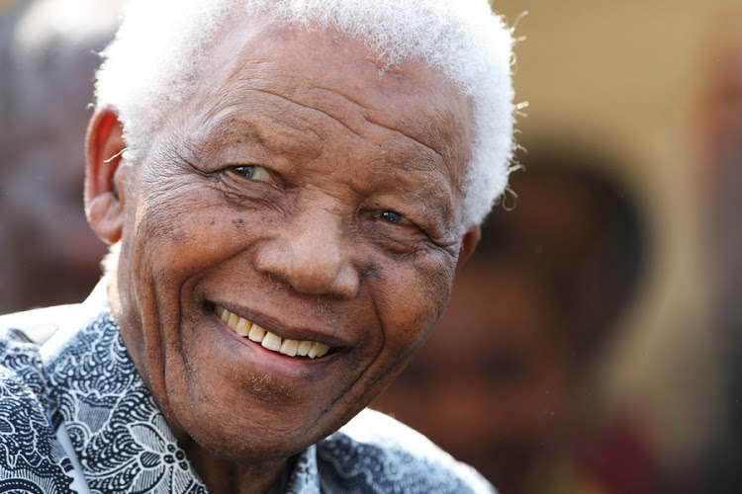

Slide 3
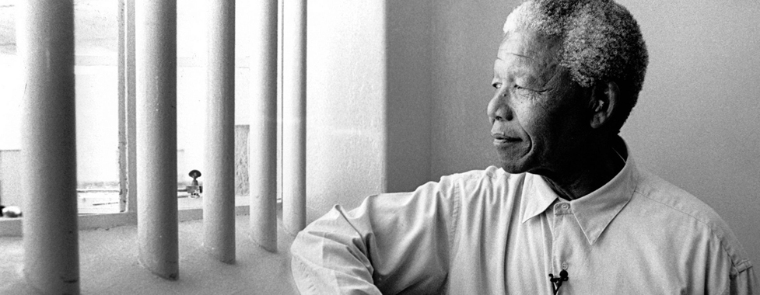
Nelson Mandela recalls the scene when he first laid eyes on his granddaughter. At the time he was working at hard labor on Robben Island in almost unbearable conditions, cutting lime in a quarry under a sun so bright it nearly blinded him. Only one thing kept the prisoners from despair, he writes: they sang together as they worked. The songs reminded them of family and home and tribe and the world outside they might otherwise forget.
During the fourteenth year of his imprisonment, Mandela gained permission for a visit from his daughter (he was generally forbidden visitors).

Slide 4
She ran across the room and embraced him. Mandela had not held his daughter since she was a young girl, and it was both poignant and dizzying to hug this fully-grown woman, his child. Then she handed over her own newborn baby, Nelson’s granddaughter, into his callused, leathery hands. “To hold a newborn baby, so vulnerable and soft in my rough hands, hands that for too long had held only picks and shovels, was a profound joy. I don’t think a man was ever happier to hold a baby than I was that day.”

Slide 5
Mandela’s tribal culture had a tradition of letting the grandfather choose a new baby’s name, and Nelson toyed with various names as he held that tiny, helpless baby. He settled on Zaziwe, which means Hope. “That name had special meaning for me, for during all my years in prison hope never left me – and now it never would. I was convinced that this child would be a part of a new generation of South Africans for whom apartheid would be a distant memory – that was my dream.”

Slide 6
As it turned out, Mandela had served barely half his sentence and would not gain freedom for thirteen more years. The vision of hope, however, of Zaziwe, sustained him. Despite little present evidence at the time, he believed that the reality of apartheid in South Africa would someday crumble. The time would come, whether in his lifetime or his granddaughter’s, when a new kind of justice would descend. Future faith determined his present.
(Philip Yancey, “Reaching For The Invisible God”)

Slide 7
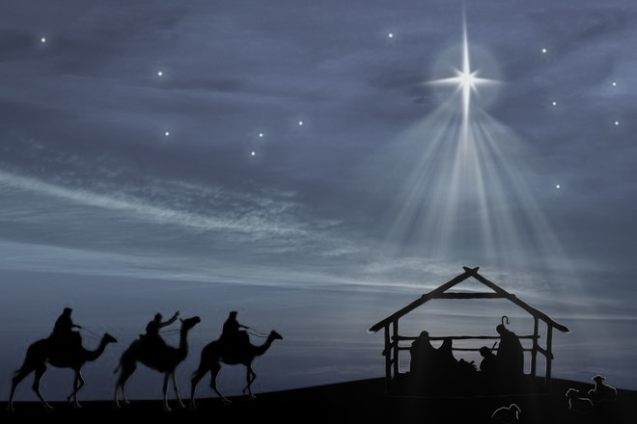
The Promise of Hope

Slide 8
¹Nevertheless, there will be no more gloom for those who were in distress. In the past he humbled the land of Zebulun and the land of Naphtali, but in the future he will honor Galilee of the nations, by the Way of the Sea, beyond the Jordan — ² The people walking in darkness have seen a great light; on those living in the land of deep darkness a light has dawned. ³ You have enlarged the nation and increased their joy; they rejoice before you as people rejoice at the harvest, as warriors rejoice when dividing the plunder. ⁴ For as in the day of Midian’s defeat, you have shattered the yoke that burdens them, the bar across their shoulders, the rod of their oppressor. ⁵ Every warrior’s boot used in battle and every garment rolled in blood will be destined for burning, will be fuel for the fire. ⁶ For to us a child is born, to us a son is given, and the government will be on his shoulders. And he will be called Wonderful Counselor, Mighty God, Everlasting Father, Prince of Peace. ⁷ Of the greatness of his government and peace there will be no end. He will reign on David’s throne and over his kingdom, establishing and upholding it with justice and righteousness from that time on and forever. The zeal of the Lord Almighty will accomplish this.
(Isaiah 9)

Slide 9
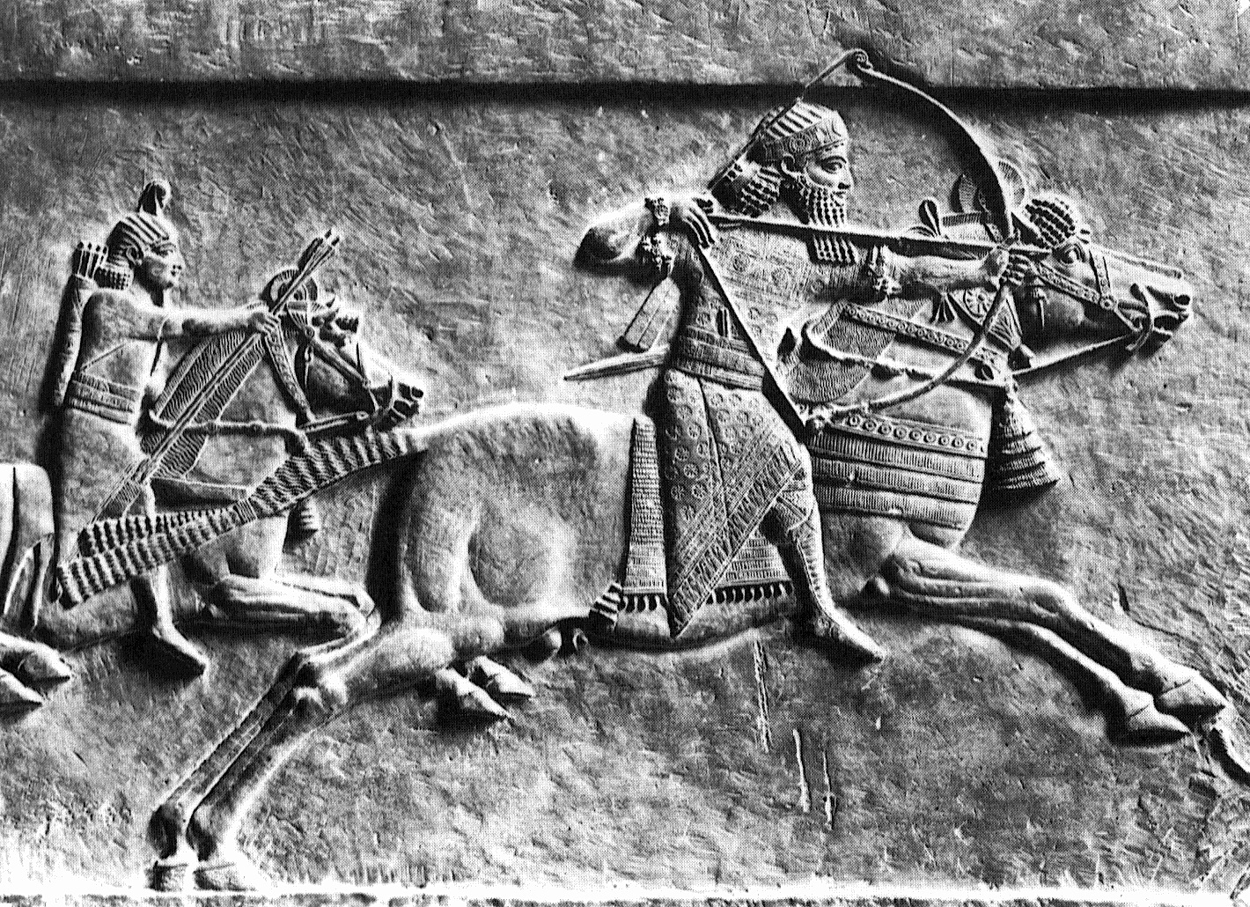
Distress And Hopelessness
²¹ Distressed and hungry, they will roam through the land; when they are famished, they will become enraged and, looking upward, will curse their king and their God. ²² Then they will look toward the earth and see only distress and darkness and fearful gloom, and they will be thrust into utter darkness. (Isaiah 8)

Slide 10
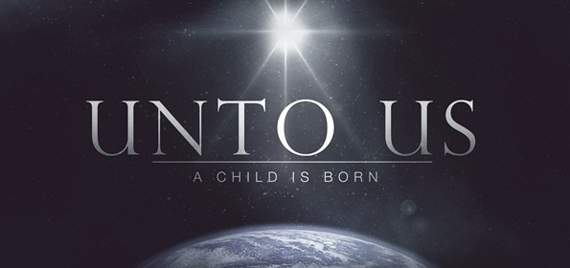
⁶ For to us a child is born, to us a son is given, and the government will be on his shoulders. And he will be called Wonderful Counselor, Mighty God, Everlasting Father, Prince of Peace. ⁷ Of the greatness of his government and peace there will be no end. He will reign on David’s throne and over his kingdom, establishing and upholding it with justice and righteousness from that time on and forever. The zeal of the Lord Almighty will accomplish this.
(Isaiah 9)

Slide 11
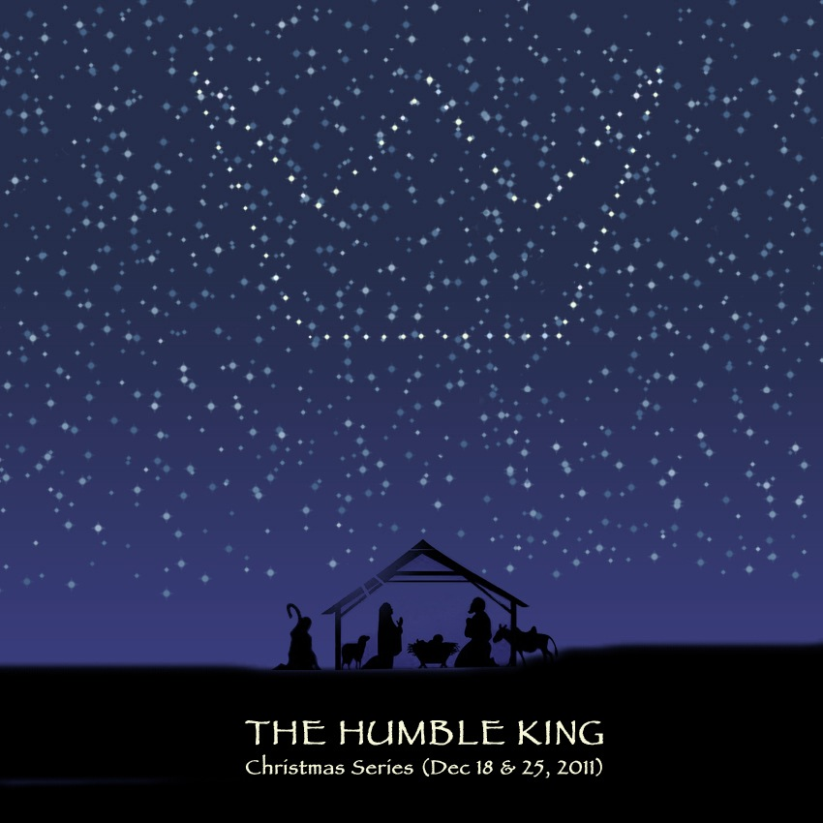
Marvelous In How He Came

Slide 12
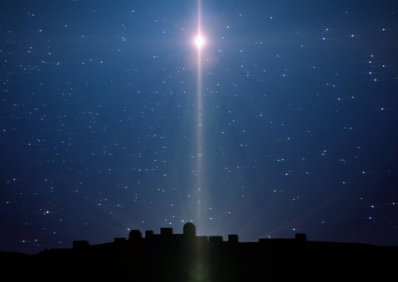
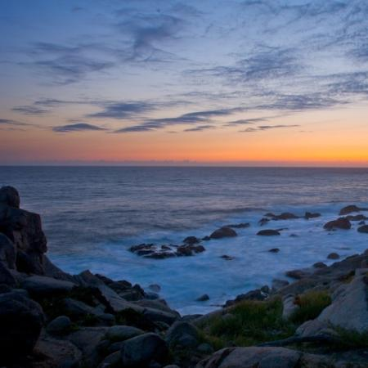
Earthly Humanity
Heavenly Deity
A Child Is Born
A Son Is Given
Divinity putting on humanity; the Creator appearing as creature; the eternal Son of God incarnate as the Son of Man.
(Walter A. Maier, “The Christ of Christmas”)

Slide 13
Majestic In Who He Is

Slide 14
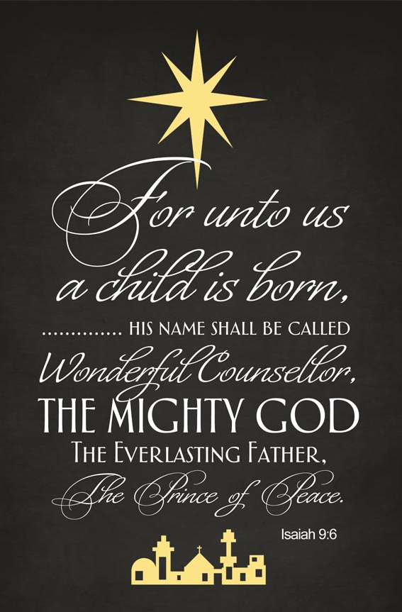
The Wonderful Counselor Who Solves Our Confusion
²⁴ … Christ the power of God and the wisdom of God.
(1 Corinthians 1)
² ... Christ, ³ in whom are hidden all the treasures of wisdom and knowledge.
(Colossians 2)

Slide 15
The Mighty God Who Shelters Us In Conflict
²⁴ … Christ the power of God and the wisdom of God.
(1 Corinthians 1)

Slide 16
The Everlasting Father Who Showers Us With Compassion

Slide 17
The Prince of Peace Who Soothes Our Cares
⁷ Of the greatness of his government and peace there will be no end.
(Isaiah 9)
Peace With God
Peace Of God

Slide 18
This Baby Changed Everything

Slide 19
Thanks Be To God For His Indescribable Gift

Slide 20
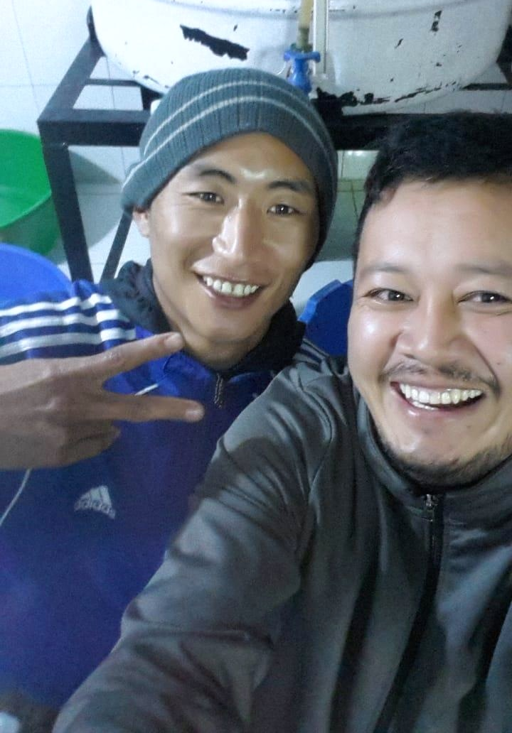
Hope For Jigme

Slide 21
What We Find In Jesus
We find peace, and the Prince of Peace
We find righteousness, and the Righteous One
We find counsel, and the Counselor
We find wonders, and the Wonderful One
We find salvation, and the Saviour
We find the Kingdom, and the King.
In Jesus, we find more gifts
Than our hearts can imagine

