Slide 2
A very important message

Slide 3
The message of the kingdom
Have you heard it before ? Matthew 13

Slide 4
About the Kingdom of God
Refers to the rule of God.
The arrival of Jesus unveiled the kingdom.
The kingdom is now here but it is not fully consummated until Jesus’ second coming.
We are now living in the “latter days” aka “end times”.

Slide 5
Many prophets and righteous people longed to hear what you hear but did not hear it.
Matthew 13:17
Privileged

Slide 6
Those who hear the message and understand it, they will bear fruit, some as much as one hundred times, others sixty, and others thirty.
Matthew 13:23 (GNT)
Productive

Slide 7
The kingdom of heaven is like yeast that a woman took and mixed into about 60 pounds of flour until it worked all through the dough.
Matthew 13:33
Life-Changing

Slide 8
The kingdom of heaven is a merchant looking for fine pearls. When he found one of great value, he went away and sold everything he had and bought it.
Matthew 13:43
Of Great Value

Slide 9
The message of the kingdom - Important but very few have really comprehended

Slide 10
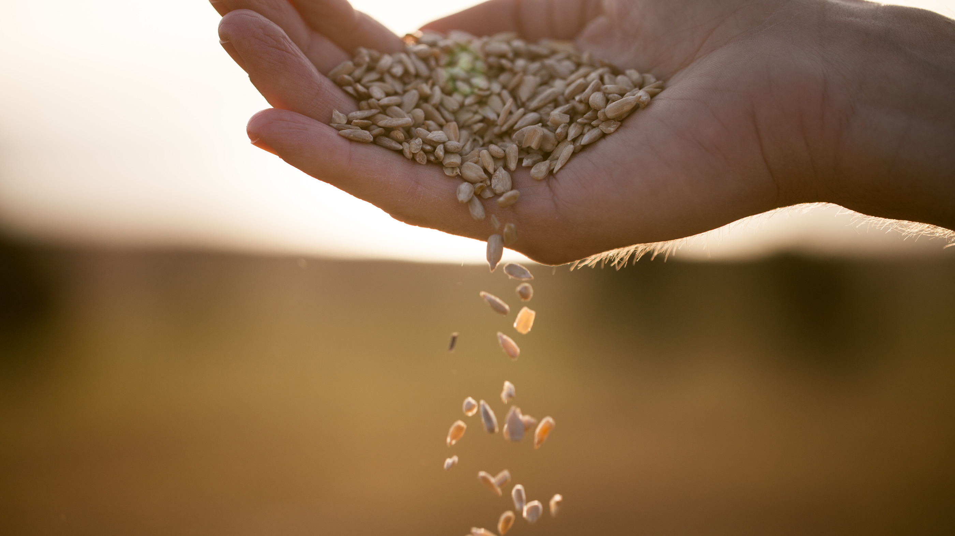
Today’s Text
Parable of the Sower
Matthew 13:1-9,18-24

Slide 11
13 That same day Jesus went out of the house and sat by the lake. ² Such large crowds gathered around him that he got into a boat and sat in it, while all the people stood on the shore. ³ Then he told them many things in parables, saying: “A farmer went out to sow his seed. ⁴ As he was scattering the seed, some fell along the path, and the birds came and ate it up. ⁵ Some fell on rocky places, where it did not have much soil. It sprang up quickly, because the soil was shallow. ⁶ But when the sun came up, the plants were scorched, and they withered because they had no root. ⁷ Other seed fell among thorns, which grew up and choked the plants. ⁸ Still other seed fell on good soil, where it produced a crop—a hundred, sixty or thirty times what was sown. ⁹ Whoever has ears, let them hear.”

Slide 12
¹⁸ “Listen then to what the parable of the sower means: ¹⁹ When anyone hears the message about the kingdom and does not understand it, the evil one comes and snatches away what was sown in their heart. This is the seed sown along the path. ²⁰ The seed falling on rocky ground refers to someone who hears the word and at once receives it with joy. ²¹ But since they have no root, they last only a short time. When trouble or persecution comes because of the word, they quickly fall away. ²² The seed falling among the thorns refers to someone who hears the word, but the worries of this life and the deceitfulness of wealth choke the word, making it unfruitful. ²³ But the seed falling on good soil refers to someone who hears the word and understands it. This is the one who produces a crop, yielding a hundred, sixty or thirty times what was sown.”

Slide 13
Two Kinds of Hearers in the Parable
People who get the message
People who do not get the message

Slide 14
The evil one comes and snatches away what was sown in their heart
Some fell along the path, and the birds came and ate it

Slide 15
Some fell on rocky places where it did not have much soil
People who hear the word and receive it with joy. But they have no root, they only last for a short while

Slide 16
Worries of life and deceitfulness of wealth choke the word, making it unfruitful
Other seed fell amongst thorns, grew up and choked the plants

Slide 17
But the seed falling on good soil refers to someone who hears and understands it. This is the one who produces a crop, yielding a hundred, sixty or thirty times what was sown.

Slide 18
Those who hear the message and understand it, they will bear fruit, some as much as one hundred times, others sixty, and others thirty.
The kingdom of heaven is a merchant looking for fine pearls. When he found one of great value, he went away and sold everything he had and bought it. Matthew 13:43
Matthew 13:23 (GNT)
Those who hear the message and understand it, they will bear fruit, some as much as one hundred times, others sixty, and others thirty.
Matthew 13:23 (GNT)

Slide 19
The man who gets the message
The kingdom of heaven is a merchant looking for fine pearls. When he found one of great value, he went away and sold everything he had and bought it.
Matthew 13:43

Slide 20
He who has an ear let him hear…

