Slide 2
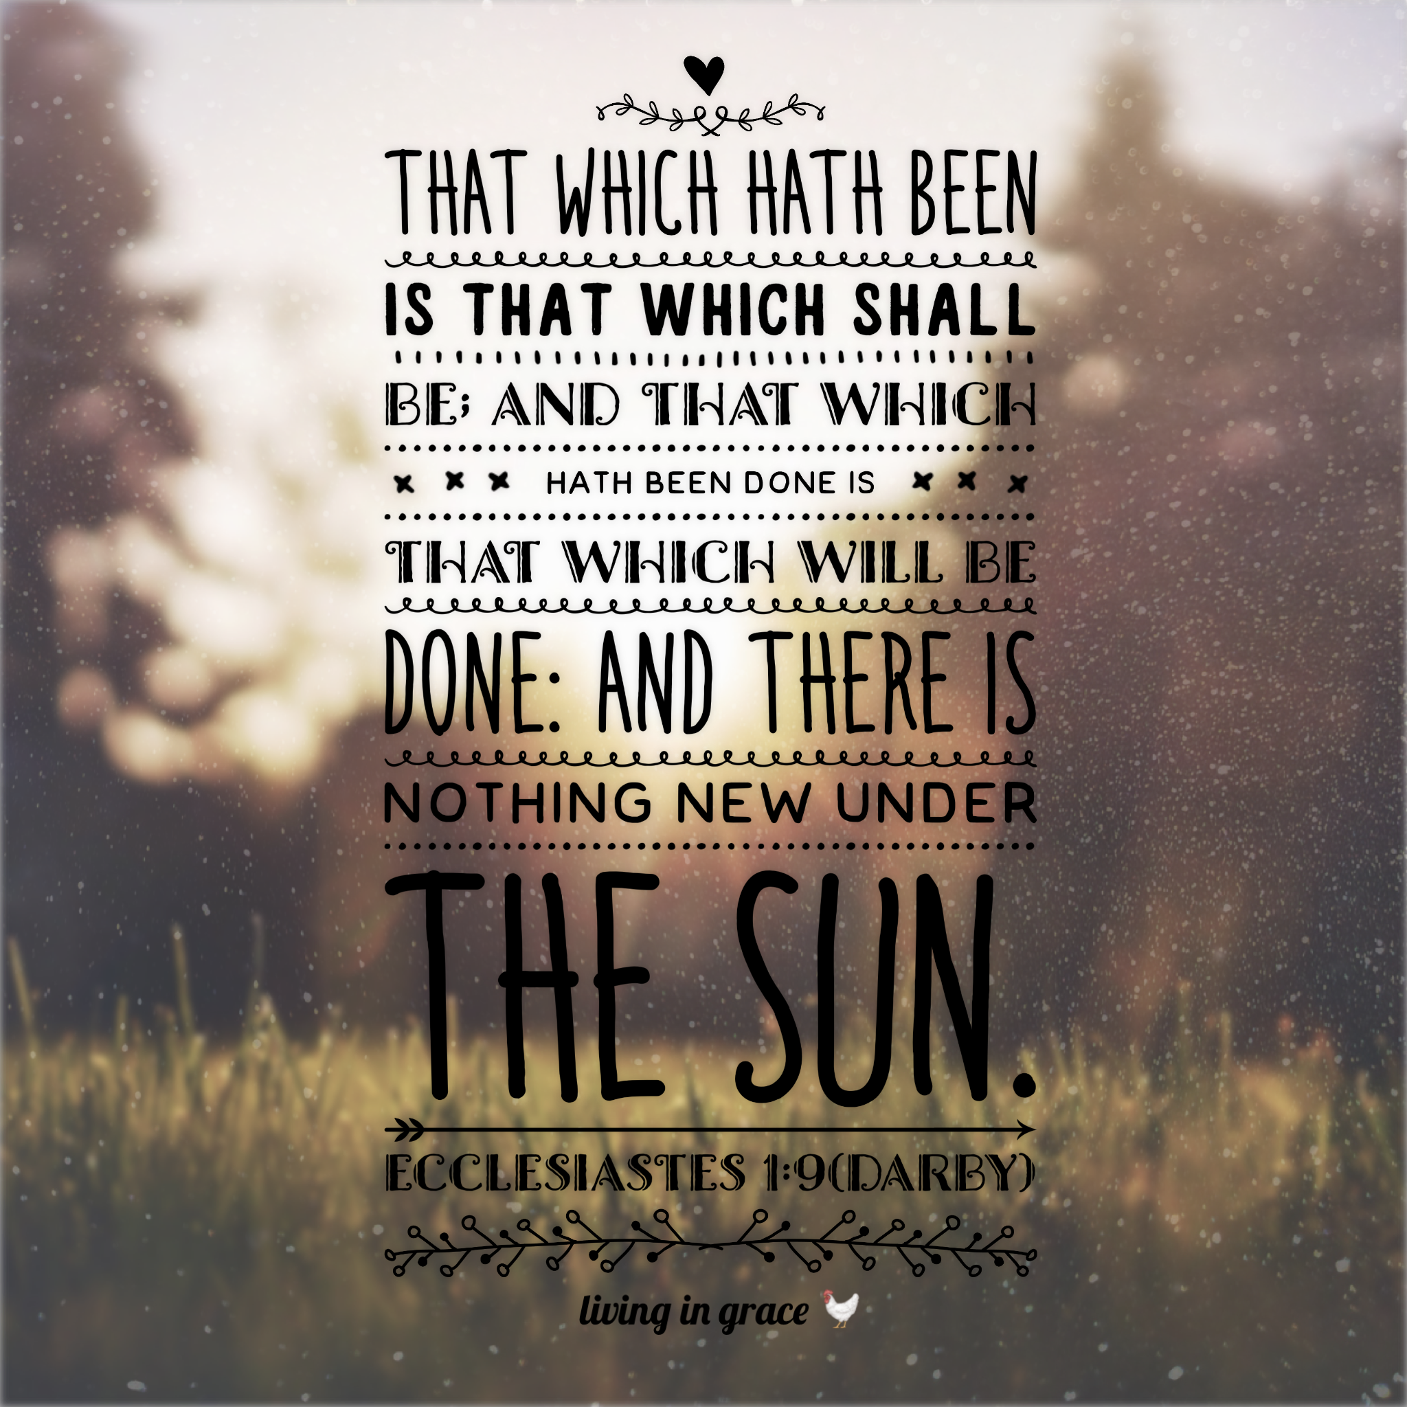
Happy OLD Year!

Slide 3
A New Beginning
We must learn to live each day, each hour, yes, each minute as a new beginning, as a unique opportunity to make everything new. Imagine that we could live each moment as a moment pregnant with new life. Imagine that we could live each day as a day full of promises. Imagine that we could walk through the new year always listening to the voice saying to us: “I have a gift for you and can’t wait for you to see it!” Imagine.
Is it possible that our imagination can lead us to the truth of our lives? Yes, it can! The problem is that we allow our past, which becomes longer and longer each year, to say to us: “You know it all; you have seen it all, be realistic; the future will just be a repeat of the past. Try to survive it as best you can.” There are many cunning foxes jumping on our shoulders and whispering in our ears the great lie: “There is nothing new under the sun... don’t let yourself be fooled.”

Slide 4
A New Beginning
When we listen to these foxes, they eventually prove themselves right: our new year, our new day, our new hour become flat, boring, dull, and without anything new.
So what are we to do? First, we must send the foxes back to where they belong: in their foxholes. And then we must open our minds and our hearts to the voice that resounds through the valleys and hills of our life saying: “Let me show you where I live among my people. My name is ‘God-with-you.’ I will wipe all the tears from your eyes; there will be no more death, and no more mourning or sadness. The world of the past has gone” (Revelation 21:2–5).
(Henri Nouwen)

Slide 5
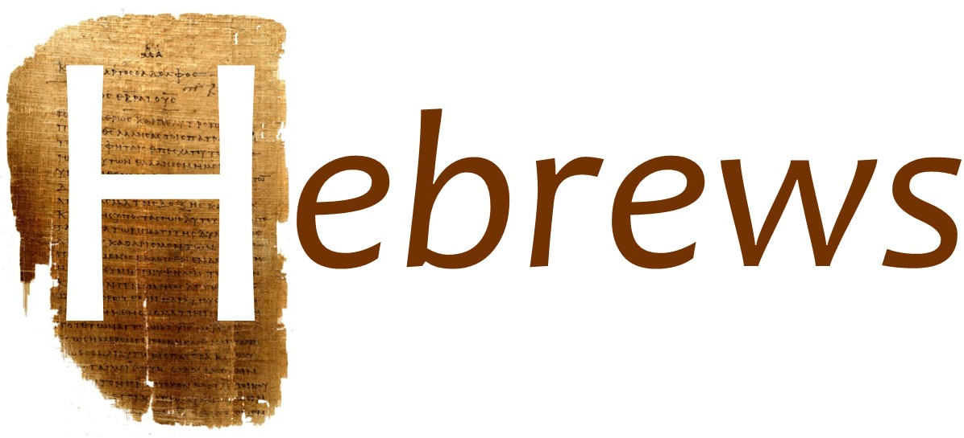
A Letter To An Old Church
³² Remember those earlier days after you had received the light, when you stood your ground in a great contest in the face of suffering.
(Hebrews 10)

Slide 6
Bethlehem turned 120 years old last week. We have been around a long time. And O how easy it is in an old church to get tired and begin to coast. Or to get diverted with mere maintenance ministries. Or to get careless in spiritual vigilance. Or to quench the Holy Spirit with passionless, dead, dutiful religious exercises. I don't think that has happened to us. But O how real is the danger! And the book of Hebrews was written to keep it from happening.
And so the writer says (in 3:12), "Take care, brethren, [that is, fight the fight! Run the race!] lest there be in any of you an evil heart of unbelief leading you to fall away from the living God." And in 12:12–14 he says, "Lift your drooping hands and strengthen your weak knees, and make straight paths for your feet, so that what is lame may not be put out of joint but rather be healed. Pursue peace with all men, and the holiness without which no one will see the Lord"—there it is: Run the race! Fight the fight! Pursue peace! Pursue holiness!
Hebrews 12:1 is a trumpet call (or the warning gun that the last laps are starting) to see our life as a race to be run with passion and zeal and energy and discipline. When he says, "lay aside every weight and sin which clings so closely [or so easily distracts]," he meant "get serious about the race!”
(John Piper)

Slide 7
¹ Therefore, since we are surrounded by such a great cloud of witnesses, let us throw off everything that hinders and the sin that so easily entangles. And let us run with perseverance the race marked out for us, ² fixing our eyes on Jesus, the pioneer and perfecter of faith. For the joy that was set before him he endured the cross, scorning its shame, and sat down at the right hand of the throne of God. ³ Consider him who endured such opposition from sinners, so that you will not grow weary and lose heart. (Hebrews 12)

Slide 8
Encouragement To Keep Running
¹ Therefore, since we are surrounded by such a great cloud of witnesses …
(Hebrews 12)

Slide 9
martureo - giving of a testimony
⁴ By faith Abel offered God a better sacrifice than Cain did. By faith he was commended as a righteous man, when God spoke well of his offerings. And by faith he still speaks, even though he is dead. (Hebrews 11)

Slide 10
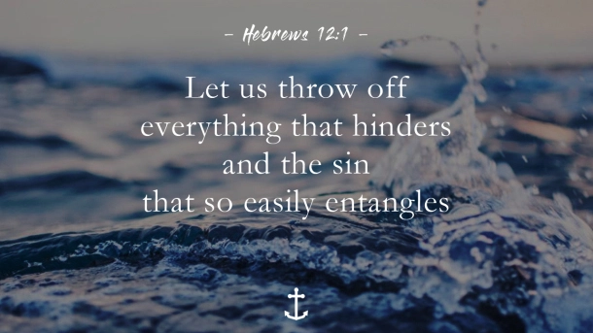

Slide 11
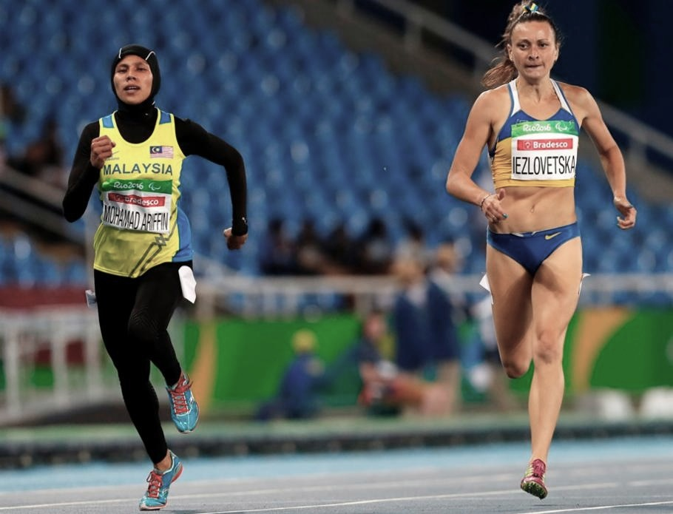
Everything That Hinders
Encumbrance

Slide 12
I remember the effect this verse had on me as a boy when I heard someone explain that we must lay aside not only entangling sins, but “every encumbrance,” that is, every weight or obstacle — things that in themselves may not be sins.
This was revolutionary. What it did (and I hope it does the same for you) was show me that the fight of faith — the race of the Christian life — is not fought well or run well by asking, “what’s wrong with this or that?” but by asking, “Is it in the way of greater faith and greater love and greater purity and greater courage and greater humility and greater patience and greater self-control?” Not, “Is it a sin?” but, “Does it help me run? Is it in the way?”
I commend it to you young people especially. Don’t ask about your music, your movies, your parties, your habits: What’s wrong with it? Ask: Does it help me run the race? Does it help me run for Jesus?
Hebrews 12:1 is a command to look at your life, think hard about what you are doing, and get ruthless about what stays and what goes.
(John Piper, “Running With The Witnesses”)

Slide 13
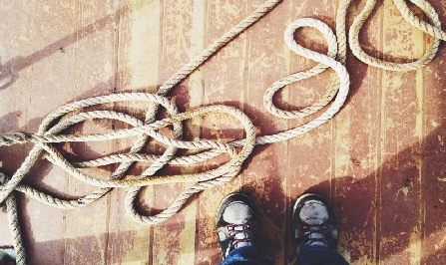
The Sin That So Easily Entangles
This doesn’t refer only to certain besetting sins, but to all sins. Sin always begins in the mind, and so we must judge all sin at the thought level. Pride, lust, envy, greed, anger, grumbling, selfishness—all of these things originate in our thought life. If you cut it off there, it goes no farther. If you entertain these things, they incubate and develop into sinful words and actions (James 1:14-15). But the author’s point is, you can’t run the Christian race if you keep tripping over your sins.
(Steven J Cole, "Faith To Run The Christian Marathon”)

Slide 16
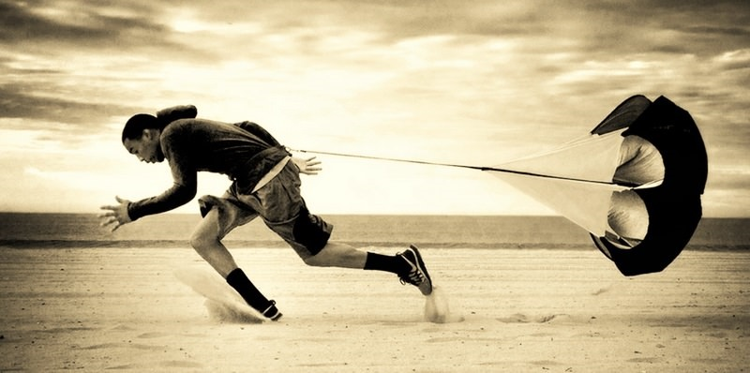
Run With Perseverance

Slide 18
² fixing our eyes on Jesus, the pioneer and perfecter of faith. For the joy that was set before him he endured the cross, scorning its shame, and sat down at the right hand of the throne of God. ³ Consider him who endured such opposition from sinners, so that you will not grow weary and lose heart. (Hebrews 12)

Slide 19
⁶ being confident of this, that he who began a good work in you will carry it on to completion until the day of Christ Jesus.
(Philippians 1)

Slide 20
The Motivation To Persevere
¹¹ After the suffering of his soul, he will see the light of life and be satisfied; by his knowledge my righteous one servant will justify many, and he will bear their iniquities. (Isaiah 53)
¹⁰ In bringing many sons to glory, it was fitting that God, for whom and through whom everything exists, should make the author of their salvation perfect through suffering. (Hebrews 2)

Slide 21
The Greatest Example of
Perseverance
³ Consider him who endured such opposition from sinners, so that you will not grow weary and lose heart. (Hebrews 12)
⁴ In your struggle against sin, you have not yet resisted to the point of shedding your blood. (Hebrews 12)

Slide 22
The Final Reward of Faith

Slide 23
⁸ Now there is in store for me the crown of righteousness, which the Lord, the righteous Judge, will award to me on that day – and not only to me, but also to all who have longed for his appearing.
(2 Timothy 4)

Slide 25
Run Beloved Run
You are surrounded By great and good companions
With witnesses who ran the race before you Now cheering you on Inspiring you with their courageous faith
With witnesses running beside you Churning up the dust of this well-traveled-path Encouraging you with the steady beat of their beautiful feet
Run beloved, run Lay aside every weight Every worry Every excuse Every inner critic shouting against inspiration

Slide 26
Lay aside the sin that clings so closely Every self-serving motivation Every self-medicating choice Every weak thing you’ve trusted more than God
Lay them aside and run
Run beloved, run Run with perseverance the race Daring Enduring Alive
Looking not to the dust, but to Jesus The Pioneer and Perfecter of your faith Look not to the right or to the left Look to Jesus Focus Follow

Slide 27
Jesus is The Way, opening the path The Truth, clearing the clutter The Light, blazing the trail
He runs He endures For the sake of the joy Of setting the joy before you and in you
Run Run remembering Joy is your strength Remember and endure For this race comes with a cross A course of blood and tears Mocking and piercing

Slide 28
Take it up Disregard its shame (that ancient enemy) Let it fall by the wayside Tired scraps on the breath of new life
Take it up and run Sit down in the next life Not this one
Run beloved, run Following and looking and remembering him who endured So that you may not grow weary Or lose heart For your strongest step is yet to come
(Lisa Ann Moss Degrenia)

