Slide 2
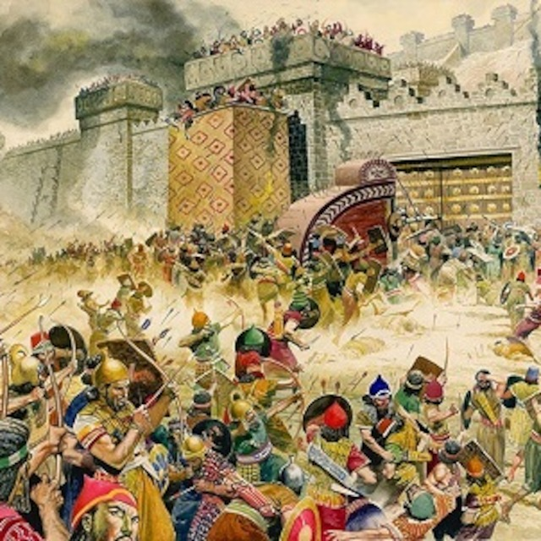
Background to Isaiah 52
The nation of Israel was divided into the northern and southern kingdoms (1 Kings 12:16)
Judah (S) tried to stay faithful to God, but Israel (N) had strayed far from Him
Israel had already been demolished by the Assyrian army in 722 BC (2 Kings 17:5-6)
Isaiah lived in Judah and prophesied from about 700 to 680 BC
Jerusalem was in Judah

Slide 3
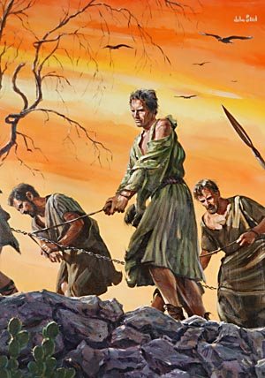
Isaiah 52: 1-2 – Setting the stage
52 Awake, awake, Zion, clothe yourself with strength! Put on your garments of splendor, Jerusalem, the holy city. The uncircumcised and defiled will not enter you again. ² Shake off your dust; rise up, sit enthroned, Jerusalem. Free yourself from the chains on your neck, Daughter Zion, now a captive.

Slide 4
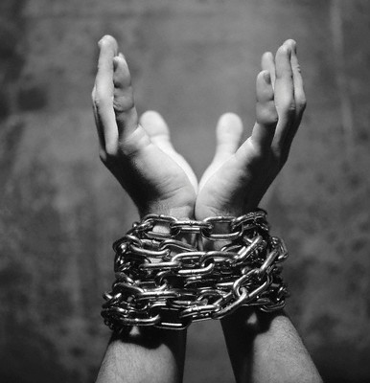
Are you captive to sin?
If you have strayed far from God and do not know the salvation from Jesus
He will save you if you ask Him
Romans 10:13 “For everyone who calls upon the name of the Lord will be saved.”

Slide 5
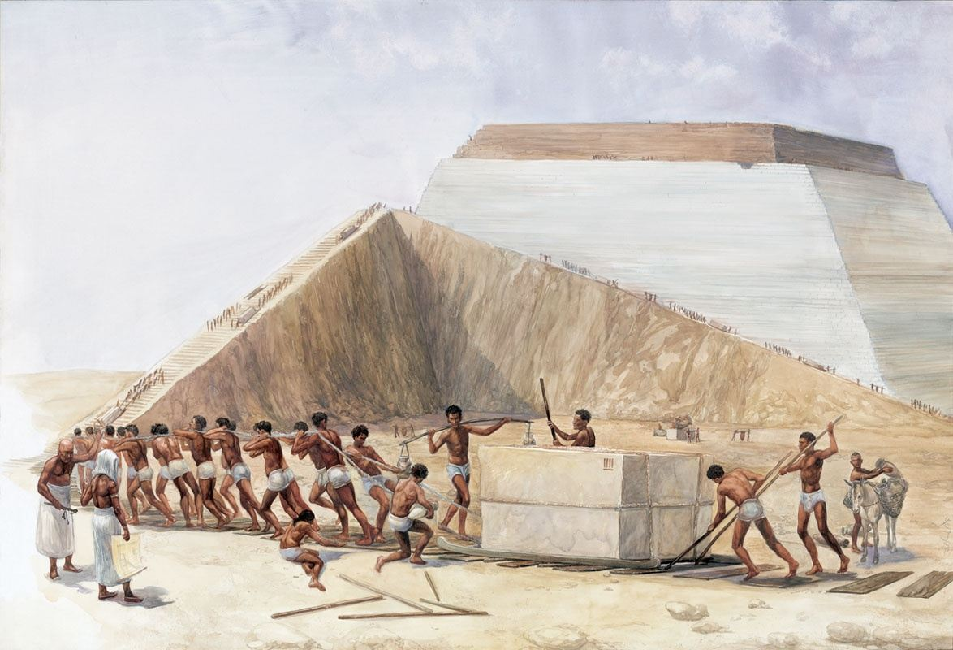
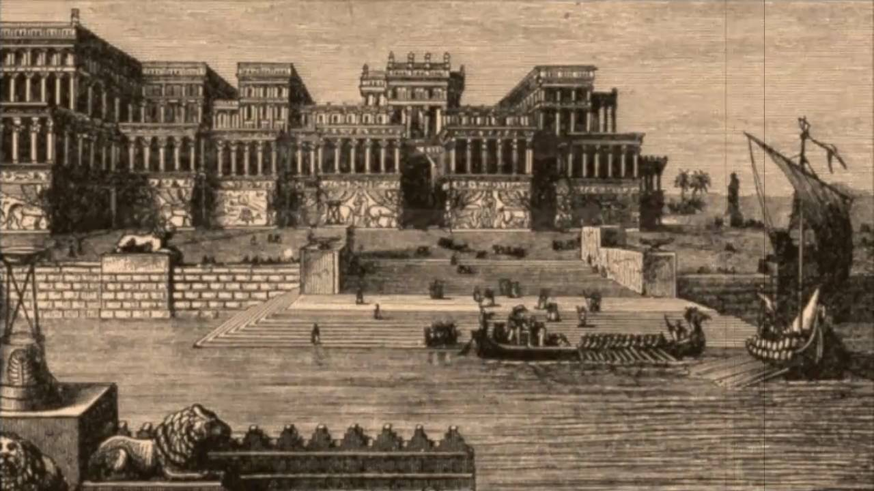
Isaiah 52: 3-4 – Israel’s Bondage
³ For this is what the Lord says:
“You were sold for nothing, and without money you will be redeemed.”
⁴ For this is what the Sovereign Lord says:
“At first my people went down to Egypt to live; lately, Assyria has oppressed them.

Slide 6
Isaiah 52:5-6 – Judah’s Bondage
⁵ “And now what do I have here?” declares the Lord.
“For my people have been taken away for nothing, and those who rule them mock,” declares the Lord. “And all day long my name is constantly blasphemed. ⁶ Therefore my people will know my name; therefore in that day they will know that it is I who foretold it. Yes, it is I.”

Slide 7
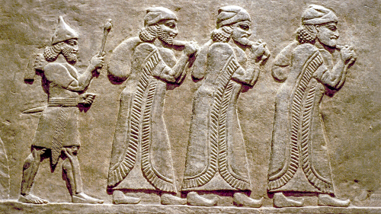
Prophesying Judah’s captivity and return
After Israel was exiled by the Assyrians in 722 BC, Judah remained free for over 100 years under the rule of godly kings Hezekiah and Josiah, but then no other kings of Judah obeyed God
Isaiah prophesied this from about 700 to 680 BC
In 586 BC, Judah was conquered by Babylon and all of its people were forced to leave as slaves (Jeremiah 52:12-16)

Slide 8
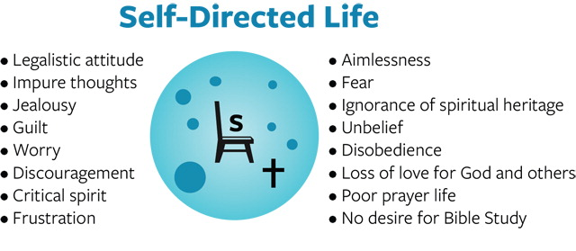
Are you captive to sin?
If you are a Christian but exhibit some of these characteristics (Galatians 5:19-21)

Slide 9
Isaiah 52:7 - Prophesying release
⁷ How beautiful on the mountains are the feet of those
who bring good news, who proclaim peace, who bring good tidings, who proclaim salvation, who say to Zion, “Your God reigns!”

Slide 10
You can be released from captivity!
Allow Christ to reign in your life (Gal. 5:22-23)

Slide 11
Prophesying all of Israel’s return
Persia conquered Babylon in 539 BC and Jews were permitted to return to Jerusalem, a ravaged city (Ezra 1 – 2)
King Cyrus the Persian feared God (Ezra 1:1-2)
He allowed the Jews to rebuild the Temple in Jerusalem, led by Ezra (Ezra 3:8)
Later, King Artaxerxes allowed Nehemiah to take people and return to build the walls of Jerusalem around 440 BC (Nehemiah 2:1-6)

Slide 12
Prophesying the return of the Lord to Jerusalem
⁸ Listen! Your watchmen lift up their voices; together they shout for joy. When the Lord returns to Zion, they will see it with their own eyes. ⁹ Burst into songs of joy together, you ruins of Jerusalem, for the Lord has comforted his people, he has redeemed Jerusalem. ¹⁰ The Lord will lay bare his holy arm in the sight of all the nations, and all the ends of the earth will see the salvation of our God.

Slide 13
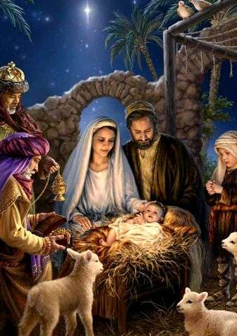
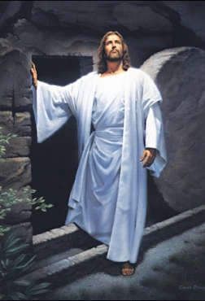
Prophesying Jesus
Isaiah 52:13-15 and all of Isaiah 53 prophesy about Jesus
God in flesh was coming to Jerusalem (Is. 52:8)
He was coming to save Israel and all mankind (Is. 53:5-6)

Slide 14
Our God Reigns!
The salvation of our God - He sets us free from captivity to sin
God reigns throughout history
God reigns in every area of our life
We can tell the world around us about His greatness

Slide 15
Psalm 145
¹ I will exalt you, my God the King; I will praise your name for ever and ever. ² Every day I will praise you and extol your name for ever and ever.
³ Great is the Lord and most worthy of praise; his greatness no one can fathom. ⁴ One generation commends your works to another; they tell of your mighty acts. ⁵ They speak of the glorious splendor of your majesty— and I will meditate on your wonderful works. ⁶ They tell of the power of your awesome works— and I will proclaim your great deeds. ⁷ They celebrate your abundant goodness and joyfully sing of your righteousness.

Slide 16
⁸ The Lord is gracious and compassionate, slow to anger and rich in love.
⁹ The Lord is good to all; he has compassion on all he has made. ¹⁰ All your works praise you, Lord; your faithful people extol you. ¹¹ They tell of the glory of your kingdom and speak of your might, ¹² so that all people may know of your mighty acts and the glorious splendor of your kingdom. ¹³ Your kingdom is an everlasting kingdom, and your dominion endures through all generations.
The Lord is trustworthy in all he promises and faithful in all he does.

Slide 17
¹⁴ The Lord upholds all who fall and lifts up all who are bowed down. ¹⁵ The eyes of all look to you, and you give them their food at the proper time. ¹⁶ You open your hand and satisfy the desires of every living thing.
¹⁷ The Lord is righteous in all his ways and faithful in all he does. ¹⁸ The Lord is near to all who call on him, to all who call on him in truth. ¹⁹ He fulfills the desires of those who fear him; he hears their cry and saves them. ²⁰ The Lord watches over all who love him, but all the wicked he will destroy.
²¹ My mouth will speak in praise of the Lord. Let every creature praise his holy name for ever and ever.

