Slide 1
Isaiah 66:1-2
“Heaven is my throne, and the earth is my footstool. Where is the house you will build for me? Where will my resting place be? ² Has not my hand made all these things, and so they came into being?” declares the Lord
“These are the ones I look on with favour: those who are humble and contrite in spirit, and who tremble at my word.

Slide 2
Walking in awe of God 5th May 2019

Slide 3
Proverbs 9:10a-11
The fear of the Lord is the beginning of wisdom.
For through wisdom your days will be many, and years will be added to your life.

Slide 4
Proverbs 9:10a-11 (The reverse)
The lack of fear of the Lord is the beginning of folly (and many many problems).
For through folly your days will be few, and years will be cut short (wasted).

Slide 5
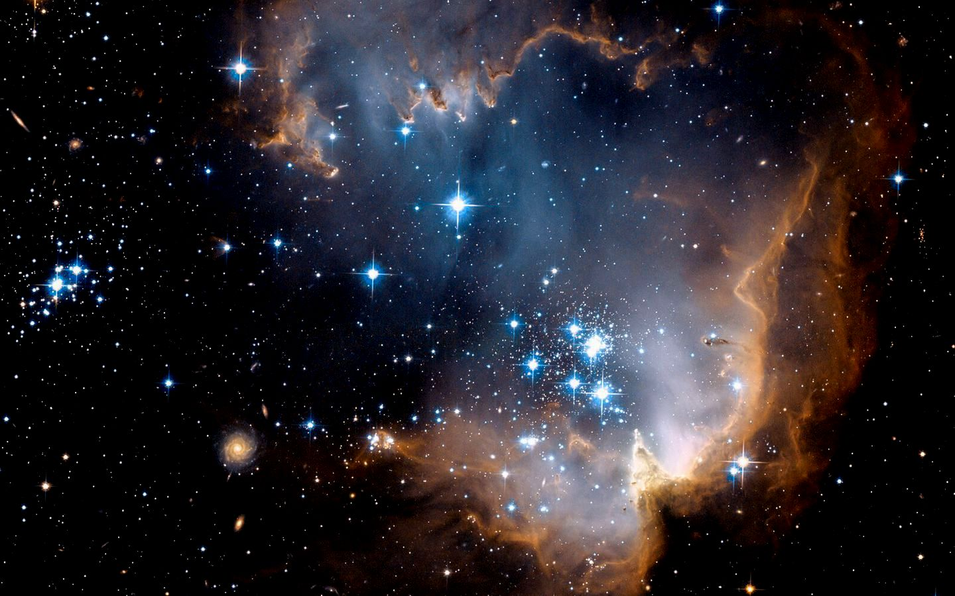
Do we realize how big our God is?
Heaven is my throne, earth is my footstool
Isaiah 66:1a

Slide 6
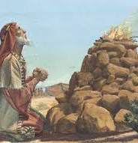
God has no needs
Where is the house you will build for me? Where will my resting place be? ² Has not my hand made all these things, and so they came into being?” declares the Lord

Slide 7
Isaiah 66:3
But whoever sacrifices a bull is like one who kills a person, and whoever offers a lamb is like one who breaks a dog's neck

Slide 8
The one I look with favour – the humble and contrite in spirit

Slide 9
The one who trembles at His Word

Slide 10
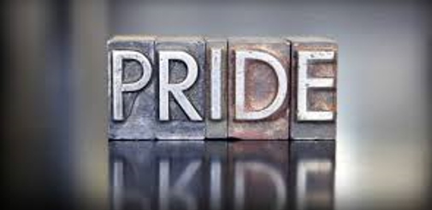
The Root is Pride
Pride goes before destruction, a haughty spirit before a fall - Proverbs 16:18

Slide 11
Make a Sober Judgment of ourselves

Slide 12
I will only boast of my weaknesses - Paul
“My grace is sufficient for you, for my power is made perfect in weakness.” Therefore I will boast all the more gladly about my weaknesses, so that Christ’s power may rest on me.

Slide 13
Attitude Like Christ’s
Who, being in very nature God, did not consider equality with God something to be used to his own advantage; rather, he made himself nothing by taking the very nature of a servant, being made in human likeness.

Slide 14
Summary
A need to have a sense of awe and reverence for God.
Fear of God is the pathway to wisdom (and all kinds of benefits and our well being)
God is BIG, he does not need anything from us.
God sets his eyes on the one who is humble and takes His word seriously
We must deal with PRIDE because it stands in the way to our devotion to God
3 Suggestions to deal with PRIDE. - Come back to the point of lowliness and complete dependence on God. - Confess our weaknesses. - Imitate Christ’s humility.

