Slide 1
Overview Part 2

Slide 2
Focus For 2019

Slide 3
Lessons From A Messy Church
Divisions
Disorder
Difficulties

Slide 4
Difficulties
¹ Now for the matters you wrote about: (1 Corinthians 7)

Slide 5
Liberty & License

Slide 6
“There is no God but one.” ⁵ For even if there are so-called gods, whether in heaven or on earth (as indeed there are many “gods” and many “lords”) (1 Corinthians 8)

Slide 7
Scenario 1
⁷ But not everyone possesses this knowledge. Some people are still so accustomed to idols that when they eat sacrificial food they think of it as having been sacrificed to a god, and since their conscience is weak, it is defiled. ⁸ But food does not bring us near to God; we are no worse if we do not eat, and no better if we do.
⁹ Be careful, however, that the exercise of your rights does not become a stumbling block to the weak. ¹⁰ For if someone with a weak conscience sees you, with all your knowledge, eating in an idol’s temple, won’t that person be emboldened to eat what is sacrificed to idols? ¹¹ So this weak brother or sister, for whom Christ died, is destroyed by your knowledge.¹² When you sin against them in this way and wound their weak conscience, you sin against Christ. ¹³ Therefore, if what I eat causes my brother or sister to fall into sin, I will never eat meat again, so that I will not cause them to fall. (1 Corinthians 8)

Slide 8
Scenario 2
²⁵ Eat anything sold in the meat market without raising questions of conscience, ²⁶ for, “The earth is the Lord’s, and everything in it.”
(1 Corinthians 10)

Slide 9
The Core Principle
¹ Now about food sacrificed to idols: we know that ‘We all possess knowledge.’ But knowledge puffs up while love builds up. ² Those who think they know something do not yet know as they ought to know.
(1 Corinthians 8)

Slide 10
²³ ‘I have the right to do anything,’ you say – but not everything is beneficial. ‘I have the right to do anything’– but not everything is constructive. ²⁴ No one should seek their own good, but the good of others.
(1 Corinthians 10)

Slide 11
³¹ So whether you eat or drink or whatever you do, do it all for the glory of God. ³² Do not cause anyone to stumble, whether Jews, Greeks or the church of God – ³³ even as I try to please everyone in every way. For I am not seeking my own good but the good of many, so that they may be saved. (1 Corinthians 10)

Slide 12
Weekly Gatherings & Worship
¹ Now about the gifts of the Spirit, brothers and sisters, I do not want you to be uninformed. (1 Corinthians 12)

Slide 13
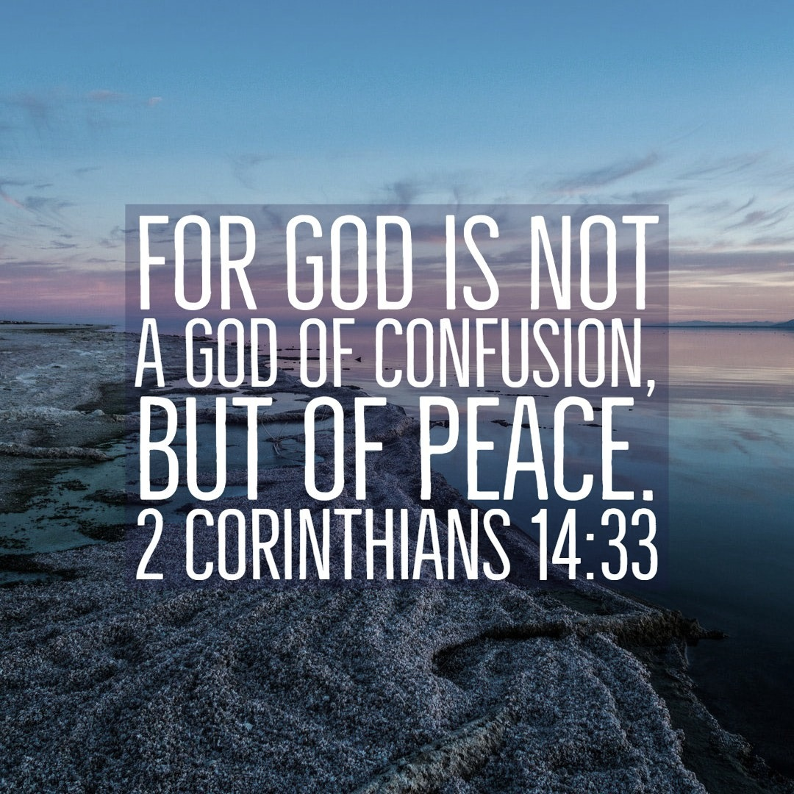
Chaos & Distraction
²⁶ What then shall we say, brothers and sisters? When you come together, each of you has a hymn, or a word of instruction, a revelation, a tongue or an interpretation. Everything must be done so that the church may be built up. ²⁷ If anyone speaks in a tongue, two – or at the most three – should speak, one at a time, and someone must interpret. ²⁸ If there is no interpreter, the speaker should keep quiet in the church and speak to himself and to God.
²⁹ Two or three prophets should speak, and the others should weigh carefully what is said. ³³ For God is not a God of disorder but of peace – as in all the congregations of the Lord’s people. (1 Corinthians 14)

Slide 14
The Two ‘Everything’
²⁶ Everything must be done so that the church may be built up.
(1 Corinthians 14)
⁴⁰ But everything should be done in a fitting and orderly way. (1 Corinthians 14)

Slide 15
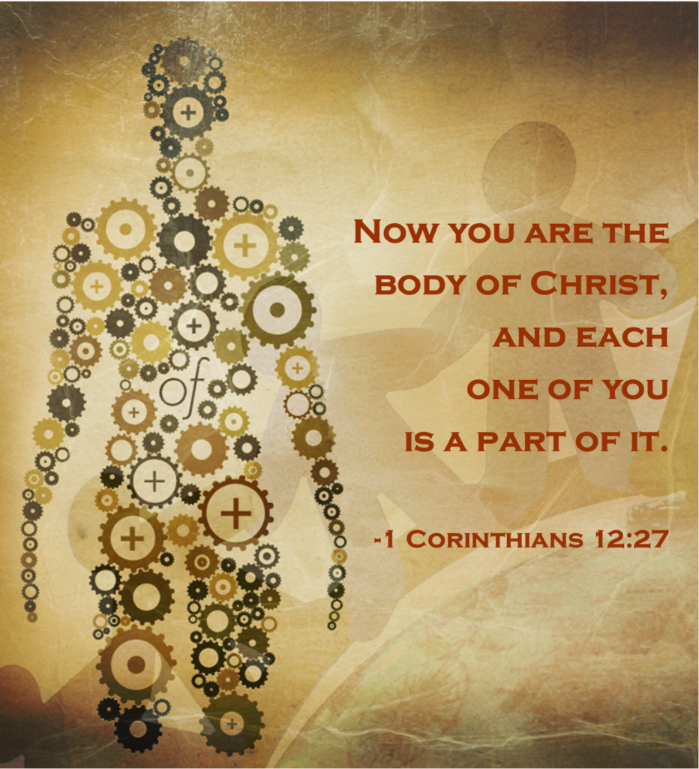
The Church
¹² Just as a body, though one, has many parts, but all its many parts form one body, so it is with Christ. ¹³ For we were all baptised by one Spirit so as to form one body – whether Jews or Gentiles, slave or free – and we were all given the one Spirit to drink. ¹⁴ And so the body is not made up of one part but of many… ¹⁹ If they were all one part, where would the body be? ²⁰ As it is, there are many parts, but one body.
(1 Corinthians 12)

Slide 16
Different BUT Same
⁴ There are different kinds of gifts, but the same Spirit distributes them. ⁵ There are different kinds of service, but the same Lord. ⁶ There are different kinds of working, but in all of them and in everyone it is the same God at work.
⁷Now to each one the manifestation of the Spirit is given for the common good.
¹¹ All these are the work of one and the same Spirit, and he distributes them to each one, just as he determines.
(1 Corinthians 12)

Slide 17
¹ If I speak in the tongues of men or of angels, but do not have love, I am only a resounding gong or a clanging cymbal. ² If I have the gift of prophecy and can fathom all mysteries and all knowledge, and if I have a faith that can move mountains, but do not have love, I am nothing. ³ If I give all I possess to the poor and give over my body to hardship that I may boast, but do not have love, I gain nothing.
(1 Corinthians 13)

Slide 18
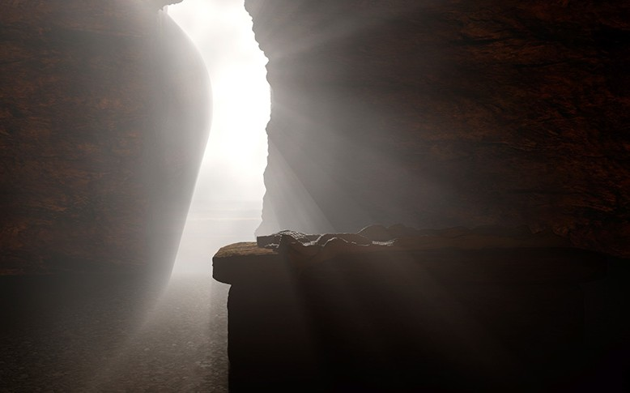
Death & Resurrection
¹² But if it is preached that Christ has been raised from the dead, how can some of you say that there is no resurrection of the dead? (1 Corinthians 15)

Slide 19
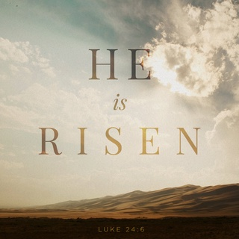
¹ Now, brothers and sisters, I want to remind you of the gospel I preached to you, which you received and on which you have taken your stand. ² By this gospel you are saved, if you hold firmly to the word I preached to you. Otherwise, you have believed in vain.
³ For what I received I passed on to you as of first importance: that Christ died for our sins according to the Scriptures, ⁴ that he was buried, that he was raised on the third day according to the Scriptures, ⁵ and that he appeared to Cephas, and then to the Twelve.
³ ⁶ After that, he appeared to more than five hundred of the brothers and sisters at the same time, most of whom are still living, though some have fallen asleep. ⁷ Then he appeared to James, then to all the apostles, ⁸ and last of all he appeared to me also, as to one abnormally born.
(1 Corinthians 15)

Slide 20
¹³ If there is no resurrection of the dead, then not even Christ has been raised. ¹⁴ And if Christ has not been raised, our preaching is useless and so is your faith. ¹⁵ More than that, we are then found to be false witnesses about God, for we have testified about God that he raised Christ from the dead. But he did not raise him if in fact the dead are not raised. ¹⁶ For if the dead are not raised, then Christ has not been raised either. ¹⁷ And if Christ has not been raised, your faith is futile; you are still in your sins. ¹⁸ Then those also who have fallen asleep in Christ are lost. ¹⁹ If only for this life we have hope in Christ, we are of all people most to be pitied. (1 Corinthians 15)

Slide 21
²⁰ But Christ has indeed been raised from the dead, the firstfruits of those who have fallen asleep. ²¹ For since death came through a man, the resurrection of the dead comes also through a man. ²² For as in Adam all die, so in Christ all will be made alive. ²³ But each in turn: Christ, the firstfruits; then, when he comes, those who belong to him. ²⁴ Then the end will come, when he hands over the kingdom to God the Father after he has destroyed all dominion, authority and power. ²⁵ For he must reign until he has put all his enemies under his feet. (1 Corinthians 15)

Slide 22
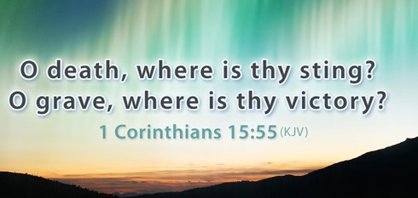
²⁶ The last enemy to be destroyed is death. ²⁷ For he ‘has put everything under his feet’.
‘Death has been swallowed up in victory.’
⁵⁵ ‘Where, O death, is your victory? Where, O death, is your sting?’
⁵⁶ The sting of death is sin, and the power of sin is the law. ⁵⁷ But thanks be to God! He gives us the victory through our Lord Jesus Christ. (1 Corinthians 15)

Slide 23
Unshakeable Confidence
²² For as in Adam all die, so in Christ all will be made alive. (1 Corinthians 15)
¹⁰ because you will not abandon me to the realm of the dead, nor will you let your faithful one see decay.
¹¹ You make known to me the path of life; you will fill me with joy in your presence, with eternal pleasures at your right hand. (Psalm 16)

Slide 24
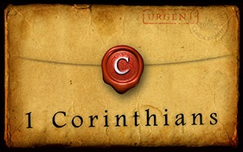
Response
An Epistle To The 21st century

Slide 25
Response

