Slide 1
1 Corinthians 3:1-9
CARNAL
Christians

Slide 2
The Corinthian Church
Divisions
Disorder
Difficulties

Slide 3
The Root of The Problem
¹ Brothers and sisters, I could not address you as people who live by the Spirit but as people who are still worldly – mere infants in Christ.
(1 Corinthians 3)

Slide 4
The Two Man
Natural
Spiritual

Slide 5
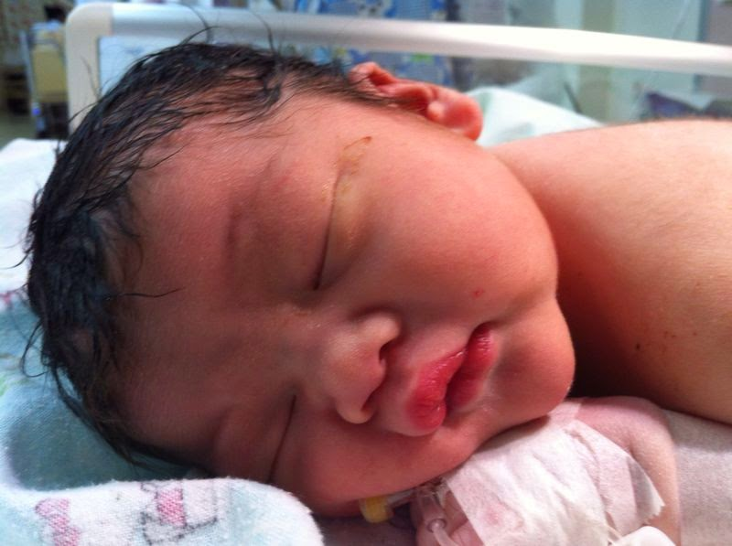
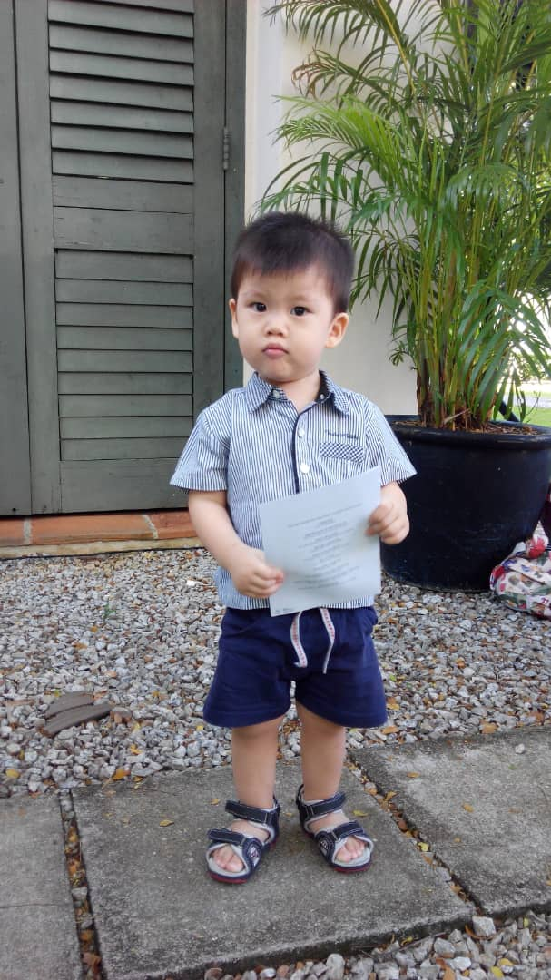
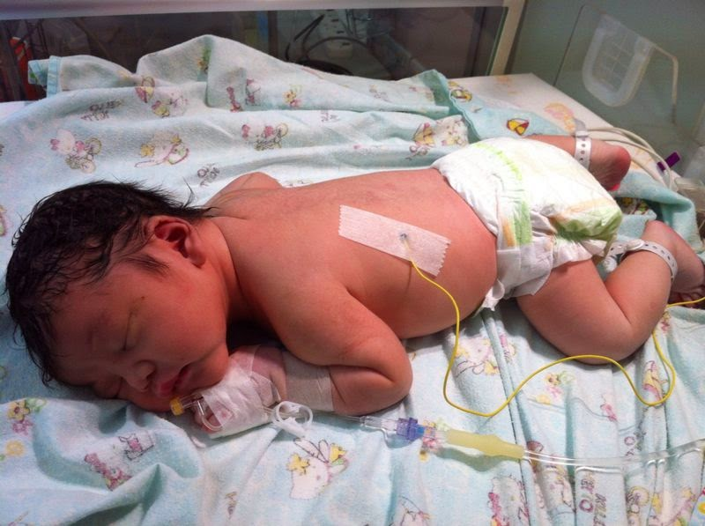

Slide 6
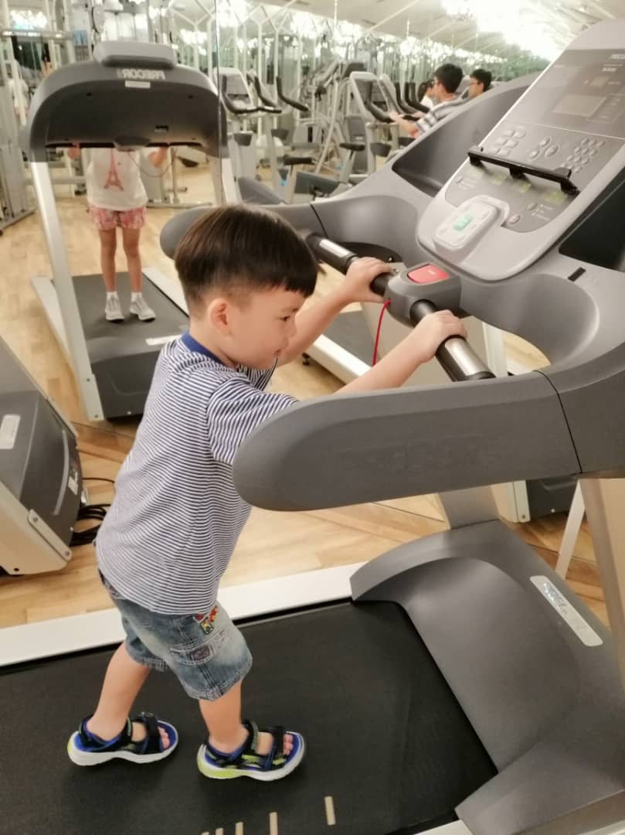
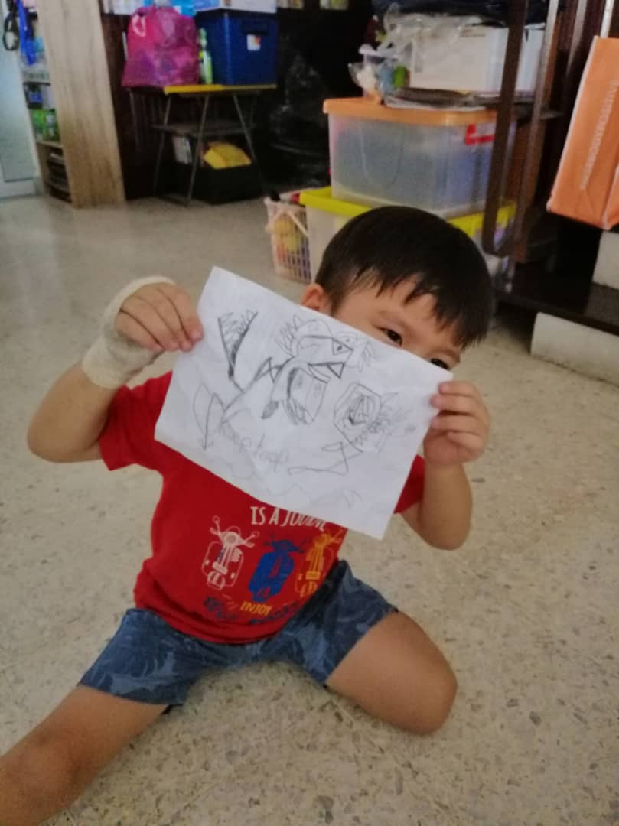

Slide 7
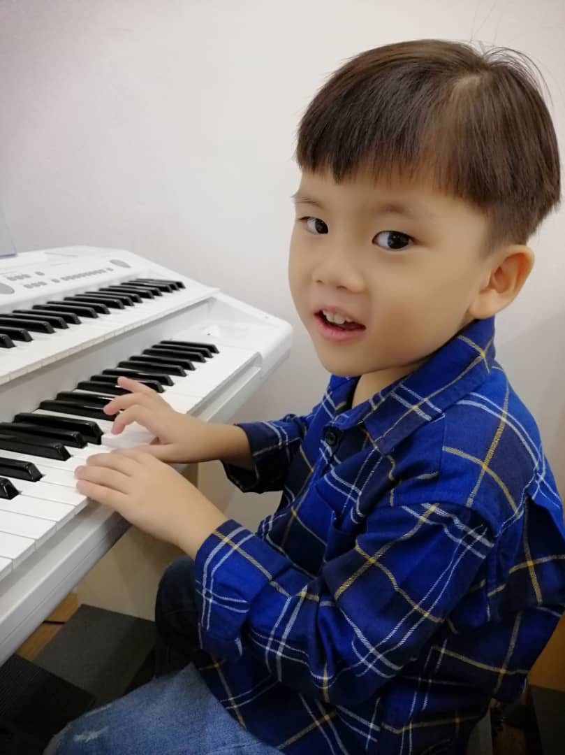

Slide 8
Wordly
¹ Brothers and sisters, I could not address you as people who live by the Spirit but as people who are still worldly – mere infants in Christ.
(1 Corinthians 3)

Slide 9
Worldly
¹ Brothers and sisters, I could not address you as people who live by the Spirit but as people who are still worldly – mere infants in Christ. ² I gave you milk, not solid food, for you were not yet ready for it. Indeed, you are still not ready. ³ You are still worldly. For since there is jealousy and quarrelling among you, are you not worldly? Are you not acting like mere humans? ⁴ For when one says, ‘I follow Paul,’ and another, ‘I follow Apollos,’ are you not mere human beings? (1 Corinthians 3)

Slide 10
Inner Conflict
Every Christian is carnal in some area of his life at many times in his life. (Bob Deffinbaugh, “Substandard Saints”)

Slide 11
Who Will Win?

Slide 12
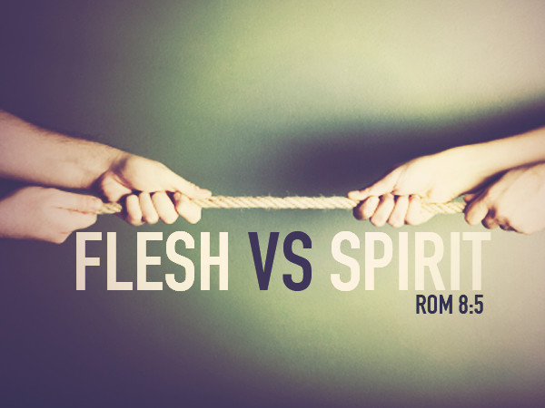
⁵ Those who live according to the flesh have their minds set on what the flesh desires; but those who live in accordance with the Spirit have their minds set on what the Spirit desires. ⁶ The mind governed by the flesh is death, but the mind governed by the Spirit is life and peace. ⁷ The mind governed by the flesh is hostile to God; it does not submit to God’s law, nor can it do so. ⁸ Those who are in the realm of the flesh cannot please God. (Romans 8)

Slide 13
⁹ You, however, are not in the realm of the flesh but are in the realm of the Spirit, if indeed the Spirit of God lives in you.
¹² Therefore, brothers and sisters, we have an obligation – but it is not to the flesh, to live according to it. ¹³ For if you live according to the flesh, you will die; but if by the Spirit you put to death the misdeeds of the body, you will live. (Romans 8)

Slide 14
Spiritual Infancy
² I gave you milk, not solid food, for you were not yet ready for it. Indeed, you are still not ready. (1 Corinthians 3)

Slide 15
Arrested Development
¹² In fact, though by this time you ought to be teachers, you need someone to teach you the elementary truths of God’s word all over again. You need milk, not solid food! ¹³ Anyone who lives on milk, being still an infant, is not acquainted with the teaching about righteousness. ¹⁴ But solid food is for the mature, who by constant use have trained themselves to distinguish good from evil.
(Hebrews 5)
¹ Therefore let us move beyond the elementary teachings about Christ and be taken forward to maturity, not laying again the foundation of repentance from acts that lead to death, and of faith in God, ² instruction about cleansing rites, the laying on of hands, the resurrection of the dead, and eternal judgment. (Hebrews 6)

Slide 16
Milk & Meat
Meat is preaching that unfolds the full riches and magnificence of the gospel so that people grow up. They stop being children, as Paul says in Ephesians 4, "...no longer to be children, tossed to and fro and carried about every wind of doctrine," (Ephesians 4:14 RSV). That requires the meat of the word. Christ died for my sins; that is milk. We died with Christ to sin: that is meat. That is what will free me from habits and attitudes that are irritating to others and that make me difficult to live with. The knowledge of the gifts of the Spirit -- that is milk. These Corinthians had that knowledge. Paul says right at the very beginning that they had all the gifts present among them so that "you are not lacking in any spiritual gift," he says (1 Corinthians 1:7 RSV). They knew all that, but that is milk. What they did not understand was how to produce the fruit of the Spirit, which is love. That is meat.

Slide 17
Milk & Meat
Later on Paul will point that out to them. He will discuss the gifts of the Spirit, and then he will say, "and I will show you a still more excellent way," (1 Corinthians 12:31b RSV). That is love.
When you rejoice in hope of sharing the glory of God, that is milk, that is looking forward to the glory coming at the end of life, but when you learn to rejoice in your sufferings because you know that God is working out something in your life that nothing else could do, that is meat. That is growing up as a Christian.
(Ray Stedman, “Carnal & Spiritual Christians”)

Slide 18
The Mark of Spiritual Infancy
⁴ For when one says, ‘I follow Paul,’ and another, ‘I follow Apollos,’
are you not mere human beings?
(1 Corinthians 3)

Slide 19
Cooperation NOT Competition
The evangelist plants, the Bible teacher waters. Well, which is more important, Bible teaching or evangelizing? Paul's answer is: "Neither!" God can do away with both of those. The important thing is not what either can do, but what God alone can do -- take that truth and change lives with it. Evangelists cannot do that. Bible teachers cannot do that. Only God gives increase. Only God opens the mind, changes the heart, and makes people different.
(Ray Stedman, "Carnal & Spiritual Christians”)

Slide 20
God Can Do It All

Slide 21
God’s Fellow Workers
⁹ For we are fellow workers in God’s service; you are God’s field, God’s building. (1 Corinthians 3)
²¹ In him the whole building is joined together and rises to become a holy temple in the Lord. ²² And in him you too are being built together to become a dwelling in which God lives by his Spirit.
(Ephesians 2)

Slide 22
The Danger of Being Carnal
¹² Therefore, brothers and sisters, we have an obligation – but it is not to the flesh, to live according to it. ¹³ For if you live according to the flesh, you will die; but if by the Spirit you put to death the misdeeds of the body, you will live. (Romans 8)

Slide 23
The Seriousness of Spiritual Maturity
¹¹ When I was a child, I talked like a child, I thought like a child, I reasoned like a child. When I became a man, I put the ways of childhood behind me.
(1 Corinthians 13)

Slide 24
Goal
¹³ until we all reach unity in the faith and in the knowledge of the Son of God and become mature, attaining to the whole measure of the fullness of Christ. (Ephesians 4)

