Slide 1
Luke 15:11-32
Seek Recover Celebrate

Slide 2
The Lost!

Slide 3
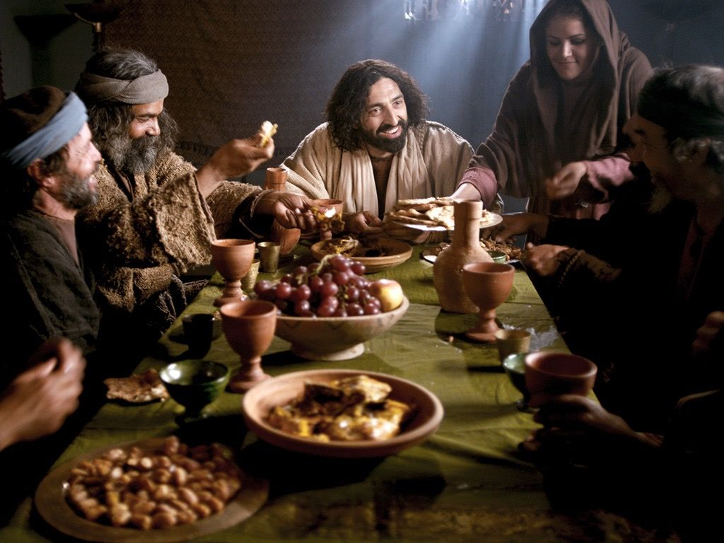
^{They muttered:}Jesus welcomes sinners and eats with them! v1-2
Then Jesus told them this parable v3

Slide 4
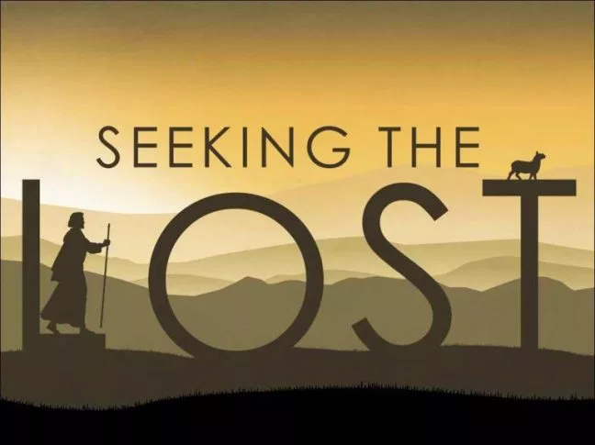
Lost sheep v4-7 1:100
Lost coin v8-10 1:10
Lost ________ v11-32
son vs brother 1:1

Slide 5
The required response:
To seek until found and rejoice when he/she/it is returned.
In the same way there is rejoicing over one who repents v7&10.

Slide 6
2. The spiritually lost
a. The younger brother
The sinners feasting with Jesus.
b. The elder brother
The religious purists condemning the sinners.

Slide 7
‘Look! All these years I’ve been slaving for you and never disobeyed your orders. Yet…

Slide 8
Going Forward
Seek them out?
Recover what is lost?
Celebrate their salvation?

