Slide 1
Marriage & Divorce
1 Corinthians 7:10-16, 39-40

Slide 2
1 Corinthians 7
¹⁰ To the married I give this command (not I, but the Lord): a wife must not separate from her husband. ¹¹ But if she does, she must remain unmarried or else be reconciled to her husband. And a husband must not divorce his wife.
¹² To the rest I say this (I, not the Lord): If any brother has a wife who is not a believer and she is willing to live with him, he must not divorce her. ¹³ And if a woman has a husband who is not a believer and he is willing to live with her, she must not divorce him. ¹⁴ For the unbelieving husband has been sanctified through his wife, and the unbelieving wife has been sanctified through her believing husband. Otherwise your children would be unclean, but as it is, they are holy.

Slide 3
1 Corinthians 7
¹⁵ But if the unbeliever leaves, let it be so. The brother or the sister is not bound in such circumstances; God has called us to live in peace. ¹⁶ How do you know, wife, whether you will save your husband? Or, how do you know, husband, whether you will save your wife?
³⁹ A woman is bound to her husband as long as he lives. But if her husband dies, she is free to marry anyone she wishes, but he must belong to the Lord. ⁴⁰ In my judgment, she is happier if she stays as she is – and I think that I too have the Spirit of God.

Slide 4
For The Matters You Wrote About
“In view of the sexual temptations we face in Corinth, is it perhaps better to take a vow of celibacy, to renounce marriage for life, and to withdraw from all contact with the opposite sex?”

Slide 5
Erroneous Thinking
But a segment of the church goes so far as to view divorce as the spiritual thing to do. Some Corinthian ascetics hold that sex is dirty, even within marriage. The next step is to look upon marriage as evil, something not unheard of in the churches (1 Timothy 4:3). If sex and marriage are unspiritual, does this mean that a “spiritual Christian” should seek to be loosed from the bonds of marriage? And what of those who find themselves married to an unbeliever? Paul has written in chapter 6 that the union of a Christian with a pagan prostitute has very serious spiritual implications (1 Corinthians 6:16). Is a Christian sinning every time he has sexual intercourse with his unbelieving spouse?
(Bob Deffinbaugh, “The Relationship Between Spirituality And Sexuality”)

Slide 6
Paul’s Instruction
Christian
Couples
Unequally Yoked Couples

Slide 7
Designed By God
¹⁸ The Lord God said, ‘It is not good for the man to be alone. I will make a helper suitable for him.’ ²⁴ That is why a man leaves his father and mother and is united to his wife, and they become one flesh. (Genesis 2)

Slide 8
The Lord’s Command
¹⁰ To the married I give this command (not I, but the Lord): a wife must not separate from her husband. ¹¹ But if she does, she must remain unmarried or else be reconciled to her husband. And a husband must not divorce his wife. (1 Corinthians 7)

Slide 9
⁴ ‘Haven’t you read,’ he replied, ‘that at the beginning the Creator “made them male and female,” ⁵ and said, “For this reason a man will leave his father and mother and be united to his wife, and the two will become one flesh”? ⁶ So they are no longer two, but one flesh. Therefore what God has joined together, let no one separate.’ (Matthew 19)

Slide 10
A Solemn Warning
¹⁵ … So guard yourself in your spirit, and do not break faith with the wife of your youth. ¹⁶ “I hate divorce,” says the Lord God of Israel …
(Malachi 2)

Slide 11
But Isn’t Divorce Allowed?
³¹ ‘It has been said, “Anyone who divorces his wife must give her a certificate of divorce.” ³² But I tell you that anyone who divorces his wife, except for sexual immorality, makes her the victim of adultery, and anyone who marries a divorced woman commits adultery. (Matthew 5)

Slide 12
A Question On Divorce
³ The Pharisees also came to Him, testing Him, and saying to Him, “Is it lawful for a man to divorce his wife for just any reason?”
⁴ And He answered and said to them, “Have you not read that He who made them at the beginning ‘made them male and female,’ ⁵ and said, ‘For this reason a man shall leave his father and mother and be joined to his wife, and the two shall become one flesh’? ⁶ So then, they are no longer two but one flesh. Therefore what God has joined together, let not man separate.”
⁷ They said to Him, “Why then did Moses command to give a certificate of divorce, and to put her away?”
⁸ He said to them, “Moses, because of the hardness of your hearts, permitted you to divorce your wives, but from the beginning it was not so. ⁹ And I say to you, whoever divorces his wife, except for sexual immorality, and marries another, commits adultery; and whoever marries her who is divorced commits adultery.”
¹⁰ His disciples said to Him, “If such is the case of the man with his wife, it is better not to marry.”
(Matthew 19)

Slide 13
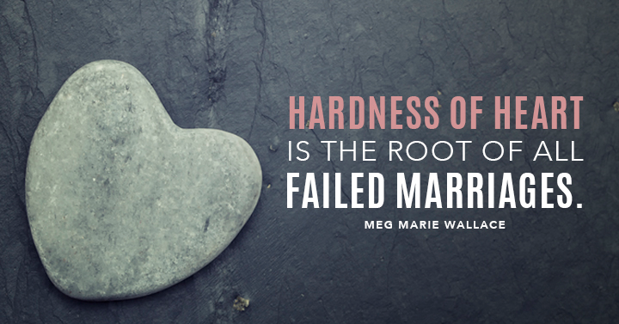
Hardness Of Heart

Slide 14
Divorced
¹¹ But if she does, she must remain unmarried or else be reconciled to her husband. And a husband must not divorce his wife.
(1 Corinthians 7)

Slide 15
Divorced
He (Paul) says, "if she does, let her remain single..." The marriage is not broken just because it has become impossible to go on with. If she leaves even for a temporary separation, or, if it is a long continued problem, even if she gains a divorce, yet in God's sight the marriage is not broken.
Remember we are not dealing with the Law as Christians: We are dealing with God and reality and what is ultimately true, regardless of what the fluctuations of the Law may allow. In God's sight the marriage is not broken, therefore, "let her remain single or else be reconciled to her husband)." In other words she is not to remarry because that would create a broken marriage involving, in this case, some form of adultery. Therefore, while her mate lives and remains unmarried (or while his mate lives and remains unmarried, because this would apply to a man as well as a woman), she or he is not to remarry, for there is always the possibility that the grace of God can work to restore and reconcile that marriage.
(Ray Stedman, ”Answers On Divorce”)

Slide 16
Unequally Yoked Couples
¹² To the rest I say this (I, not the Lord): If any brother has a wife who is not a believer and she is willing to live with him, he must not divorce her. ¹³ And if a woman has a husband who is not a believer and he is willing to live with her, she must not divorce him. ¹⁴ For the unbelieving husband has been sanctified through his wife, and the unbelieving wife has been sanctified through her believing husband. Otherwise your children would be unclean, but as it is, they are holy.
¹⁵ But if the unbeliever leaves, let it be so. The brother or the sister is not bound in such circumstances; God has called us to live in peace. ¹⁶ How do you know, wife, whether you will save your husband? Or, how do you know, husband, whether you will save your wife?
(1 Corinthians 7)

Slide 17
Question For Paul
How can a believer remain in a marriage union with an unbeliever?

Slide 18
Do Not Divorce
I think the problem had arisen because of what Paul had said, or taught, in Corinth that is reflected in Chapter 6 where he speaks about "your bodies are members of Christ" (1 Corinthians 6:15 RSV), and how wrong it was to take the members of Christ, the physical body that belongs to Jesus Christ, and to involve it with the temple prostitutes of Corinth. That was a defiling act, and perhaps many had inferred from that that any kind of sexual union with an unbeliever was a defiling act -- that now you have a marriage where one is a Christian and the other is not and the Christian in that marriage is saying, "Do my sexual practices in marriage mean that I am taking the members of Christ and defiling them with an unbeliever?”

Slide 19
Do Not Divorce
Paul's assurance is, "No, you are not." As Hebrews says: "Marriage is honorable in all, and the bed undefiled," (Hebrews 13:4). The marriage, therefore, remains unchanged. "In fact," the apostle says, "a wonderful thing occurs. Instead of defiling, it is the other way around; it is the believing mate that, in a sense, sanctifies the unbeliever." Now that does not mean "saves them" or "regenerates them." That is always an individual matter left up to the individual faith. What it means is no defilement is involved when sexual union occurs in such a marriage, but rather it sets the unbeliever apart for a special treatment by the Lord; there is a strong exposure to a loving witness that is very difficult for him or her to resist, and it may very well ultimately lead that unbelieving mate to the Lord.
(Ray Stedman, “Answers On Divorce”)

Slide 20
Do Not Divorce
Paul urges the believing marriage partner to do all he or she can to preserve the marriage. This is because the teaching of the ascetics is exactly opposite the truth. The believing partner and the children of this mixed marriage are not defiled by the presence of the unbeliever. To the contrary, the unbelieving partner and the children of the union are “sanctified” by the presence of the believing partner.
Paul reasons that if marriage to an unbeliever in some way defiles the believing mate, it must also defile the children of that union. But since the unbeliever is blessed in the believer, so also are the children. Remaining married to an unbeliever has no negative connotations for the believing partner or the children, but there are distinct advantages for the unbeliever. There is, therefore, no good reason for the believer to seek to dissolve the marriage. All of this, however, is contingent on the desire of the unbeliever to remain married.
(Bob Deffinbaugh, “The Relationship Between Spirituality And Sexuality”)

Slide 21
Do Not Divorce …

Slide 22
Remarriage

Slide 23
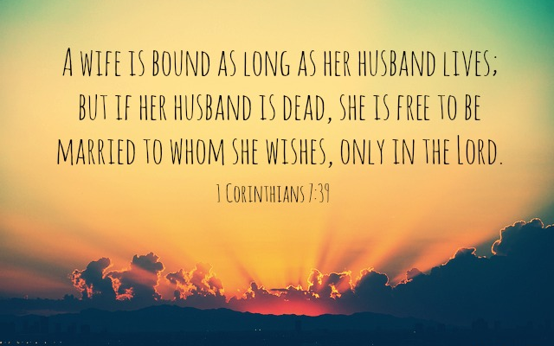
Remarriage

Slide 24
Consider Singlehood
⁴⁰ In my judgment, she is happier if she stays as she is – and I think that I too have the Spirit of God. (1 Corinthians 7)

Slide 25
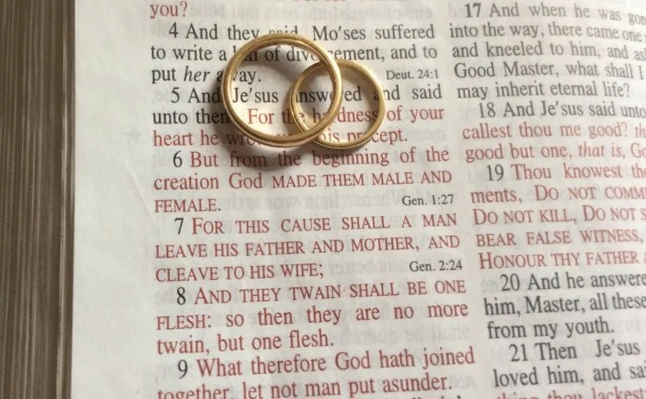
Take Marriage Seriously

Slide 26
Making Marriage Strong & Beautiful

Slide 27
Making Marriage Strong & Beautiful
A marriage that merely exists, but which lacks the love, intimacy, and joy of a godly marriage, is an offense to the One who first instituted marriage in the Garden of Eden. Quite frankly, there are all too many marriages like this, both outside and inside the church. The marriage may be legally intact, but the relationship is virtually dead. Divorce is like a death certificate—it pronounces someone to be legally dead. A decree of divorce pronounces a marriage to be legally dead. There are a good many marriages around—even in the church—which are functionally dead, even though they have never been legally declared dead by a certificate of divorce. While divorce is often a sin, a sub-standard marriage is likewise a sin.

Slide 28
Making Marriage Strong & Beautiful
Our Lord intended Christian marriage to reflect the love and intimate relationship which exists between Jesus Christ and His bride, the church (the body of all true believers). Texts like Ephesians 5:22-33 spell out the responsibilities of both the husband and the wife, so that the spiritual union of Christ and His bride may be displayed through the earthly relationship of a husband and his wife. When a marriage is dead or dying, it reflects badly on our Lord and His relationship with His church. This is a most serious offense. Let no one take pride for having avoided divorce who has likewise avoided striving in the power of the Spirit to manifest Christ in their marriage.
(Bob Deffinbaugh, “The Relationship Between Spirituality And Sexuality”)

Slide 29
To The Single
The single person should not see marriage as the key to happiness or fulfillment, just as the married person should not see the single life as the key to happiness. People who are content with their present state are those who have the greatest freedom to choose marriage or the single life, and who can be content with either, knowing that in either state, they can serve and glorify God. The one who is desperate to marry is in danger of jumping at anything, of grasping at any straw. The one who is content as a single will take a more careful look at the possibility of marriage, knowing it is not something which they must have to be happy and fulfilled.
(Bob Deffinbaugh, “The Relationship Between Spirituality And Sexuality”)

Slide 30
The Past Is The Past

