Slide 1
1st October
United Nations Senior Citizens’ Day

Slide 2
Honouring my Father
A story of healing and reconciliation with my Dad
29th September 2019

Slide 3
Ephesians 6:1-3
Children, obey your parents in the Lord, for this is right. ² “Honor your father and mother”—which is the first commandment with a promise— ³ “so that it may go well with you and that you may enjoy long life on the earth.”

Slide 4
Honour in Chinese Character
“Rong” means glory
“Yu” means fame

Slide 5
My Dad
Born in 1934 (85 years old)
Hailed from Gopeng Perak
Ethnicity: Hokkien
One wife, 4 children

Slide 6
Life was hard
Lived in the times of Japanese’ occupation.
My Grandpa was an opium addict
Dad was forced to leave his home in Gopeng, Perak to work in Penang
Lived with his Uncle and worked for him in exchange for education and lodging

Slide 7
Poverty
Dad worked as a Clerk in a Shipping Company all his life
Drew a meagre salary
Married to Mom and moved to a house in Tanjung Bunga.
4 of us were raised there.
Ran out of money each month to buy food.
Mom supplemented family’s income by washing neighbors’ clothes, making “Kuih” during Chinese New Year.

Slide 8
Poor but rich in love
Kind to others
Shared our foods with our neighbours
Gave alms to the poor

Slide 9
WE WERE A HAPPY FAMILY

Slide 10
My Early Years
Born in 1971
Troubled childbirth
Lived with my Godparents during confinement period and my preschool days

Slide 11
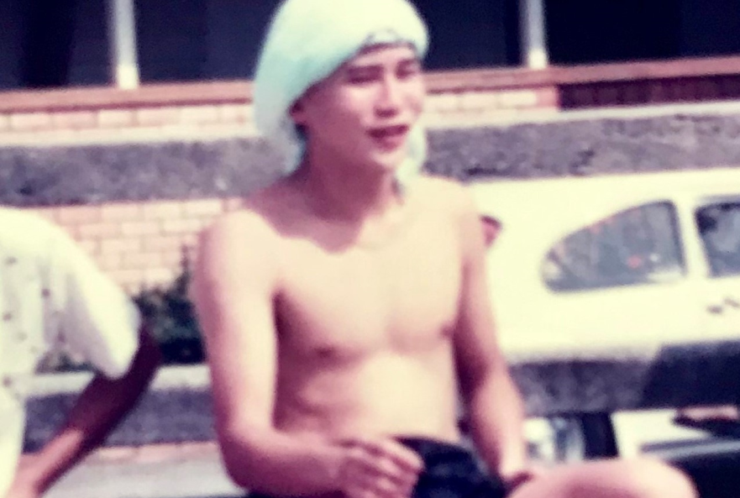
Blacksheep
Rebellious
Unfocused

Slide 12
Resentment

Slide 13
Healing through a dream

Slide 14
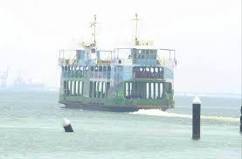
In my dream, God showed me my Dad crossing the Ferry from Butterworth to Penang. He was carrying a suitcase.

Slide 15
Dad was like a servant in his Uncle’s house

Slide 16
Dad never failed to buy new clothes for us during Chinese New Year and he seldom bought for himself

Slide 17
I was blind but now I see

Slide 18
New Vision I saw a different Dad
Faithful Husband
Hardworking
A Responsible Father
A Disciplined man
Sacrificial & Selfless
Generous

Slide 19
He Found Faith Saved and Serving Jesus
Dad gave his life to Jesus and was baptized
Found new meaning in Life and service to God
He is a worshipper of Jesus Christ and also active member in the Seniors’ CG

Slide 20
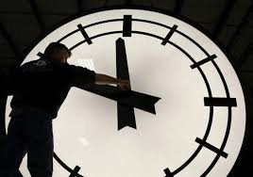
If I could turn back the clock

Slide 21
Proverbs 4:1
Pay Attention
Listen, my sons, to a father’s instruction; pay attention and gain understanding

Slide 22
Do you really Believe?

