Slide 1
Live As You Were Called
1 Corinthians 7:17-24

Slide 2
1 Corinthians 7
¹⁷ Nevertheless, each person should live as a believer in whatever situation the Lord has assigned to them, just as God has called them. This is the rule I lay down in all the churches. ¹⁸ Was a man already circumcised when he was called? He should not become uncircumcised. Was a man uncircumcised when he was called? He should not be circumcised. ¹⁹ Circumcision is nothing and uncircumcision is nothing. Keeping God’s commands is what counts. ²⁰ Each person should remain in the situation they were in when God called them.
²¹ Were you a slave when you were called? Don’t let it trouble you – although if you can gain your freedom, do so. ²² For the one who was a slave when called to faith in the Lord is the Lord’s freed person; similarly, the one who was free when called is Christ’s slave. ²³ You were bought at a price; do not become slaves of human beings. ²⁴ Brothers and sisters, each person, as responsible to God, should remain in the situation they were in when God called them.

Slide 3
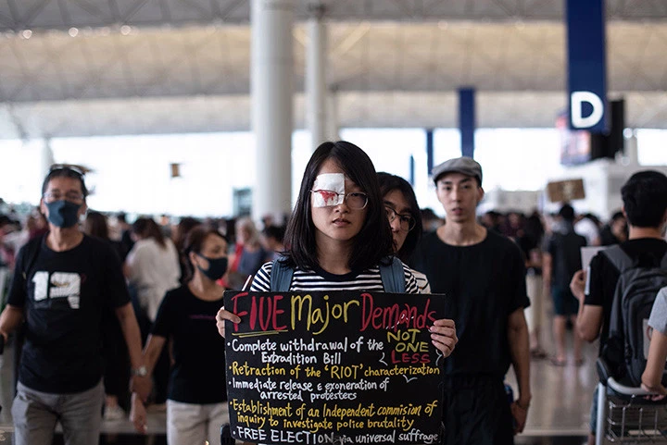
Change!

Slide 4
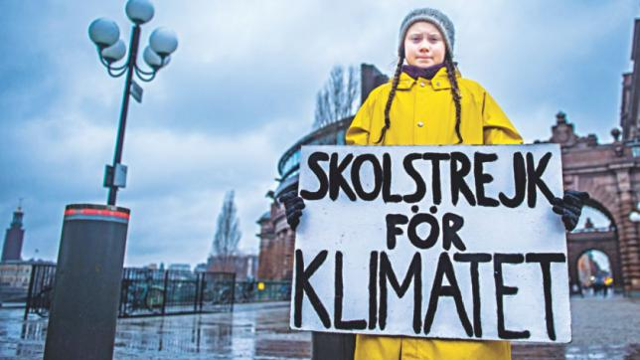
Change!

Slide 5
This Is The Rule I Lay Down
Remain in the situation you were in when God called you.

Slide 6
Radical Change
¹¹ ‘Go now and leave your life of sin.’ (John 8)

Slide 7
But a segment of the church goes so far as to view divorce as the spiritual thing to do. Some Corinthian ascetics hold that sex is dirty, even within marriage. The next step is to look upon marriage as evil. If sex and marriage are unspiritual, does this mean that a “spiritual Christian” should seek to be loosed from the bonds of marriage? And what of those who find themselves married to an unbeliever? Is a Christian sinning every time he has sexual intercourse with his unbelieving spouse?
(Bob Deffinbaugh, “The Relationship Between Spirituality And Sexuality”)

Slide 8
Preoccupation
²⁶ Brothers and sisters, think of what you were when you were called. Not many of you were wise by human standards; not many were influential; not many were of noble birth. (1 Corinthians 1)

Slide 9
Remain
¹⁷ Nevertheless, each person should live as a believer in whatever situation the Lord has assigned to them, just as God has called them. This is the rule I lay down in all the churches.
(1 Corinthians 7)

Slide 10
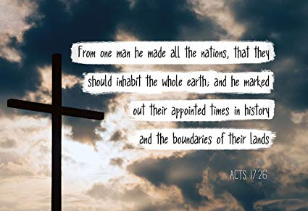
As The Lord Has Assigned

Slide 11
As The Lord Has Assigned
Paul emphatically states that God has sovereignly assigned each believer with a station in life, and it is from this station that they are to serve Him. Our “place” in this world is not a matter of chance, or simply the result of racial or economic or social bias (though these may well be factors). Our place in this world has been assigned to us by none other than our Lord. We know that place because it is the station in life we held at the time of our calling to faith. And this “calling” is to service, as well as to salvation. This calling is to serve God where we are. As a general rule, we have been called at a certain point in time, within a particular culture, and with a particular social station in life. It is in this setting that we are to begin to live out our faith and to fulfill our calling.
(Bob Deffinbaugh, “Spirituality And The Status Quo”)

Slide 12
Circumcision
¹⁸ Was a man already circumcised when he was called? He should not become uncircumcised. Was a man uncircumcised when he was called? He should not be circumcised. ¹⁹ Circumcision is nothing and uncircumcision is nothing. Keeping God’s commands is what counts. ²⁰ Each person should remain in the situation they were in when God called them. (1 Corinthians 7)

Slide 13
A Matter of The Heart

Slide 14
Rite To Reality
⁹ For in Christ all the fullness of the Deity lives in bodily form, ¹⁰ and in Christ you have been brought to fullness. He is the head over every power and authority. ¹¹ In him you were also circumcised with a circumcision not performed by human hands. Your whole self ruled by the flesh was put off when you were circumcised by Christ, ¹² having been buried with him in baptism, in which you were also raised with him through your faith in the working of God, who raised him from the dead. ¹³ When you were dead in your sins and in the uncircumcision of your flesh, God made you alive with Christ. He forgave us all our sins, ¹⁴ having cancelled the charge of our legal indebtedness, which stood against us and condemned us; he has taken it away, nailing it to the cross. ¹⁵ And having disarmed the powers and authorities, he made a public spectacle of them, triumphing over them by the cross.¹⁶ Therefore do not let anyone judge you by what you eat or drink, or with regard to a religious festival, a New Moon celebration or a Sabbath day. ¹⁷ These are a shadow of the things that were to come; the reality, however, is found in Christ. (Colossians 2)

Slide 15
What Matters

Slide 16
What Matters
²⁵ Circumcision has value if you observe the law, but if you break the law, you have become as though you had not been circumcised. ²⁶ So then, if those who are not circumcised keep the law’s requirements, will they not be regarded as though they were circumcised? ²⁷ The one who is not circumcised physically and yet obeys the law will condemn you who, even though you have the written code and circumcision, are a law-breaker. ²⁸ A person is not a Jew who is one only outwardly, nor is circumcision merely outward and physical. ²⁹ No, a person is a Jew who is one inwardly; and circumcision is circumcision of the heart, by the Spirit, not by the written code. Such a person’s praise is not from other people, but from God. (Romans 2)

Slide 17
Verna Mae Thomas

Slide 18
Slavery
²¹ Were you a slave when you were called? Don’t let it trouble you – although if you can gain your freedom, do so.
(1 Corinthians 7)

Slide 19
A Spiritual Perspective
²² For the one who was a slave when called to faith in the Lord is the Lord’s freed person; similarly, the one who was free when called is Christ’s slave.
(1 Corinthians 7)

Slide 20
²⁶ So in Christ Jesus you are all children of God through faith, ²⁷ for all of you who were baptized into Christ have clothed yourselves with Christ. ²⁸ There is neither Jew nor Gentile, neither slave nor free, nor is there male and female, for you are all one in Christ Jesus. ²⁹ If you belong to Christ, then you are Abraham’s seed, and heirs according to the promise. (Galatians 3)

Slide 21
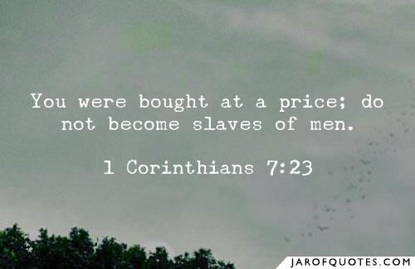
Reminder

Slide 22
Reminder
But in seeking man’s approval, they must abandon seeking to please God, for the two are incompatible. By seeking to win man’s approval, the Corinthians are enslaving themselves to the values of an unbelieving world (or a carnal church).
The Corinthians, like all saints, are saved by the blood of Jesus Christ. As such, they were bought at the price of the precious blood of the Savior. They were redeemed from slavery, so how can they return to bondage? If the approval of God is our goal, and not the esteem of men, then matters like circumcision and slavery will not consume us. We will simply seek to serve God wherever He has placed us.
(Bob Deffinbaugh, “Spirituality And The Status Quo”)

Slide 23
Response
¹⁷ Nevertheless, each person should live as a believer in whatever situation the Lord has assigned to them, just as God has called them. This is the rule I lay down in all the churches.
(1 Corinthians 7)

Slide 24
Saint Francis de Sales
Truly charity has no limit; for the love of God has been poured into our hearts by His Spirit dwelling in each one of us, calling us to a life of devotion and inviting us to bloom in the garden where He has planted and directing us to radiate the beauty and spread the fragrance of His Providence.

