Slide 1
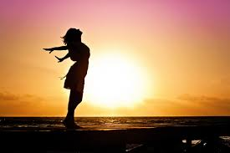
Undistracted Devotion
A Biblical View of Singlehood
1 Cor 7:25-40

Slide 2
Singlehood
Seldom talked about subject in church
A large population of Singles
Bible talks about singlehood
Singlehood is encouraged by Paul in 1 Corinthians 7

Slide 3
1 Corinthians 7:25-28
²⁵ Now about virgins: I have no command from the Lord, but I give a judgment as one who by the Lord’s mercy is trustworthy. ²⁶ Because of the present crisis, I think that it is good for a man to remain as he is. ²⁷ Are you pledged to a woman? Do not seek to be released. Are you free from such a commitment? Do not look for a wife. ²⁸ But if you do marry, you have not sinned; and if a virgin marries, she has not sinned. But those who marry will face many troubles in this life, and I want to spare you this.

Slide 4
1 Corinthians 7:29-31
²⁹ What I mean, brothers and sisters, is that the time is short. From now on those who have wives should live as if they do not; ³⁰ those who mourn, as if they did not; those who are happy, as if they were not; those who buy something, as if it were not theirs to keep; ³¹ those who use the things of the world, as if not engrossed in them. For this world in its present form is passing away.

Slide 5
1 Corinthians 7:32-35
³² I would like you to be free from concern. An unmarried man is concerned about the Lord’s affairs how he can please the Lord. ³³ But a married man is concerned about the affairs of this world how he can please his wife ³⁴ and his interests are divided. An unmarried woman or virgin is concerned about the Lord’s affairs: Her aim is to be devoted to the Lord in both body and spirit. But a married woman is concerned about the affairs of this world how she can please her husband. ³⁵ I am saying this for your own good, not to restrict you, but that you may live in a right way in undivided devotion to the Lord.

Slide 6
1 Corinthians 7:36-37
³⁶ If anyone is worried that he might not be acting honorably toward the virgin he is engaged to, and if his passions are too strong^{[b]} and he feels he ought to marry, he should do as he wants. He is not sinning. They should get married. ³⁷ But the man who has settled the matter in his own mind, who is under no compulsion but has control over his own will, and who has made up his mind not to marry the virgin—this man also does the right thing.

Slide 7
1 Corinthians 7:38-40
³⁸ So then, he who marries the virgin does right, but he who does not marry her does better. ³⁹ A woman is bound to her husband as long as he lives. But if her husband dies, she is free to marry anyone she wishes, but he must belong to the Lord. ⁴⁰ In my judgment, she is happier if she stays as she is—and I think that I too have the Spirit of God.

Slide 8
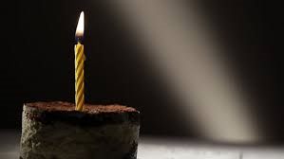
Virgins
It is good to remain single
Not the Lord’s commands but Paul’s counsel
Paul’s counsel is trustworthy
1 Cor 7:25

Slide 9
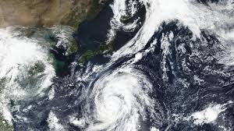
Present Crisis
Distress
Bible talks about miserable days ahead, nearing the Lord’s coming (Luke 21:23)
1 Cor 7:26

Slide 10

Remain
1 Cor 7:26-27
I think that it is good for a man to remain as he is. Are you pledged to a woman? Do not seek to be released. Are you free from such a commitment? Do not look for a wife

Slide 11
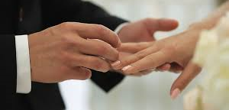
It’s not a sin to get married
1 Cor 7:28

Slide 12
WHAT I MEAN IS THIS

Slide 13
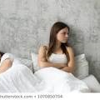
Marriage
Those who marry will face many troubles
1 Cor 7:28

Slide 14

I want to Spare you from Troubles
Apostle Paul
1 Cor 7:28c

Slide 15

Time is short
The world is passing away
Those who have wives should live as if they do not
Those who mourn, as if they did not
Those who are happy, as if they were not
Those who buy something, as if it were not theirs to keep
Those who use the things of the world, as if not engrossed in them
1 Cor 7:29-31

Slide 16

Consider being Single for the Lord
Live a life of Undistracted Devotion to the Lord
1 Cor 7:32

Slide 17

Single and Dating
If he is certain about getting married, he should marry her
If he decides not to marry her, he does even better
1 Cor 7:36-38

Slide 18
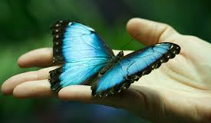
Widow
A woman is bound to her husband as long as he lives. But if her husband dies, she is free to marry anyone she wishes, but he must belong to the Lord. In my judgment, she is happier if she stays as she is
1 Cor 7:39-40

Slide 19
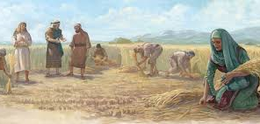
Ruth
An epitome of what life can turn out to be when you live devotedly to the Lord

