Slide 1
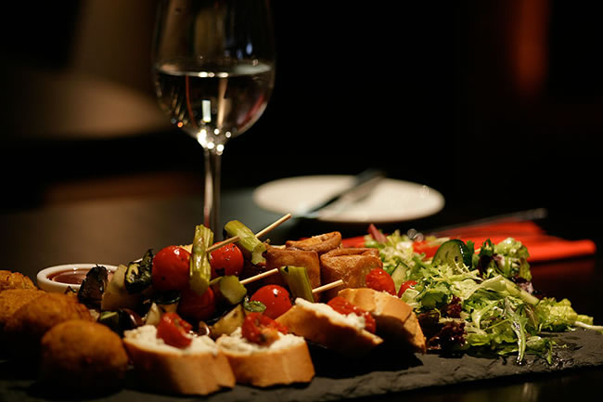
Do All to the Glory of God
1 Cor 8:1-13; 10:14-33
So, whether you eat or drink, or whatever you do, do all to the glory of God. 1 Cor 10:31

Slide 2
Can we eat food offered to idols?
YES
NO

Slide 3
So then, about eating food sacrificed to idols: We know that an idol is nothing at all in the world and that there is no God but one.” 1 Cor 8:4
If one of the unbelievers invites you to dinner and you are disposed to go, eat whatever is set before you without raising any question on the ground of conscience. 1 Cor 10:27
YES

Slide 4
Nevertheless, I have a few things against you: There are some among you who hold to the teaching of Balaam, who taught Balak to entice the Israelites to sin so that they ate food sacrificed to idols and committed sexual immorality. Rev 2:14 (Church in Pergamum)
Nevertheless, I have this against you: You tolerate that woman Jezebel, who calls herself a prophet. By her teaching she misleads my servants into sexual immorality and the eating of food sacrificed to idols. Rev 2:20 (Church in Thyatira)
NO

Slide 5
What do I imply then? That food offered to idols is anything, or that an idol is anything?
No, I imply that what pagans sacrifice they offer to demons and not to God. I do not want you to be participants with demons. You cannot drink the cup of the Lord and the cup of demons. You cannot partake of the table of the Lord and the table of demons. 1 Cor 10:19-21
NO

Slide 6
Inside an Idol’s Temple
But take care that this right of yours does not somehow become a stumbling block to the weak. For if anyone sees you who have knowledge eating in an idol's temple, will he not be encouraged, if his conscience is weak, to eat food offered to idols? 1 Cor 8:9-10

Slide 7
Do Not Stumble Others
But take care that this right of yours does not somehow become a stumbling block to the weak. For if anyone sees you who have knowledge eating in an idol's temple, will he not be encouraged, if his conscience is weak, to eat food offered to idols? 1 Cor 8:9-10

Slide 8
Do Not Stumble Others
If one of the unbelievers invites you to dinner and you are disposed to go, eat whatever is set before you without raising any question on the ground of conscience. But if someone says to you, "This has been offered in sacrifice," then do not eat it, for the sake of the one who informed you, and for the sake of conscience-- 1 Cor 10:27-28

Slide 9
Different Views
Inside Temple In Temple Grounds At Home

Slide 10
Four Guiding Principles
If someone invites you for dinner, just eat without asking questions.
Do not stumble people.
You cannot partake of the Lord’s table and the table of demons.

Slide 11
Do All For the Glory of God
So, whether you eat or drink, or whatever you do, do all to the glory of God. 1 Cor 10:31

