Slide 1
Glory To God, Peace To Man
Luke 2:1-20

Slide 2
Luke 2
¹ In those days Caesar Augustus issued a decree that a census should be taken of the entire Roman world. ² (This was the first census that took place while Quirinius was governor of Syria.) ³ And everyone went to their own town to register.
⁴ So Joseph also went up from the town of Nazareth in Galilee to Judea, to Bethlehem the town of David, because he belonged to the house and line of David. ⁵ He went there to register with Mary, who was pledged to be married to him and was expecting a child. ⁶ While they were there, the time came for the baby to be born, ⁷ and she gave birth to her firstborn, a son. She wrapped him in cloths and placed him in a manger, because there was no guest room available for them.
⁸ And there were shepherds living out in the fields nearby, keeping watch over their flocks at night. ⁹ An angel of the Lord appeared to them, and the glory of the Lord shone around them, and they were terrified. ¹⁰ But the angel said to them, “Do not be afraid. I bring you good news that will cause great joy for all the people.

Slide 3
Luke 2
¹¹ Today in the town of David a Saviour has been born to you; he is the Messiah, the Lord. ¹² This will be a sign to you: You will find a baby wrapped in cloths and lying in a manger.”
¹³ Suddenly a great company of the heavenly host appeared with the angel, praising God and saying,
¹⁴ “Glory to God in the highest heaven, and on earth peace to those on whom his favor rests.”
¹⁵ When the angels had left them and gone into heaven, the shepherds said to one another, “Let’s go to Bethlehem and see this thing that has happened, which the Lord has told us about.”
¹⁶ So they hurried off and found Mary and Joseph, and the baby, who was lying in the manger. ¹⁷ When they had seen him, they spread the word concerning what had been told them about this child, ¹⁸ and all who heard it were amazed at what the shepherds said to them. ¹⁹ But Mary treasured up all these things and pondered them in her heart. ²⁰ The shepherds returned, glorifying and praising God for all the things they had heard and seen, which were just as they had been told.

Slide 4
Hark The Herald Hipsters Sing

Slide 5
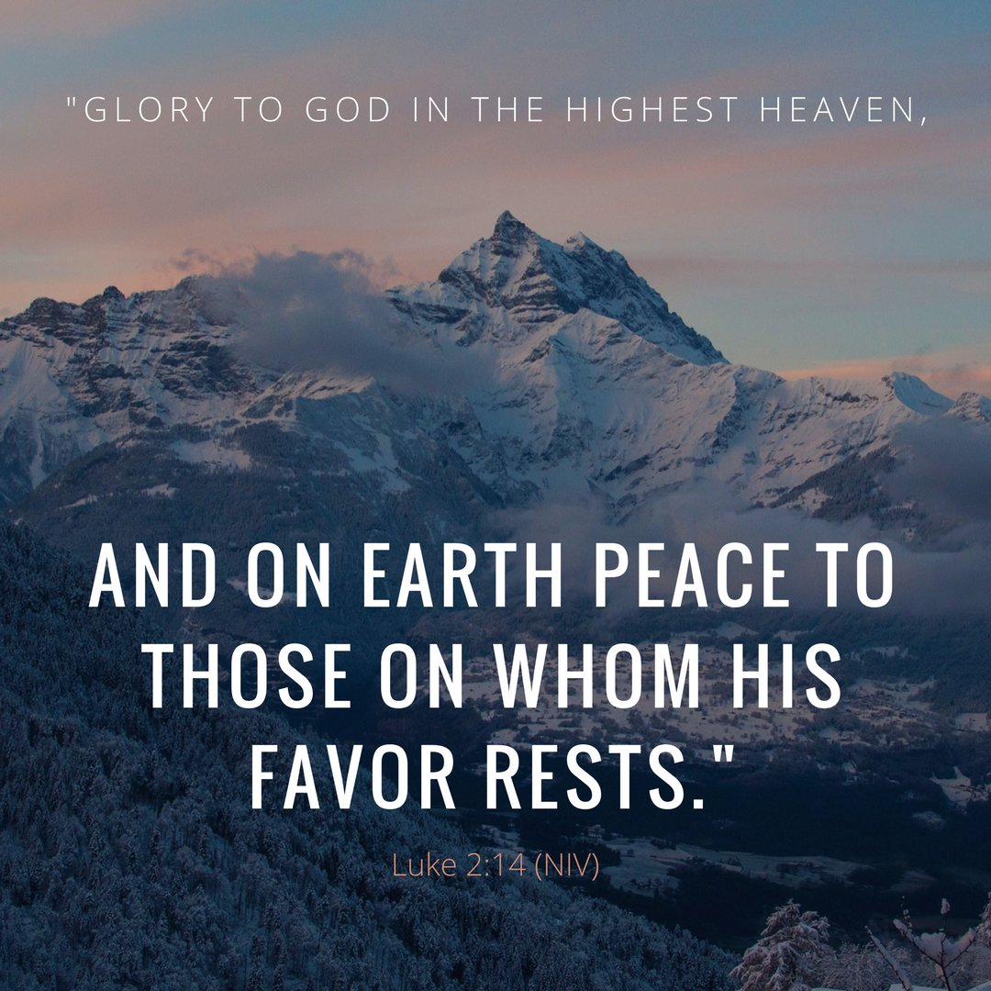
The Wonders of Christmas

Slide 6
The Great News
¹¹ Today in the town of David a Saviour has been born to you; he is the Messiah, the Lord. ¹² This will be a sign to you: You will find a baby wrapped in cloths and lying in a manger.” (Luke 2)

Slide 7
Today

Slide 8
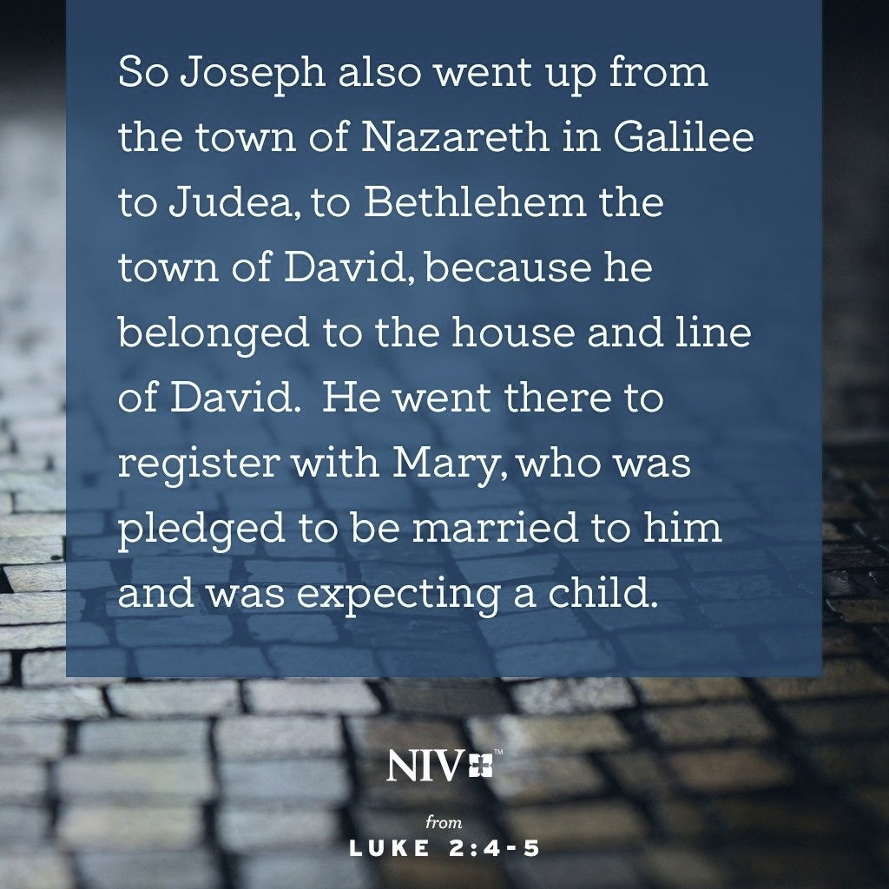
In The Town of David

Slide 9
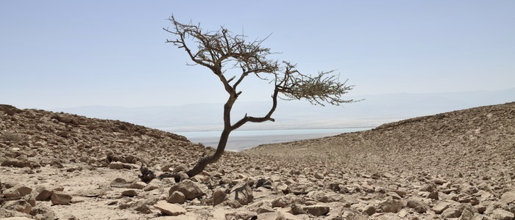
Nazareth To Bethlehem

Slide 10
O Little Town of Bethlehem
² “But you, Bethlehem Ephrathah, though you are small among the clans of Judah, out of you will come for me one who will be ruler over Israel, whose origins are from of old, from ancient times.” (Micah 5)

Slide 11
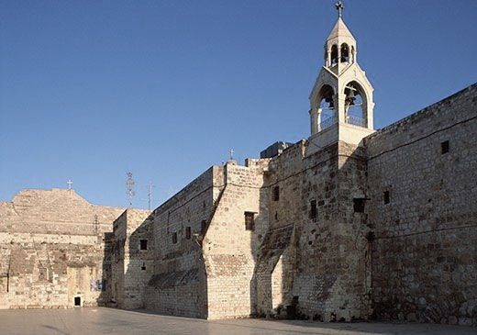
The Church of The Nativity

Slide 12
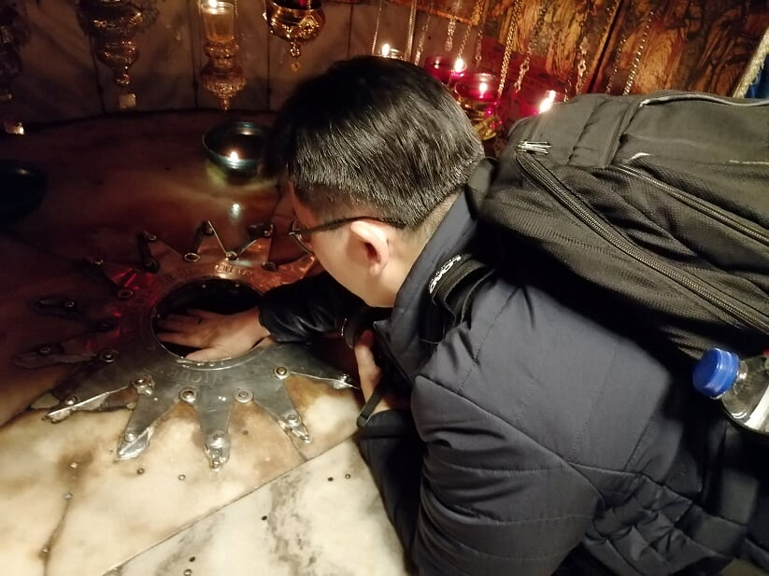
The Cave of The Nativity

Slide 13
A Saviour Has Been Born To You

Slide 14
A Saviour Has Been Born To You

Slide 15
He Is Messiah, The Lord
⁷ Of the greatness of his government and peace there will be no end. He will reign on David’s throne and over his kingdom, establishing and upholding it with justice and righteousness from that time on and for ever. (Isaiah 9)

Slide 16
Christmas In Sum
The Lord of never-ending, universal, sovereign governance. The Lord of all lords.
On a day — in real history.
In a city — in a real world.
The Savior — to take away all our guilt.
The Christ — to fulfill all our hopes.
The Lord — to defeat all our enemies, and make us safe and satisfied for ever.
So I exult with you this Christmas that we have a great Savior, Jesus, the Christ, the Lord, born on a day in a city to save us from our sins — our many sins.
(John Piper, “A Saviour Is Born”)

Slide 17
The Great Response
¹³ Suddenly a great company of the heavenly host appeared with the angel, praising God and saying, ¹⁴ “Glory to God in the highest heaven, and on earth peace to those on whom his favor rests.”
(Luke 2)

Slide 18
Glory To God!
First and foremost, God is glorified because this child is born. And second, peace is to spread everywhere this child is received. These are the great purposes for the coming of Jesus: Glory ever-ascending from man to God. Peace ever-descending from God to man. God’s glory sung out among men for the sake of his name. God’s peace lived out among men for the sake of his name.
There is hardly a better way to sum up what God was about when he created the world, or when he came to reclaim the world in Jesus Christ — his glory, our peace. His greatness, our joy. His beauty, our pleasure. The point of creation and redemption is that God is glorious and means to be known and praised for his glory by a peace-filled new humanity.
(John Piper, "A Saviour Is Born”)

Slide 19
Peace To Man
The birth of God's long-awaited redeemer was introduced to a darkened, weary, and exhausted world. History tells us that the time of our Lord's birth was indeed a time of weariness and widespread despair among men and among the nations of the earth. The civilizations of that day had all played themselves out.
It is striking that the human emotion that was first encountered by the angelic messenger was that of fear. Men were afraid in that day. They were afraid of many things, as they are today. There was Herod the Great on the throne. Herod was cruel, and was able to accomplish his wrath upon whoever was the object of his disfavor. He had personally put to death many, even in his own family, because of their antagonism to his plans. Also there were the Romans, too, with their proud legions, marching up and down across the face of the earth, holding everything in a severe and iron bondage. Many wars broke out and the economy was uncertain. The people were afraid.
(Ray Stedman, "The Coming of Joy”)

Slide 20
Receiving God’s Peace
¹⁴ … and on earth peace to those on whom his favor rests.” (NIV)
¹⁴ … and on earth peace among men with whom he is pleased.” (NASB)

Slide 21
Receiving God’s Peace
God’s purpose is to give you peace by being the most glorious Person in your life. Five times in the New Testament he is called “the God of peace”. And Jesus said, “My peace I give to you”. And Paul said “Jesus himself is our peace”.
What this means is that the peace of God, or the peace of Christ, can never be separated from God himself and Christ himself. If we want peace to rule in our lives, God must rule in our lives. Christ must rule in our lives. God’s purpose is not to give you peace separate from himself. His purpose is to give you peace by being the most glorious Person in your life.
So the key to peace is keeping together what the angels keep together: Glory to God, and peace to man. A heart bent on showing the glory of God, will know the peace of God.
(John Piper, "A Saviour Is Born”)

Slide 22
Peace With God
¹ Therefore, since we have been justified through faith, we have peace with God through our Lord Jesus Christ,
(Romans 5)

Slide 23
Peace With Ourselves
⁶ Do not be anxious about anything, but in every situation, by prayer and petition, with thanksgiving, present your requests to God. (Philippians 4)

Slide 24
Peace With Others
¹⁸ If it is possible, as far as it depends on you, live at peace with everyone. (Romans 12)

Slide 25
Glory Ever-Ascending

Slide 26
Glory Ever-Ascending

Slide 27
Peace Ever-Descending

Slide 28
Rejection of God’s Peace
⁴¹ As he approached Jerusalem and saw the city, he wept over it ⁴² and said, “If you, even you, had only known on this day what would bring you peace—but now it is hidden from your eyes.
(Luke 19)

Slide 29
Pseudo Peace

