Slide 3
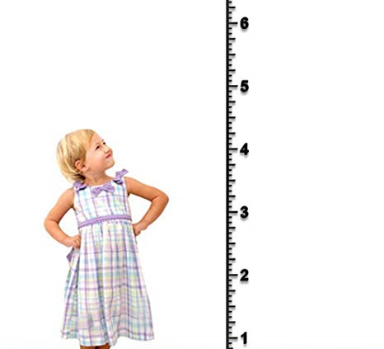
A decade of accelerated GROWTH
FPBC 2020

Slide 4
GROW IN CHRIST
TEXT: Hebrews 5:11 – 6:12

Slide 5
¹¹ We have much to say about this, but it is hard to make it clear to you because you no longer try to understand. ¹² In fact, though by this time you ought to be teachers, you need someone to teach you the elementary truths of God’s word all over again. You need milk, not solid food! ¹³ Anyone who lives on milk, being still an infant, is not acquainted with the teaching about righteousness. ¹⁴ But solid food is for the mature, who by constant use have trained themselves to distinguish good from evil.

Slide 6
6 Therefore let us move beyond the elementary teachings about Christ and be taken forward to maturity, not laying again the foundation of repentance from acts that lead to death,^{[a]} and of faith in God, ² instruction about cleansing rites,^{[b]} the laying on of hands, the resurrection of the dead, and eternal judgment. ³ And God permitting, we will do so.

Slide 7
⁴ It is impossible for those who have once been enlightened, who have tasted the heavenly gift, who have shared in the Holy Spirit, ⁵ who have tasted the goodness of the word of God and the powers of the coming age ⁶ and who have fallen^{[c]} away, to be brought back to repentance. To their loss they are crucifying the Son of God all over again and subjecting him to public disgrace.

Slide 8
⁷ Land that drinks in the rain often falling on it and that produces a crop useful to those for whom it is farmed receives the blessing of God. ⁸ But land that produces thorns and thistles is worthless and is in danger of being cursed. In the end it will be burned.

Slide 9
⁹ Even though we speak like this, dear friends, we are convinced of better things in your case—the things that have to do with salvation. ¹⁰ God is not unjust; he will not forget your work and the love you have shown him as you have helped his people and continue to help them. ¹¹ We want each of you to show this same diligence to the very end, so that what you hope for may be fully realized. ¹² We do not want you to become lazy, but to imitate those who through faith and patience inherit what has been promised.

Slide 10
Background

Slide 11
TRAINING WHEELS

Slide 12
THE BELIEVERS’ CONDITION
¹¹ We have much to say about this, but it is hard to make it clear to you because you no longer try to understand.

Slide 13
LACK PROGRESS
¹² In fact, though by this time you ought to be teachers, you need someone to teach you the elementary truths of God’s word all over again.

Slide 14
LIVE ON MILK
¹³ Anyone who lives on milk, being still an infant, is not acquainted with the teaching about righteousness.

Slide 15
SOLID FOOD
¹⁴ But solid food is for the mature,

Slide 16
TRAINING
Who by constant use (of solid food) have trained themselves to distinguish good from evil.

Slide 17
Spiritual Training
Obeying what Jesus says.
A good list can be found in Jesus’ Sermon on the Mount.
Anger
Adultery
Making promises
Love your enemies
Righteous acts
Love of Money
Judging others

Slide 18
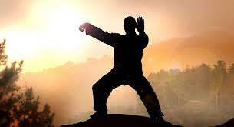
Spiritual Maturity
A spiritually mature person is able to do what Jesus says effortlessly Dallas Willard

Slide 19
Perfection
Therefore, let us move beyond the elementary teachings about Christ and be taken forward to MATURITY, not laying again the foundation of repentance from acts that lead to death, and of faith in God. Hebrews 6:1

Slide 20
Therefore, let us move beyond the elementary teachings about Christ and be taken forward to maturity
Heb 6:3

Slide 21
⁴ It is impossible for those who have once been enlightened, who have tasted the heavenly gift, who have shared in the Holy Spirit, ⁵ who have tasted the goodness of the word of God and the powers of the coming age ⁶ and who have fallen^{[c]} away, to be brought back to repentance. To their loss they are crucifying the Son of God all over again and subjecting him to public disgrace.

Slide 22
Does it really say it is impossible for a Believer who falls away to repent?

Slide 23
It is problematic if we interpret this way
What about David?
David committed serious sins, but God restored him (Psalm 51)

Slide 24
Points to note when interpret scripture
The Bible does not contradict itself
It has no errors
We cannot use one (or two) passages and form a doctrine.
When we face with a passage that we do not fully understand, it simply means we have not fully received light to a passage

Slide 25
What the Bible doesn’t teach
If you backslide as a believer, you cannot repent and come back come back to God, neither does it teach that if you are a believer and you commit sin or sins, you are doomed, there is no room for you to repent.
Bible does not support the above. For example, 1 John 1:8-9 “If we claim to be without sin, we deceive ourselves and the truth is not in us. If we confess our sins, he is faithful and just and will forgive our sins and purify us from all unrighteousness.

Slide 26
We can establish that…
This passage does not apply to all backslide believers,
For sure it is referring to a certain kind of believers.

Slide 27
Examine 3 theological views
Arminian
Calvinist
Free grace

Slide 28
Arminian
They are genuine believers as suggested in verse 4 and 5
Believers can lose their salvation if they choose to leave their faith

Slide 29
Calvinist
Those who fall away are NOT genuine believers.
They believe true believers cannot lose their salvation. They are “once saved always saved”. They based this on the character of God who keeps His covenant.

Slide 30
Free-grace
Must understand the background.
This letter was written to Messianic Jews who suffered persecution by Jews.
They are tempted to U-turn back to Judaism even after they had been presented or enlightened with the truth.
Verse 6 then makes sense because the act of animal sacrifice must be repeated. Animals sacrifice cannot take away sins. (Heb 10:4)

Slide 31
What the Bible doesn’t teach
We can continue to live in sin or however we like since our salvation is by grace and through faith in Jesus.

Slide 32
What the Bible in fact does say is the opposite
What shall we say, then? Shall we go on sinning so that grace may increase? By no means! We are those who have died to sin, how can we live in it any longer?
Romans 6:1-2

Slide 33
Take Home Message
Grow up is God’s message to us
We will experience a decade accelerated spiritual growth
“Growth window” is opened, we are like a child in a growing age
Spiritual training and disciplines are necessary
Aim for perfection, do not settle for mediocrity
There will be a season of consecration
Then will come revival.

