Slide 1
MAGNIFY THE LORD WITH ME!
Psalm 34:1-7

Slide 2
Watch Night Service 2019

Slide 3
Resolve

Slide 4
Two Themes
Magnify The Lord With Me
Learn From Me
Psalm 34

Slide 5
1 Samuel 21
¹⁰ That day David fled from Saul and went to Achish king of Gath. ¹¹ But the servants of Achish said to him, “Isn’t this David, the king of the land? Isn’t he the one they sing about in their dances: “‘Saul has slain his thousands, and David his tens of thousands’?”
¹² David took these words to heart and was very much afraid of Achish king of Gath. ¹³ So he pretended to be insane in their presence; and while he was in their hands he acted like a madman, making marks on the doors of the gate and letting saliva run down his beard.
¹⁴ Achish said to his servants, “Look at the man! He is insane! Why bring him to me? ¹⁵ Am I so short of madmen that you have to bring this fellow here to carry on like this in front of me? Must this man come into my house?”

Slide 6
From Obscurity To Renown
⁶ When the men were returning home after David had killed the Philistine, the women came out from all the towns of Israel to meet King Saul with singing and dancing, with joyful songs and with tambourines and lyres. ⁷ As they danced, they sang: ‘Saul has slain his thousands, and David his tens of thousands.’
(1 Samuel 18)

Slide 7
Saul’s Displeasure
⁸ Saul was very angry; this refrain displeased him greatly. “They have credited David with tens of thousands,” he thought, “but me with only thousands. What more can he get but the kingdom?” ⁹ And from that time on Saul kept a close eye on David.
(1 Samuel 18)

Slide 8
David’s Response

Slide 9
Lies & Deceit

Slide 10
Lies & Deceit
Now David came to Nob, to Ahimelech the priest. And Ahimelech was afraid when he met David, and said to him, “Why are you alone, and no one is with you?”
2 So David said to Ahimelech the priest, “The king has ordered me on some business, and said to me, ‘Do not let anyone know anything about the business on which I send you, or what I have commanded you.’ And I have directed my young men to such and such a place. 3 Now therefore, what have you on hand? Give me five loaves of bread in my hand, or whatever can be found.
(1 Samuel 21)

Slide 11
8 And David said to Ahimelech, “Is there not here on hand a spear or a sword? For I have brought neither my sword nor my weapons with me, because the king’s business required haste.”
9 So the priest said, “The sword of Goliath the Philistine, whom you killed in the Valley of Elah, there it is, wrapped in a cloth behind the ephod. If you will take that, take it. For there is no other except that one here.”
And David said, “There is none like it; give it to me.” (1 Samuel 21)

Slide 12
Under House Arrest
A miktam of David when the Philistines had seized him in Gath (superscription to Psalm 56)

Slide 13
David’s Problem
¹ But David thought to himself, ‘One of these days I shall be destroyed by the hand of Saul. The best thing I can do is to escape to the land of the Philistines. Then Saul will give up searching for me anywhere in Israel, and I will slip out of his hand.’
(1 Samuel 27)

Slide 14
David’s Awakening
In spite of his many failures and sometimes flagrant sins, David kept coming back to the Lord, repenting of his sins and seeking God as his chief joy and treasure. David was not, as so many do, trying to milk God for His blessings, but continuing to live for their own selfish ends. Rather, David saw God Himself as the supreme blessing. He would agree with what Asaph had written in Psalm 73:25 – “Whom have I in heaven but You? And besides You, I desire nothing on earth.”
(Steven J. Cole, “Psalm 34: Enjoying God And His Blessings”)

Slide 15
Let Us Exalt His Name Together
¹ I will bless the Lord at all times; His praise shall continually be in my mouth. ² My soul shall make its boast in the Lord; The humble shall hear of it and be glad. ³ Oh, magnify the Lord with me, And let us exalt His name together. ⁴ I sought the Lord, and He heard me, And delivered me from all my fears.⁵ They looked to Him and were radiant, And their faces were not ashamed.⁶ This poor man cried out, and the Lord heard him, And saved him out of all his troubles. ⁷ The angel of the Lord encamps all around those who fear Him, And delivers them. ⁸ Oh, taste and see that the Lord is good; Blessed is the man who trusts in Him! ⁹ Oh, fear the Lord, you His saints! There is no want to those who fear Him. ¹⁰ The young lions lack and suffer hunger; But those who seek the Lord shall not lack any good thing. (Psalm 34)

Slide 16
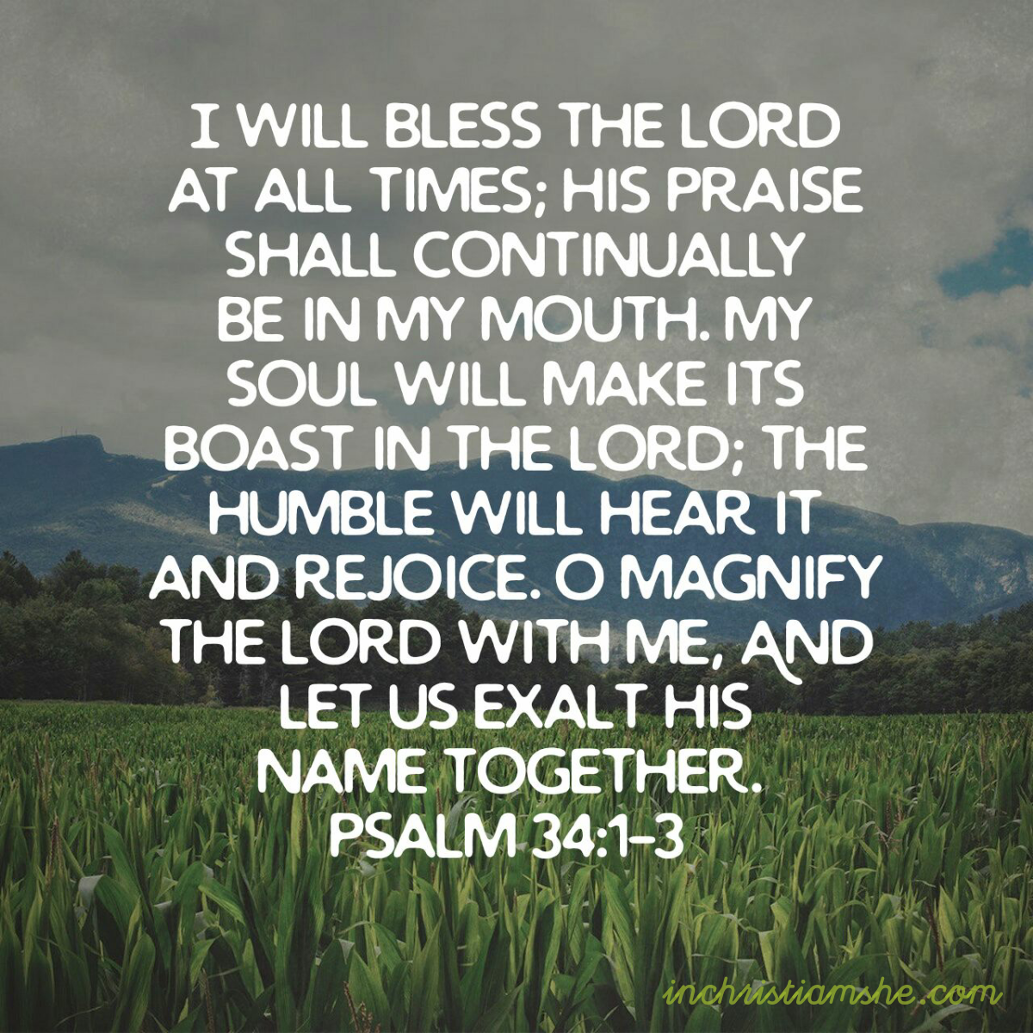
A Promise To Praise
Frequency
Focus
Fellowship

Slide 17
Frequency

Slide 18
Focus

Slide 19
Fellowship
³ Oh, magnify the Lord with me, And let us exalt His name together.
(Psalm 34)

Slide 20
David’s Testimony
⁴ I sought the Lord, and He heard me, And delivered me from all my fears.⁵ They looked to Him and were radiant, And their faces were not ashamed.⁶ This poor man cried out, and the Lord heard him, And saved him out of all his troubles. ⁷ The angel of the Lord encamps all around those who fear Him, And delivers them. (Psalm 34)

Slide 21
David’s Testimony
³ When I am afraid, I put my trust in you. ⁴ In God, whose word I praise – in God I trust and am not afraid. What can mere mortals do to me? ¹⁰ In God, whose word I praise, in the Lord, whose word I praise – ¹¹ in God I trust and am not afraid. What can man do to me? (Psalm 56)

Slide 22
David’s Invitation
⁸ Oh, taste and see that the Lord is good; Blessed is the man who trusts in Him! ⁹ Oh, fear the Lord, you His saints! There is no want to those who fear Him. ¹⁰ The young lions lack and suffer hunger; But those who seek the Lord shall not lack any good thing.
(Psalm 34)

Slide 23
David’s Assurance

Slide 24
Those Who Seek The Lord
The one who is really strong is the one who finds his strength in the Lord and not in himself. Those who have been delivered from their fear of man are those who have come to fear the Lord. There are few animals as awesome and as powerful as the young lion. He is the epitome of strength, and yet in spite of its strength, the young lion does go hungry. As great as it may be, its strength is no guarantee of abundant provision. In contrast to the young lion, which lacks in spite of his strength, those who seek the Lord (uprightly and out of weakness) are assured that they shall not lack “any good thing.” While we are not promised everything we may want if we trust in the Lord, we are promised we will not lack “any good thing.”
(Bob Deffinbaugh, “The Fear of The Lord”)

Slide 25
Response
Fear of Man
Fear of God

Slide 26
A Promise To Praise

Slide 27
Trust, Fear, Seek

