Slide 1
BODY PAINS (PART 1)
1 Corinthians 12:12-20

Slide 2
The Corinthian Church
Divisions
Disorder
Difficulties

Slide 3
Spiritual Gifts
¹ Now about the gifts of the Spirit, brothers and sisters, I do not want you to be uninformed. (1 Corinthians 12)

Slide 4
Baptised Into The Body of Christ
¹² Just as a body, though one, has many parts, but all its many parts form one body, so it is with Christ. ¹³ For we were all baptised by one Spirit so as to form one body – whether Jews or Gentiles, slave or free – and we were all given the one Spirit to drink. ¹⁴ And so the body is not made up of one part but of many. (1 Corinthians 12)

Slide 5
You In Me, I In You
Jesus put that in a very beautiful little formula: He said that the relationship we would have would be this, "You in me, and I in you," (John 14:20). That is what you find fulfilled here in regard to the Holy Spirit. When the Spirit baptizes us into the Body of Christ he puts us into Christ, "you in me." He joins our life with his; he becomes our source of existence and strength; we are part of him. Then when we are "indwelt" by the Spirit, we have all been made to "drink" of one Spirit, you find the fulfillment of our Lord's words, "I in you." That is the power by which we are to live. So it is this dual ministry of the Holy Spirit, baptizing us into the body, filling us with the Spirit so that we are both "in Christ" and he is "in us," that constitutes the mystery and the marvel of the church.
That is what the church is. It is not just a group of religious people gathered together to enjoy certain mutually desired functions. It is a group of people who share the same life, who belong to the same Lord, who are filled with the same Spirit, who are given gifts by that same Spirit, and who are intended to function together to change the world by the life of God. That is the work of the church.
(Ray Stedman, “How The Body Works”)

Slide 6
Unity & Diversity
⁷ Now to each the manifestation of the Spirit is given for the common good. (1 Corinthians 12)
Every person in the body of Christ is designed in a unique way to manifest something of the Spirit of God that no one else can. When the special grace of salvation mixes with the common grace of personhood there is a unique manifestation in human life of the Spirit of God.
(John Piper, “Body Pains: Feelings Of Uselessness”)

Slide 7
Twin Threats
Insignificance
Independence

Slide 8
Insignificance
¹⁵ Now if the foot should say, ‘Because I am not a hand, I do not belong to the body,’ it would not for that reason stop being part of the body. ¹⁶ And if the ear should say, ‘Because I am not an eye, I do not belong to the body,’ it would not for that reason stop being part of the body. ¹⁷ If the whole body were an eye, where would the sense of hearing be? If the whole body were an ear, where would the sense of smell be? ¹⁸ But in fact God has placed the parts in the body, every one of them, just as he wanted them to be. ¹⁹ If they were all one part, where would the body be? ²⁰ As it is, there are many parts, but one body. (1 Corinthians 12)

Slide 9
Spiritual Inferiority Complex
“If I am not like someone else, I am USELESS”

Slide 10
Flying Rabbits, Swimming Squirrels

Slide 11
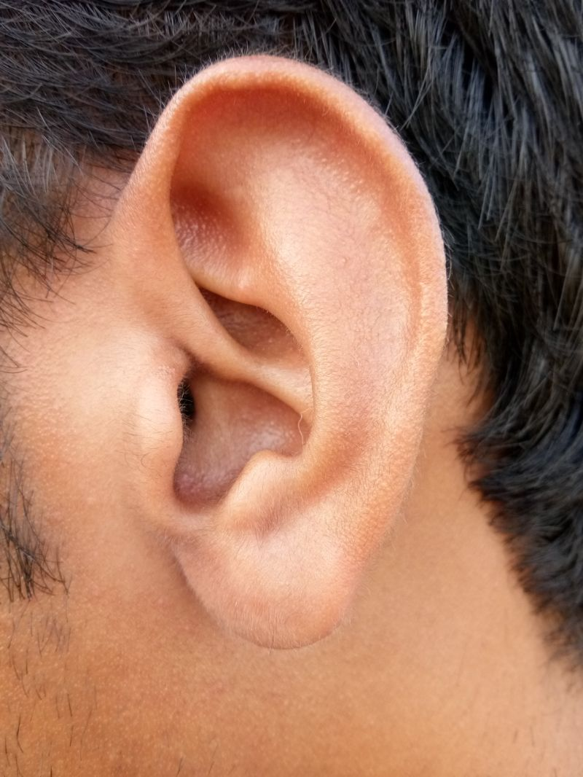
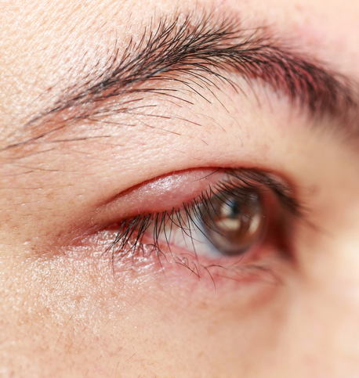
Feeling of Uselessness - Invalid
¹⁵ Now if the foot should say, ‘Because I am not a hand, I do not belong to the body,’ it would not for that reason stop being part of the body. ¹⁶ And if the ear should say, ‘Because I am not an eye, I do not belong to the body,’ it would not for that reason stop being part of the body. (1 Corinthians 12)

Slide 12
Necessity of Diversity
¹⁴ And so the body is not made up of one part but of many. ¹⁷ If the whole body were an eye, where would the sense of hearing be? If the whole body were an ear, where would the sense of smell be? ¹⁹ If they were all one part, where would the body be?
(1 Corinthians 12)

Slide 13
Necessity of Diversity
Christian unity does not flow from uniformity. God has not made us “cookie cutter Christians.” While there is but one body, there are many different members, many different limbs and organs, each of which has a unique role to play in the body. Paul emphasizes that while there is but one body, there are many different members, each with a unique role to play, a role essential to the health and ministry of the body, the church. The body is not composed of one member (one gift or ministry), but many.
As a member of the church, the body of Christ, we find we are a part of a much greater whole—we belong to an organism whose “head” is Christ and whose function is to represent Christ to a fallen world. As a member of the church, the body of Christ, we also find our true identity as an individual. The body imagery illustrates the individuality of every Christian. Each believer is, in body terms, an individublending of spiritual gifts and is given a particular function within the body. No al organ or member. Each believer is uniquely gifted with a two saints have the same place in the body. Thus, each believer is unique.
(Bob Deffinbaugh, “Spirituality & Spiritual Gifts”)

Slide 14
God’s Wise Design
¹¹ All these are the work of one and the same Spirit, and he distributes them to each one, just as he determines.
(1 Corinthians 12)

Slide 15
Response
I do not want you to be uninformed.

Slide 16
You Are Needed!

Slide 17
Vital & Significant Contribution
God has embedded desires to belong and contribute deep within us. It is fundamentally human to be part of a community and to make a difference. Diversity is necessary for unity, and unity gives diversity purpose. Each of us is different and therefore special, but in our uniqueness, we are part of something. We are part of something and therefore belong, but in belonging to something, our uniqueness is essential. Your uniqueness is designed to fit in. Furthermore, it is designed to be effective. Because you are different, you may think you are not supposed to do anything. On the contrary, because you are different, you are supposed to do something. The body of Christ needs your uniqueness.
(Scott Grant, “The Value of Each”)

Slide 18
Mindset Shift

Slide 19
Only One Letter
Xvxn though this typxwritxr is an old modxl, it works vxry wxll, xxcxpt for only onx kxy. You'd think that with all the othxr kxys working, onx kxy would hardly bx noticxd. But just onx kxy out of which sxxms to ruin thx wholx xffort.
Havx you xvxr said to yoursxlf, “I'm only onx pxrson. No onx will noticx if I don't do my bxst.” But it doxs makx a diffxrxncx, bxcausx to bx xffxctive, a family, an organization or a businxss nxxds complxtx participation by xvxryone to the bxst of his or hxr ability.
So if You'rx having onx of thosx days whxn you think you just arxn't vxry important and you'rx txmptxd to slack off, rxmxmbxr this old typxwritxr. You arx a kxy pxrson, and whxn you don't do your bxst, nothing xlsx around you works out thx way it's supposxd to.

