Slide 1
TITLE: Prepare to meet your God (Amos 4:12)
A prophecy to Israel by Amos
15th March 2020

Slide 2
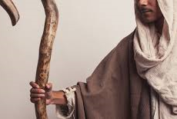
Who is Amos?
A Prophet from Judah, sent by God to prophesy to Israel.
A Shepherd and farmer of sycamore figs
Started his ministry ~ 750BC

Slide 3
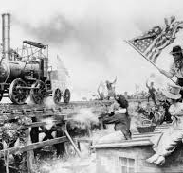
Israel in 750BC
Under King Jeroboam II
Good location
Good relationships with neighbours
Vibrant trade
Economic prosperity

Slide 4
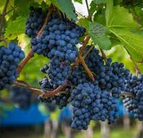
Good times in Israel
More than 700 years in Canaan
New Generation knew not hardship
Materialism ruled the day
Stone mansions (5:11)
Summer & winter houses adorned with ivory (3:15)
Planted lush vineyards for its wine

Slide 5
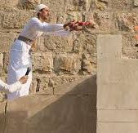
Religious
Built shrines and temples in high places like Bethel and Samaria.
Worship, offerings and festivals continue.
More religious than ever.

Slide 6
So, What’s the problem?
God sent Amos
The Party Pooper
The Rain on a Parade

Slide 7
God’s Temple Defiled
Slept with the temple whores (2:7)
Drink wine taken as fines in the temple (2:8)
Bethel (their worship) is all show, no substance (5:5-MSG)

Slide 8
Social Injustice
Sell the poor for a pair of sandals (2:6)
Trample on the heads of the poor (2:7)
Deprive the poor of justice (5:12)
Impose straw and grain tax on the poor (5:11)

Slide 9
Indulged in Worldly Pleasures
⁴ You lie on beds adorned with ivory and lounge on your couches. You dine on choice lambs and fattened calves. ⁵ You strum away on your harps like David and improvise on musical instruments. ⁶ You drink wine by the bowlful and use the finest lotions, but you do not grieve over the ruin of Joseph. (Amos 6:4-6)

Slide 10
Detestable Worship
“I hate, I despise your religious festivals; your assemblies are a stench to me. ²² Even though you bring me burnt offerings and grain offerings, I will not accept them. Though you bring choice fellowship offerings, I will have no regard for them. ²³ Away with the noise of your songs! I will not listen to the music of your harps. (Amos 5:21-23)

Slide 11
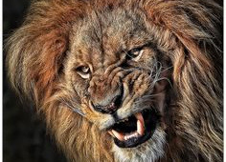
The Lion has roared – who will not fear? Amos 3:8
Surely the Sovereign Lord does nothing without revealing His plan to His servants the prophets.
(Amos 3:7)

Slide 12
Chosen
You only have I chosen of all the families of the earth, therefore I will punish you.
(Amos 3:2)

Slide 13
The law of cause & effect
Does a bird swoop down to a trap on the ground when no bait is there? Does the trap spring up from the ground if it had not caught anything? … When disaster comes to a city, has not the Lord caused it?
(Amos 3:5-6)

Slide 14
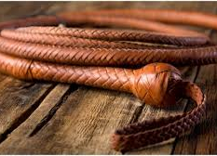
Yet you have not returned to me – Amos 4
Famine (4:6)
Drought (4:7-8)
Disease on your crops (4:9)
Plagues like Egypt (4:10a)
Young men killed in war (4:10b)
Fire like Sodom and Gomorrah (4:11)

Slide 15
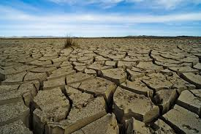
A Spiritual Famine
“The days are coming,” declares the Sovereign Lord, “when I will send a famine through the land— not a famine of food or a thirst for water, but a famine of hearing the words of the Lord. (Amos 8:11)

Slide 16
Youths faint from spiritual thirst
"In that day "the lovely young women and strong young men will faint because of thirst “. (Amos 8:13)

Slide 17
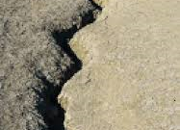
Earthquake
The words of Amos, one of the shepherds of Tekoa—the vision he saw concerning Israel two years before the earthquake, when Uzziah was king of Judah and Jeroboam son of Jehoash^{[a]} was king of Israel. (Amos 1:1)

Slide 18
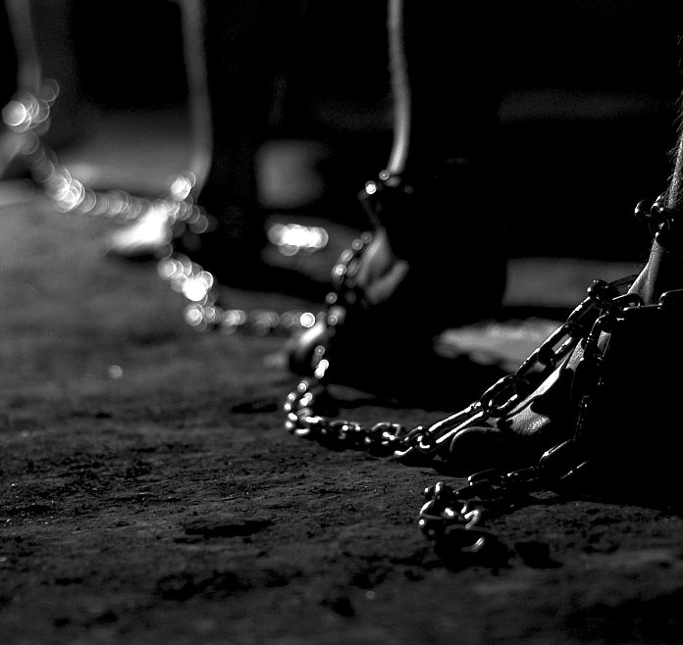
Exile
The Sovereign Lord has sworn by his holiness: “The time will surely come when you will be taken away with hooks, the last of you with fishhooks.³ You will each go straight out through breaches in the wall, and you will be cast out toward Harmon,” declares the Lord.
(Amos 4:2-3)

Slide 19
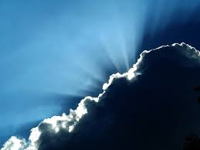
How do we respond to God in times like these?

Slide 20
Pray & Repent Lessons from Amos 7, locusts, fire and a plumb line
This is what the Sovereign Lord showed me: He was preparing swarms of locusts after the king’s share had been harvested and just as the late crops were coming up. ² When they had stripped the land clean, I cried out, “Sovereign Lord, forgive! How can Jacob survive? He is so small!” ³ So the Lord relented. “This will not happen,” the Lord said.
(Amos 7:1-3)

Slide 21
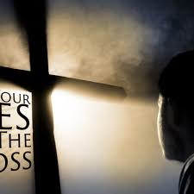
What does repentance look like?
This is what the Lord says to Israel:
“Seek me and live; ⁵ do not seek Bethel, do not go to Gilgal, do not journey to Beersheba. For Gilgal will surely go into exile, and Bethel will be reduced to nothing
(Amos 5:5-6)

Slide 22
Prepare to meet your God
“All this I have done to you, Israel, and this is why I have done it. Time’s up, O Israel! Prepare to meet your God!”.
(Amos 4:12)

